Slide 1
EYFS Phonics workshop
September 2022

Slide 2
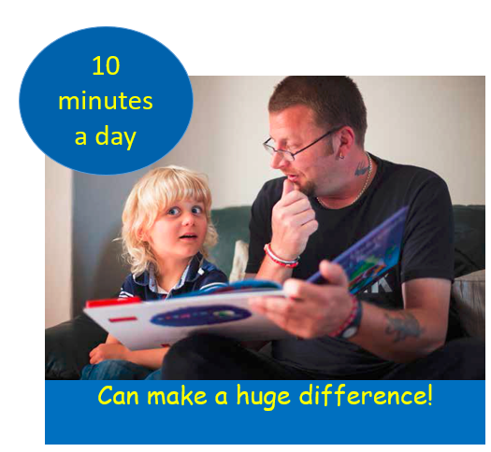
Phonics
‘the most effective way of teaching young children to read.’ DFE Reading: the next steps Supporting higher standards in schools March 2015

Slide 3
Definitions
https://home.oxfordowl.co.uk/reading/phonics/
Digraph- 2 letters 1 sound
oa ai or
Trigraph- 3 letters 1 sound
air ure igh
Split digraph-
o_e a_e i_e
Letter(s) represent a sound (phoneme)
t ai igh
A sound can be represented by more than
one letter and more than one spelling
s, se, c, sc and ce as in
sun, mouse, city, science

Slide 4
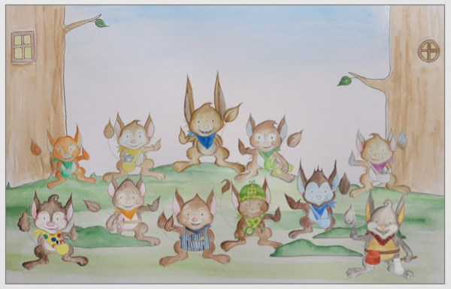

Slide 7
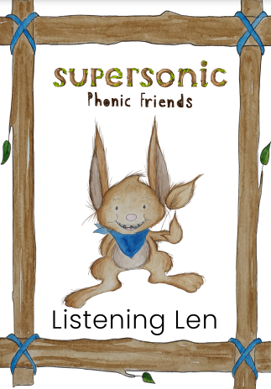
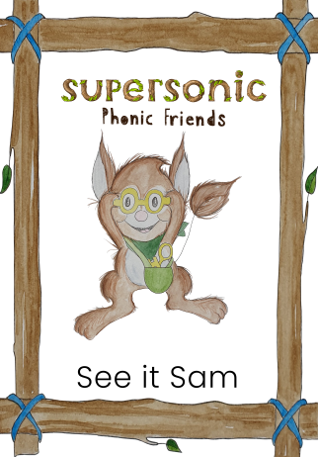
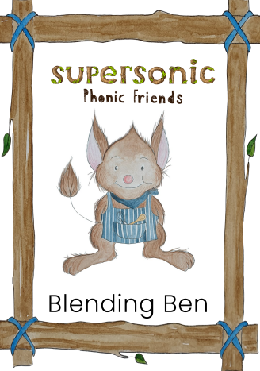
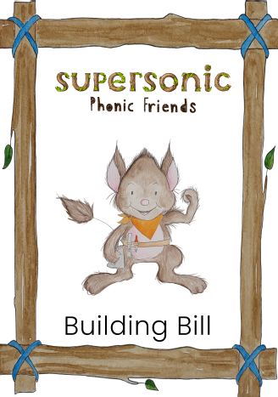
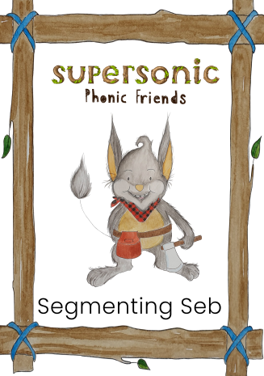
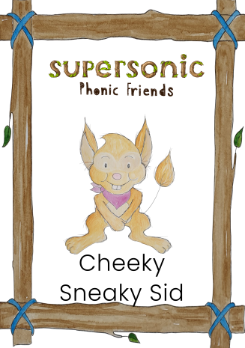

Slide 10
Just like we do in class…
If some children in the group complete the task much quicker the teachers will extend them.
If some children in the group are working at a slower pace, the teachers will support them.

Slide 11
Pronouncing the phonemes
Long: f l m n r s sh v th z
Bouncy: c p t ch h b d g w qu y
https://www.youtube.com/watch?v=UCI2mu7URBc
https://www.oxfordowl.co.uk/for-home/reading/phonics-made-easy/

Slide 17
Parent newsletter
Reading:
Reading 10 - 15 minutes daily
Please read at home to parents or another family member as frequently as possible. Reading every evening for roughly 10 minutes will greatly improve your child’s progress, understanding and experience in all areas. It will help consolidate the reading skills taught in school. It is hugely beneficial to hear your child read regularly and also to talk about the text that you have shared together.
Reading books and reading records in school Mondays for changing. Aim to be returned by Wednesday. We will change books if written in the diary.
The children choose their books. There is no harm reading a book more than once to build confidence and fluency. You could also read a book from home.
The children will receive a ‘me’ book during the first term when we begin to cover the phoneme letter sounds and a ‘we’ book from the library for you to share in the first weeks.
We read with your child in many different ways across the school day, we are unable to record each and every one of these reading experiences but please be reassured they are taking place!

Slide 18
Look out on Tapestry for phonics in action!
We are very pleased to announce that we are now using Tapestry as our online learning journal provider.
Tapestry allows you to login with a secure username and password so you can view all your children’s observations, photographs and videos. You can like and comment on observations that we add for your child and it’s also possible for you to add your own observations. Your comments and own observations will allow us to find out about which activities your child really enjoyed and the learning they get up to at home.
All data that is entered to Tapestry is stored securely on their servers. If you are interested in finding out more information about this, you can go to https://tapestry.info/security
Once we have set you up with an account you will be able to login using any web browser from tapestryjournal.com or by downloading the Tapestry app from the Play or App store, depending on what type of device you are using. Remember, if you are going to use the App version of Tapestry to ensure auto updates are turned on for your device so you always have the most up to date version of the app.
We will set you up using your email address and once this has been done, you will receive an activation email from which you can set up your own password to login with. You will also be asked to set up a 4-digit PIN which you can use on the Tapestry app to quickly log back in once you’ve initially logged in. Do remember to keep an eye out on your spam/junk folders for this email.
We do hope you enjoy using Tapestry, do let us know if you have any questions about it.
Tapestry information for parents- https://tapestry.info/parents-carers.html

Slide 19
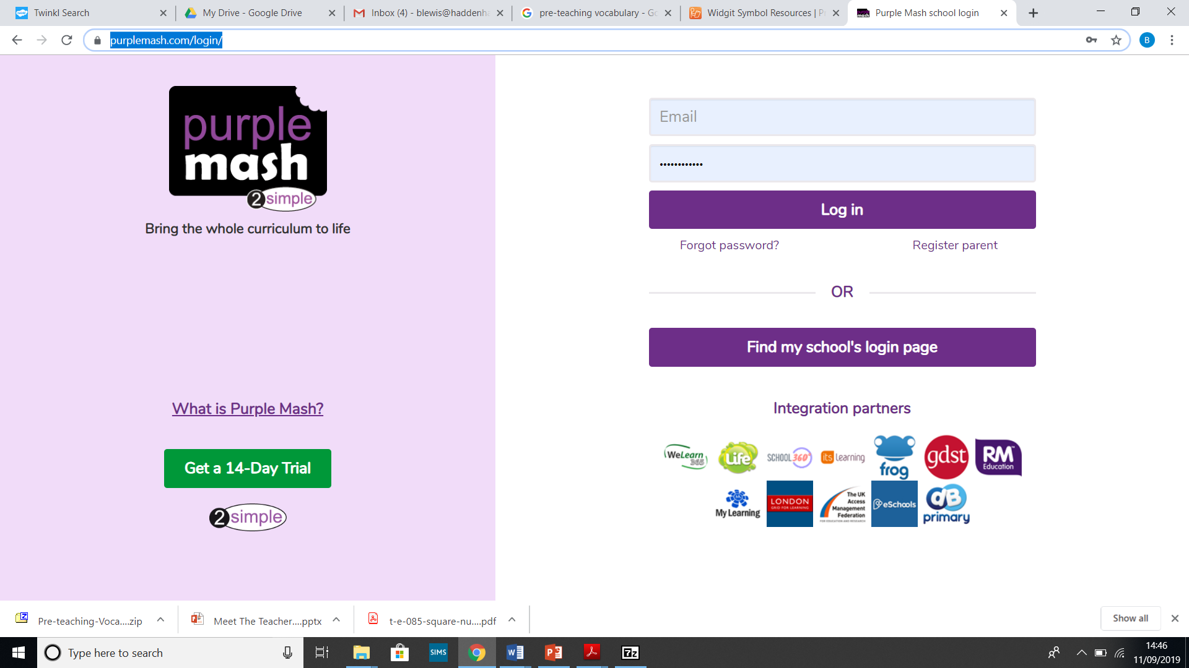
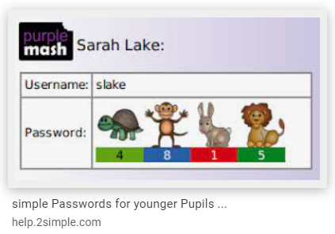
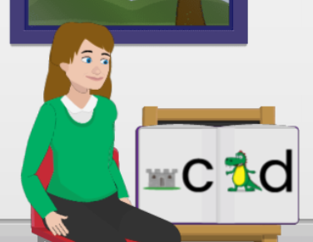
-School log in
-Childs log in
https://www.purplemash.com/login/
There are reading activities in Mini Mash for the children to explore…

Slide 20
Pre-teaching vocabulary: We work a lot on introducing and developing vocabulary linked to our topics. If you notice your child hasn’t come across a word before below are some steps to take and continue to repeat to embed the vocabulary into their working memory.

Slide 21
We cannot emphasis enough how reading little and often has the biggest impact to not only a child's reading ability but overall development and education.
Re-read books! Books can be read and re-read more than once. There is no harm repeating books that children have already read. In fact it builds fluency, confidence and retelling skills.
This time could they spot the sound they have learnt this week or answer some more questions. Did they manage to read all the tricky words?
It isn’t all about the letters on the page…
Ask questions about the characters or setting.
Make predictions, what might happen next…what might that character do next… what might they say next…
Talk about a time you or they have visited the dentist…park…zoo
Can they retell the story?
Can they talk about the characters?
Have the children seen other family members reading a book or magazine?
Where do the children share their reading book with you? Take a moment to think about the reading environment and atmosphere?

Slide 22
THANK YOU
Thank you for all the support you give in your child's learning journey!

