Slide 1

Welcome to the EYFS at Haddenham Community Infant School
September 2024

Slide 2
Haddenham Community Infant School
We value the child’s voice and foster a love for learning within a creative and exciting environment. Through positive relationships with children and families we promote a joy for life and learning. Our environment encourages our children to become resilient, reflective and respectful. We support children to research their interests and deepen their knowledge, nurturing them to take their place in the wider world.

Slide 3
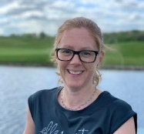

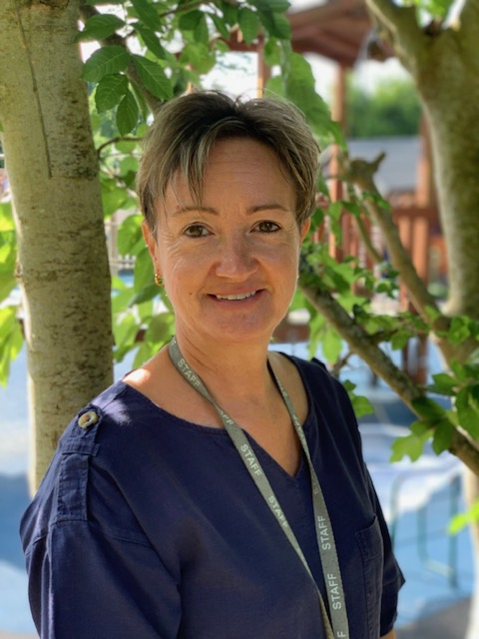
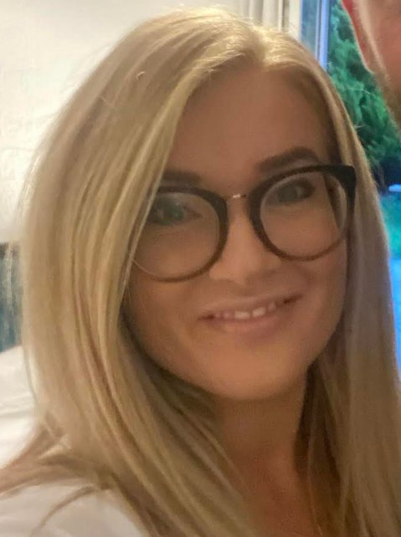
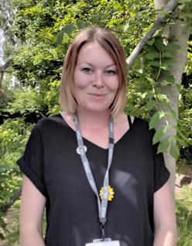
In EYFS…
Class Teacher
Mrs Crump Miss Lewis
Teaching Assistants
Mrs Bryson Mrs Teggart
Miss Cory
Uniform:
Coats in school every day
Wellies in school
Book bag – no rucksacks/large bags
PE Kit - Tuesdays
All named please ☺
EYFS gate- 8:35am
Gate closes at 8:45 -please enter through office to sign your child in if after this time.

Slide 4
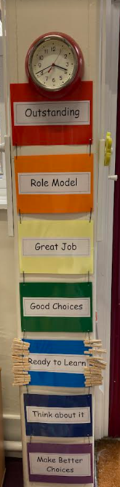
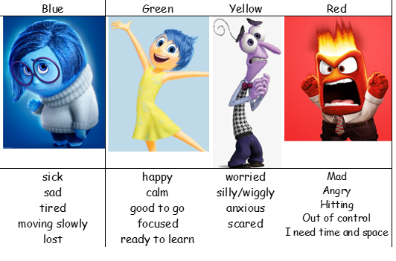
We actively promote positive behaviour
through key values and continual modelling. Rainbow Ladder
Self Regulation
(the management of difficult emotions)
Zones of Regulation; giving the child
the tools to discuss their emotions and find strategies
to support them.

Slide 5
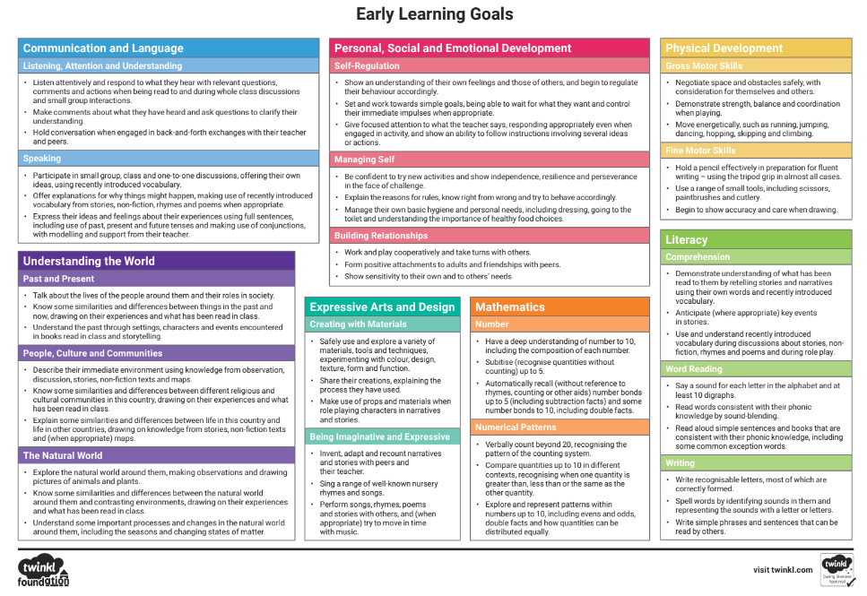
EYFS curriculum – End of year expectations (see handout)
3 prime areas
4 specific areas

Slide 6
EYFS curriculum continued…
 | Autumn 1 | Autumn 2 | Spring 1 | Spring 2 | Summer 1 | Summer 2
Topic | Super Me, Super You | Let’s Celebrate | Once Upon a Time | Here, There and Everywhere | Growing and Changing | Brilliant Beasts
 | Senses, their body, families, people who help us | Diwali, Bonfire Night, RemembranceChristmas, Black History Month | Traditional tales, fairy tales, story telling | Transport | How they have changed, how animals change, plants, seasons | Animals, minibeasts
Suggested Further Enrichment | Visitors from people who help us | Experience to celebrate BHM | Waddesdon Manor-Fun with Fairytales | Beckonscot Model Village |  | Cotswold Wildlife Park
R.E. | Special People Christianity, Judaism | Christmas Christianity | Celebrations Hinduism | Easter Christianity | Story time Christianity, Islam, Hinduism, Sikhism | Special places Christianity, Islam, Judaism

Slide 7
EYFS curriculum continued…
Music we follow the KAPOW scheme of work.
P.E. - Athletes in Motion with Mr Clark (Tuesdays) and continuous physical development opportunities across the week

Slide 8
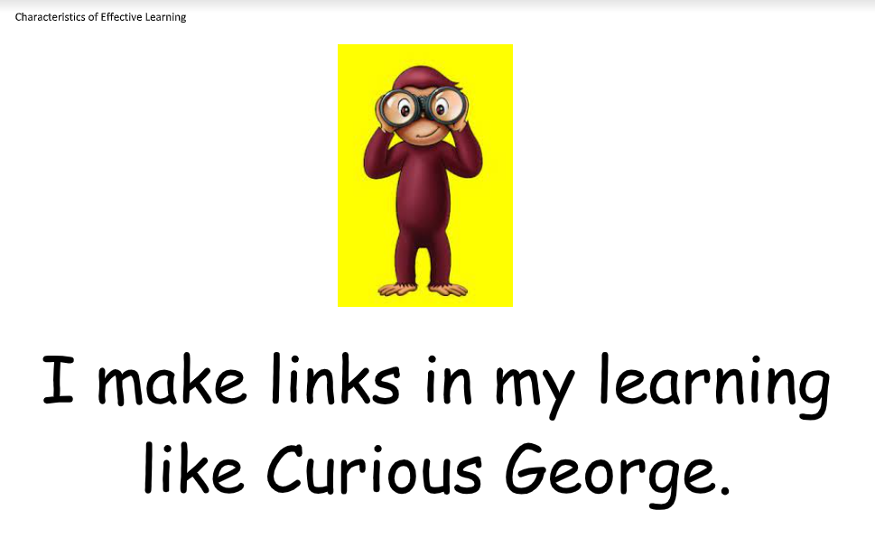
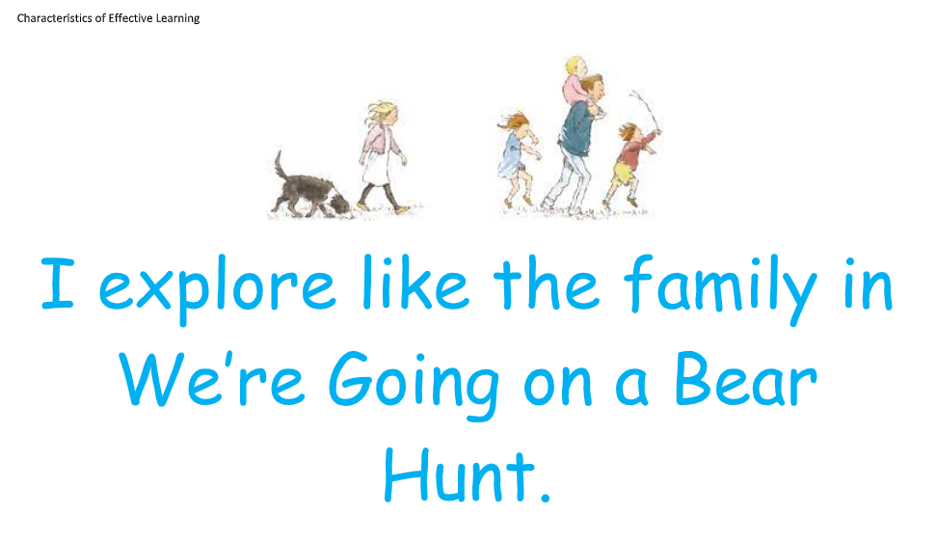
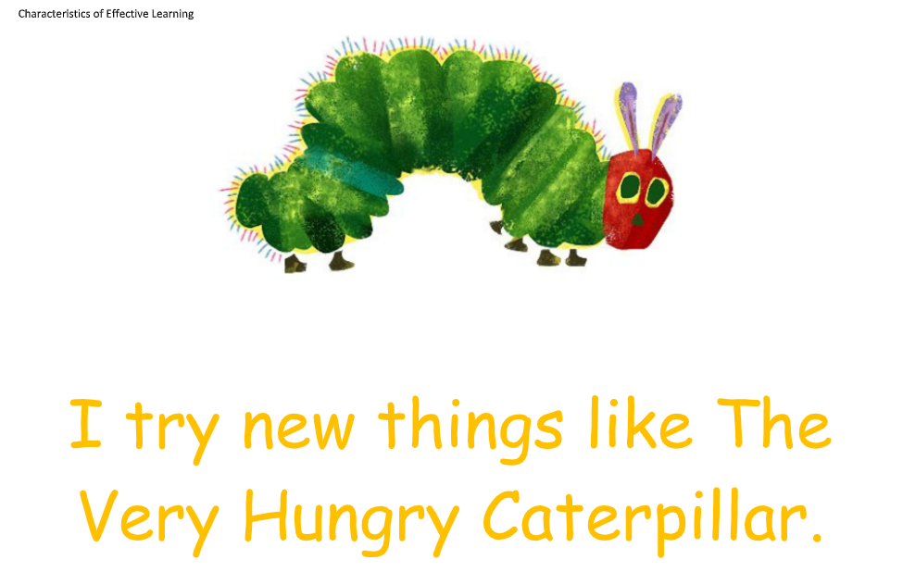
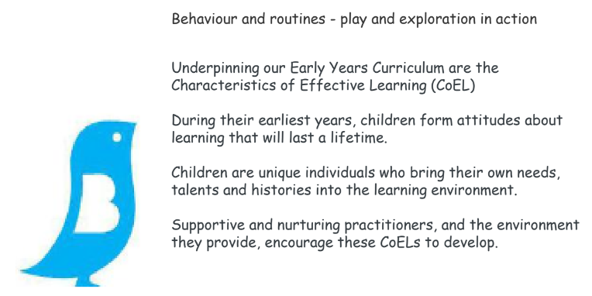
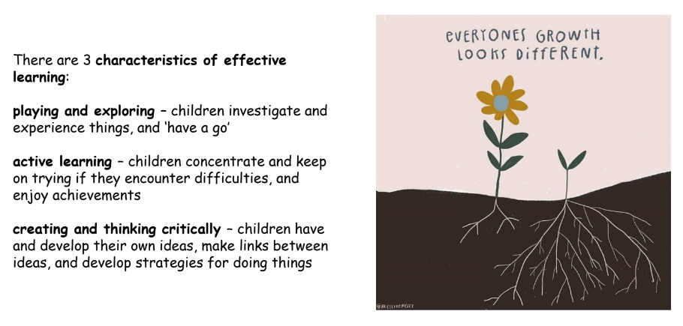
Characteristics of Effective Learning

Slide 9
Rolling fruit snack and milk 9:30-11am. Milk is free for your child until the age of 5 and then you can choose if you wish to set up payment for them to continue to have milk.
Please do not provide extra snacks for your child due to potential allergies. Children have open access to their water bottles throughout the day and we encourage drinking, eating the government provided fruit snack and eating their lunch.

Slide 10
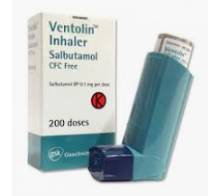
Medical Information
Medicines
  Medical form to be completed
  Children shouldn’t administer medicine themselves
Inhalers/Epipens
  Children can’t leave the school site if their inhaler/Epipen isn’t in school
  Medical labels on the box

Slide 11

We use Tapestry as our online learning journal.
Tapestry allows you to login with a secure username and password so you can view all your children’s observations, photographs and videos. You can like and comment on observations that we add for your child and it’s also possible for you to add your own observations. Your comments and own observations will allow us to find out about which activities your child really enjoyed and the learning they get up to at home.
All data that is entered to Tapestry is stored securely on their servers. If you are interested in finding out more information about this, you can go to https://tapestry.info/security
Once we have set you up with an account you will be able to login using any web browser from tapestryjournal.com or by downloading the Tapestry app from the Play or App store, depending on what type of device you are using. Remember, if you are going to use the App version of Tapestry to ensure auto updates are turned on for your device so you always have the most up to date version of the app.
We will set you up using your email address and once this has been done, you will receive an activation email from which you can set up your own password to login with. You will also be asked to set up a 4-digit PIN which you can use on the Tapestry app to quickly log back in once you’ve initially logged in. Do remember to keep an eye out on your spam/junk folders for this email.
We do hope you enjoy using Tapestry, do let us know if you have any questions about it.
Tapestry information for parents- https://tapestry.info/parents-carers.html

Slide 12
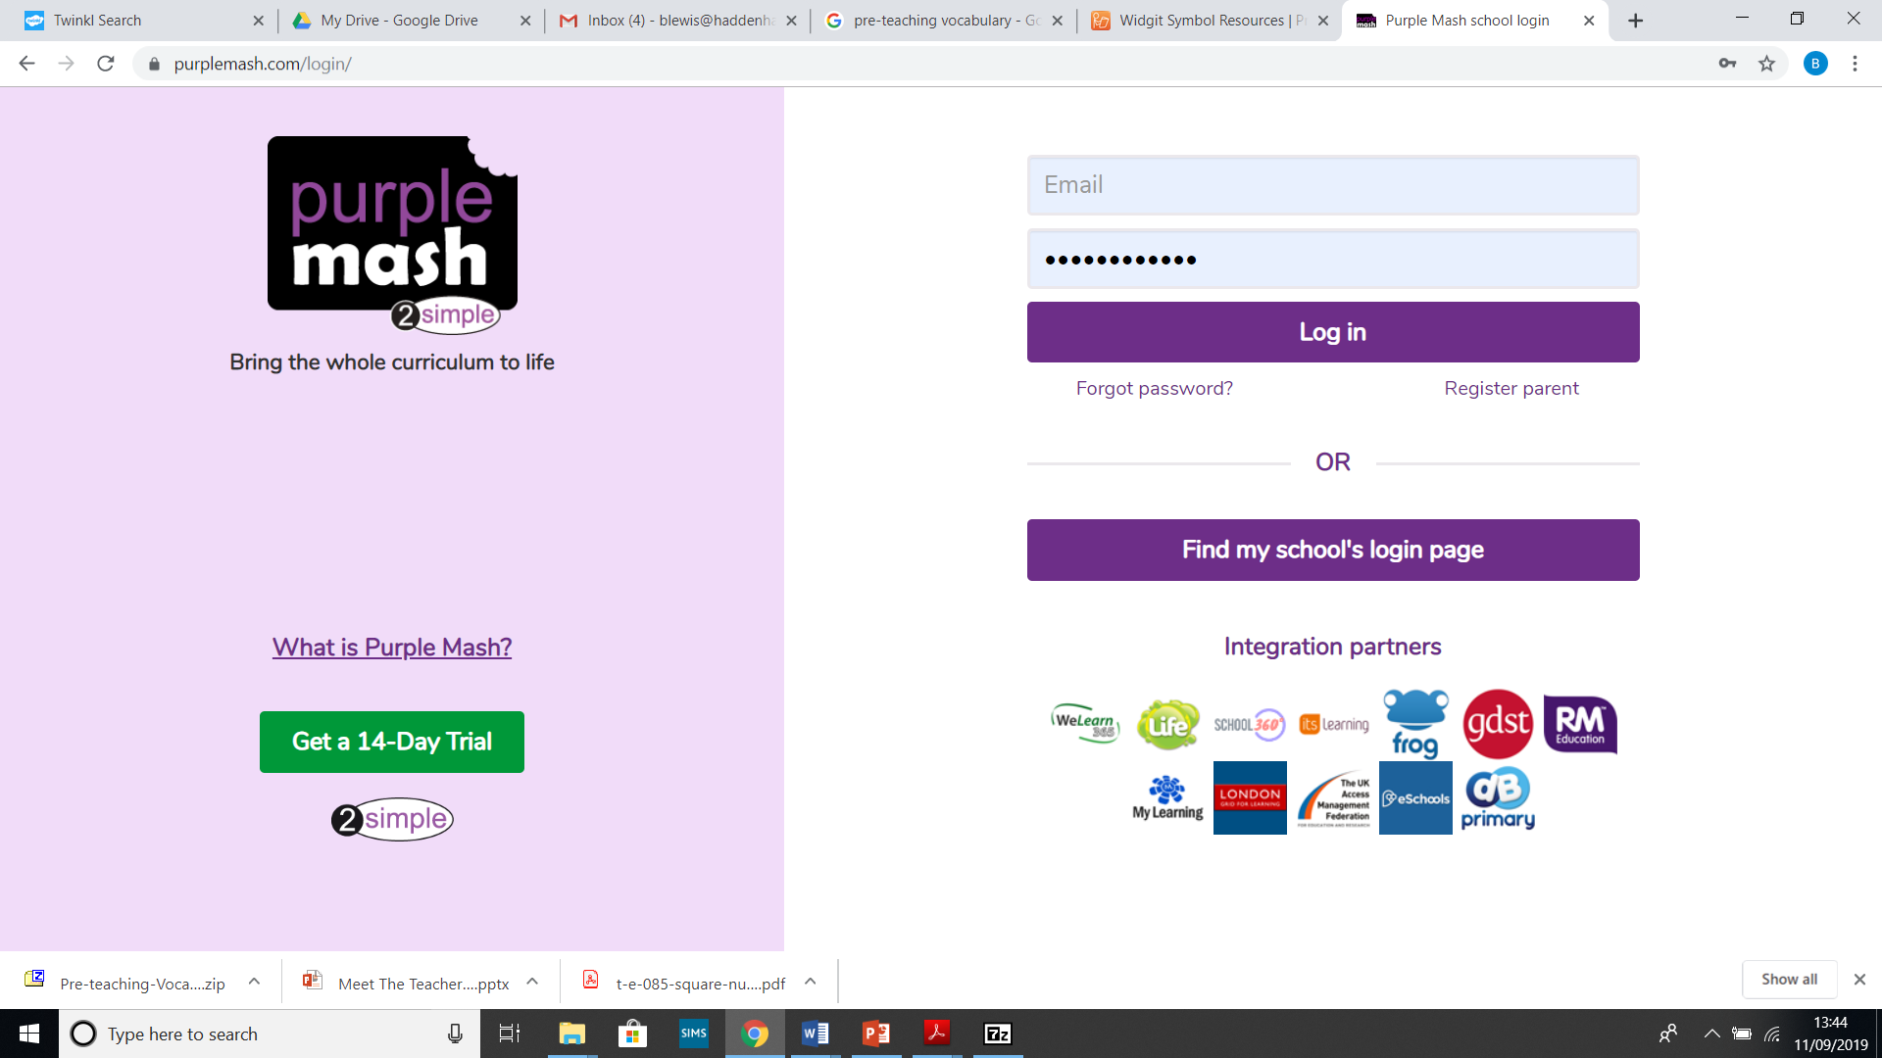
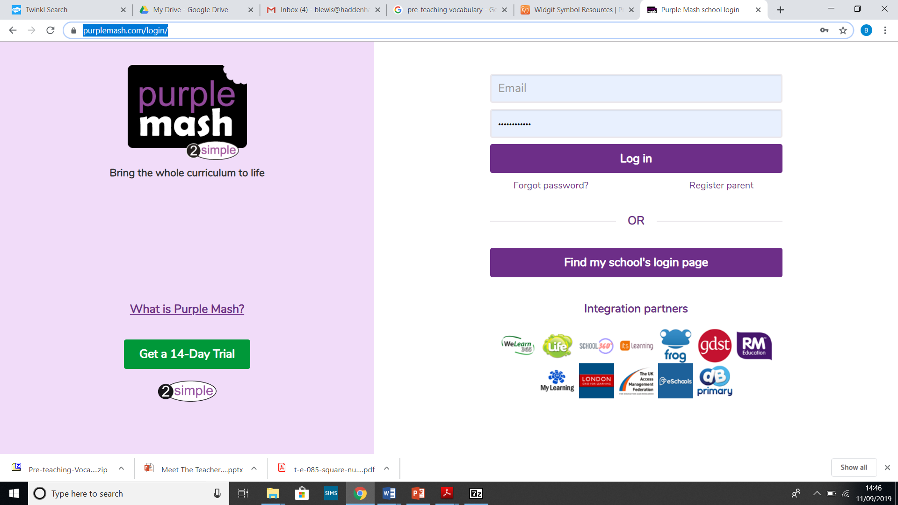
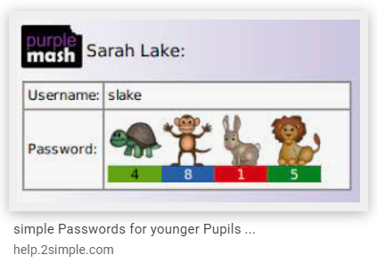
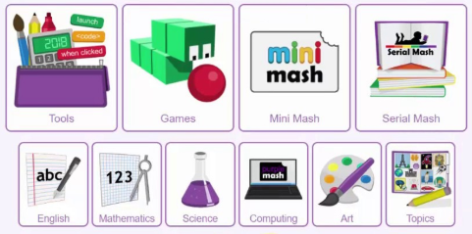
-School log in
-Childs log in
https://www.purplemash.com/login/

Slide 13
Key Information
Significant to year group;
  Working towards Early learning goals (see handout)
  Baseline assessment – Within the first six weeks
Intervention work / booster groups
  Either with teacher or teaching assistant to support progress.
  Examples of these could be phonics catch up, fine motor or gross motor activities…
  Curiosity Cuboid – natural objects that will promote curiosity and conversation

Slide 14
Communication and parents forum
Communication happens in many ways here at HCIS.
The whole school weekly newsletter is a source of information as well as the Reception ‘Our adventures next week’ weekly updates and the school website. We have a class page, a phonics workshop page and a topic plan page on the school website under the ‘classes’ tab.
https://www.haddenhaminfant.bucks.sch.uk/web
Each class has a parent WhatsApp group which is a very useful way to check what’s going on and communicate amongst yourselves.
Each term we host an active parent forum which asks for feedback on many aspects of school life.
Questionnaires are sent periodically to collect views too.

Slide 15


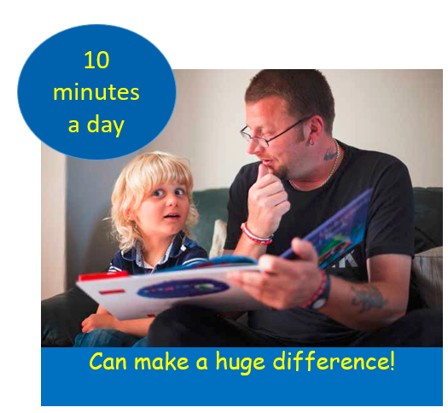
Phonics
‘the most effective way of teaching young children to read.’
DFE Reading: the next steps Supporting higher standards in schools March 2015

Slide 16
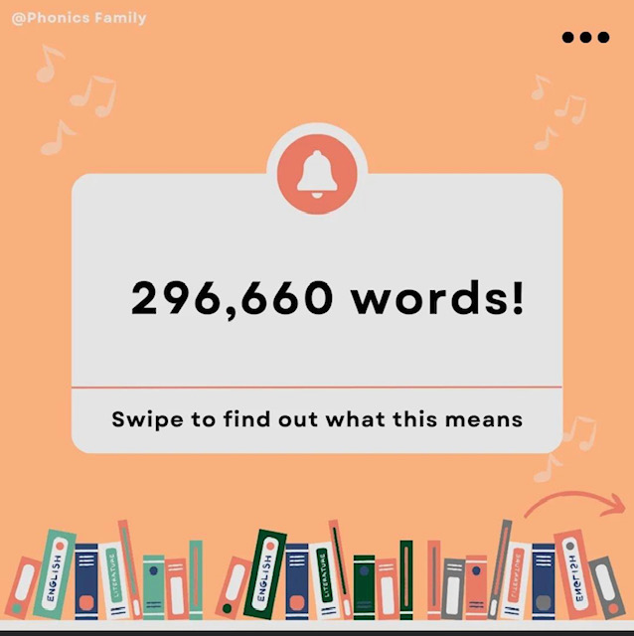

Slide 17
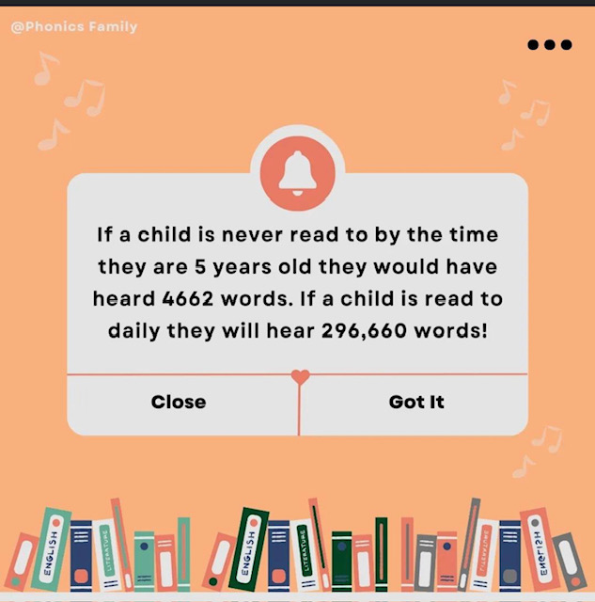

Slide 18


Slide 19
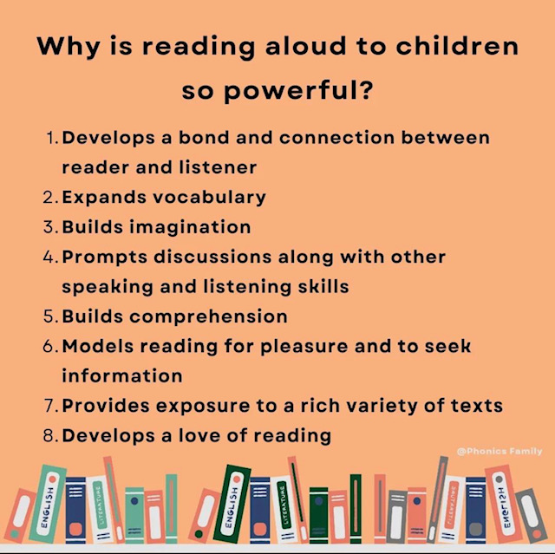

Slide 20
Phonics Definitions
Phonics is the way children are taught to read and write in schools.
Blend - this is when you say the individual sounds that make up a word and then merge or blend them together to say the word as used when reading.
Segment – this is when we split the sounds up in words (c-a-t).
CVC Words - this is an abbreviation used for consonant-vowel-consonant words. It describes the order of sounds. Some examples of CVC words are: cat, pen, top, chat (because ch makes one sound).
Grapheme - it's a written letter or a group of letters which represent one single sound (phoneme) e.g. a, l, sh, air, ck.
Phoneme – the smallest unit of sound.
Digraph – two letters that make one sound (ch, sh, th).
Trigraph – three letters that make one sound (igh, tch).

Slide 21

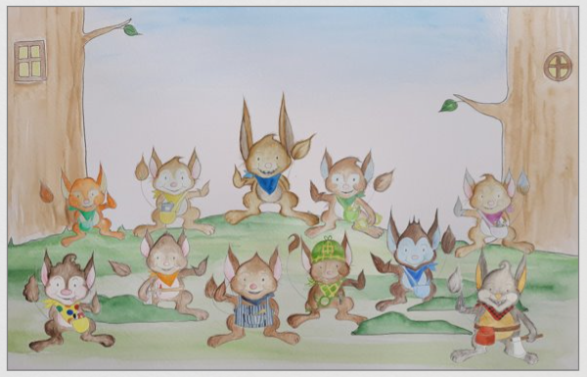

Slide 22
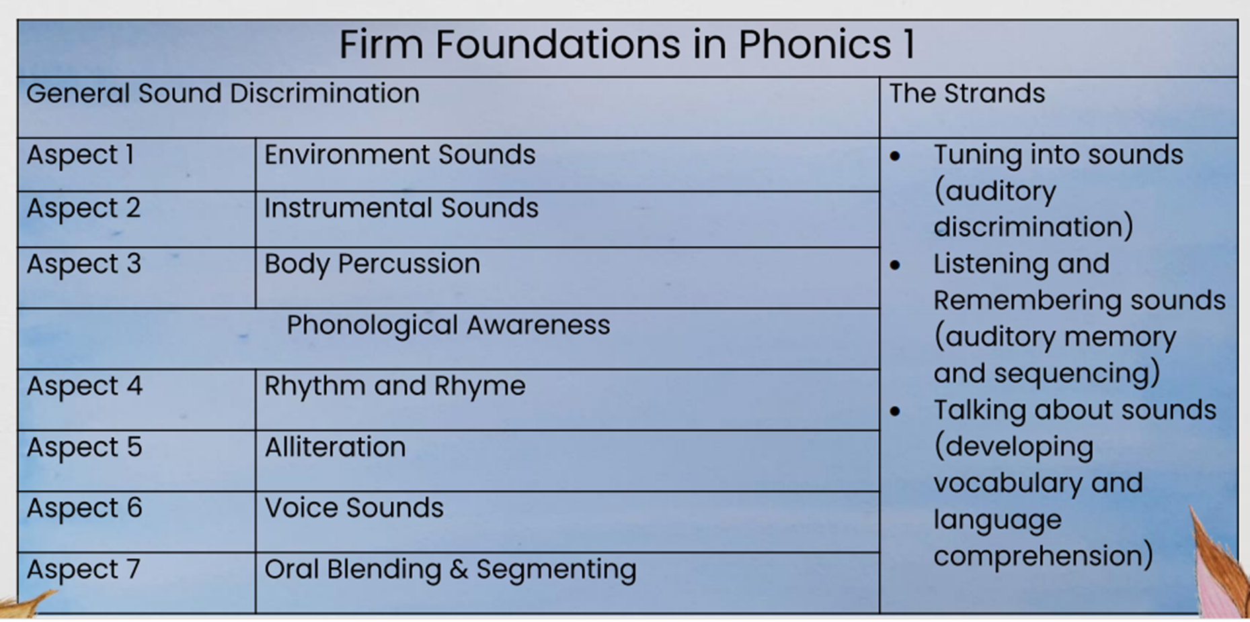
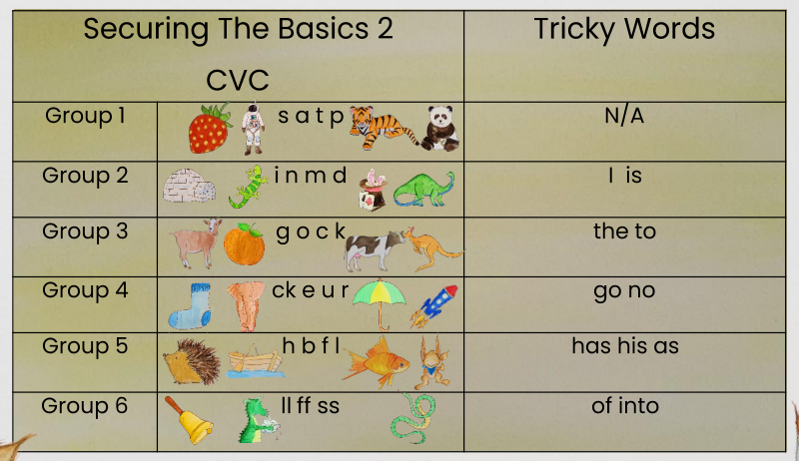
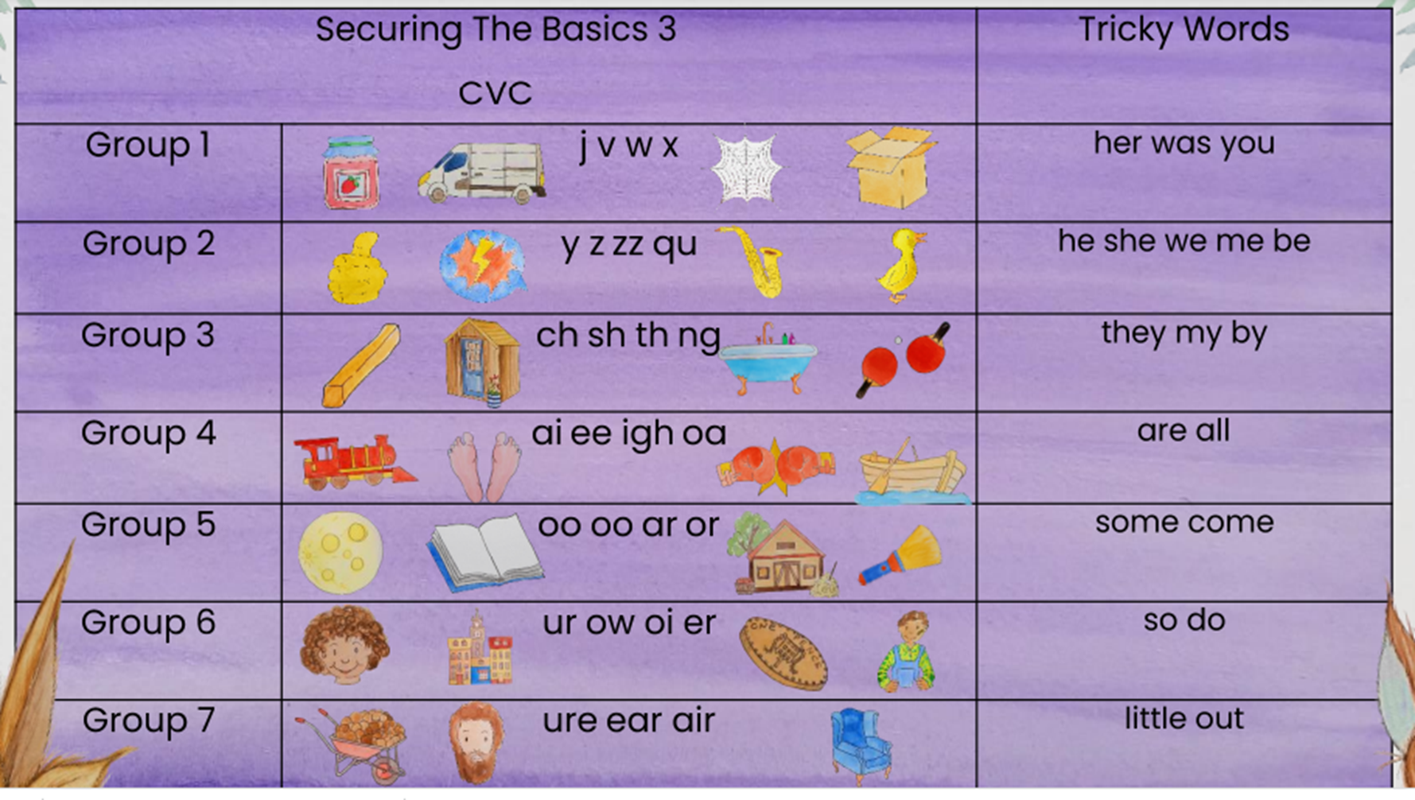

Slide 23
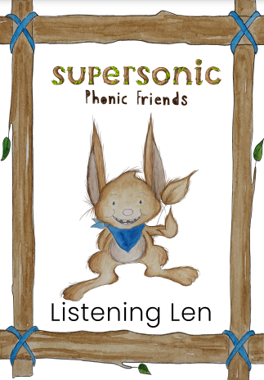
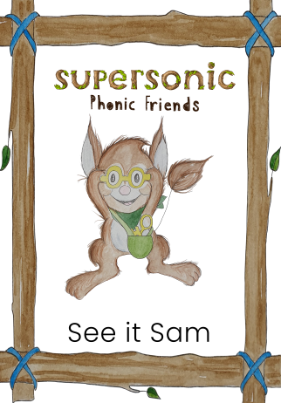


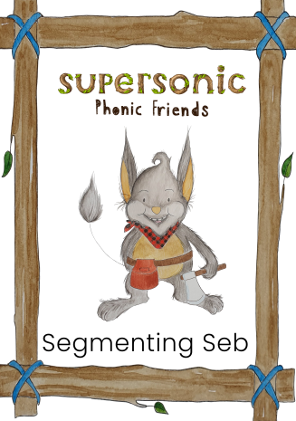


Slide 24
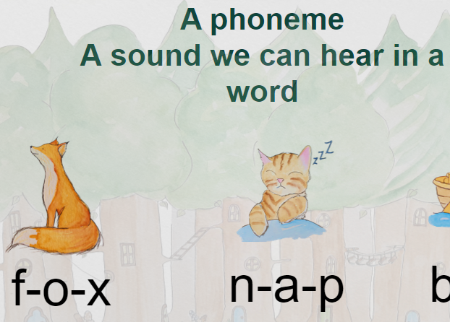

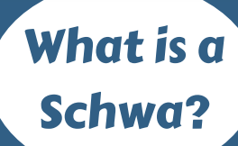
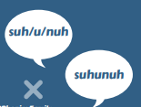
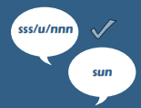

Pronouncing the phonemes
https://www.youtube.com/watch?v=UCI2mu7URBc
Long: f l m n r s sh v th z
Bouncy: c p t ch h b d g w qu y
https://home.oxfordowl.co.uk/reading/phonics/
sun

Slide 25
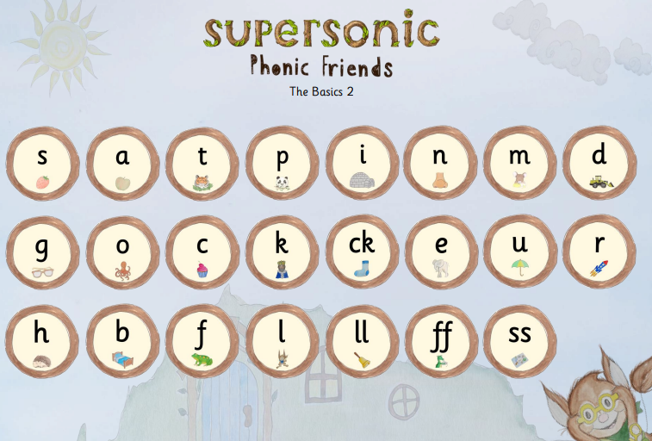
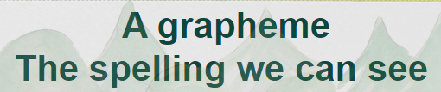

Slide 26
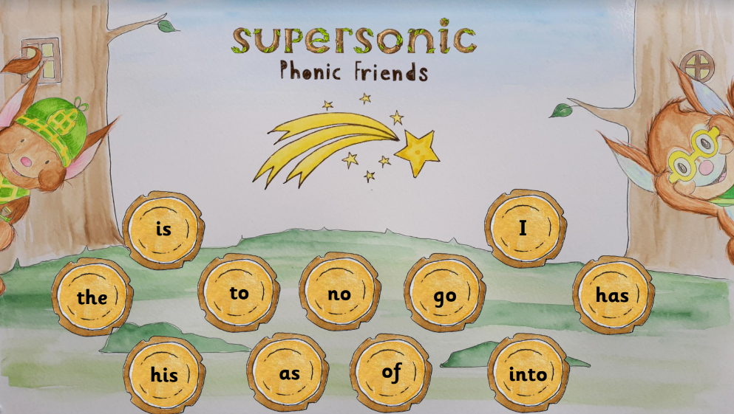

Slide 27
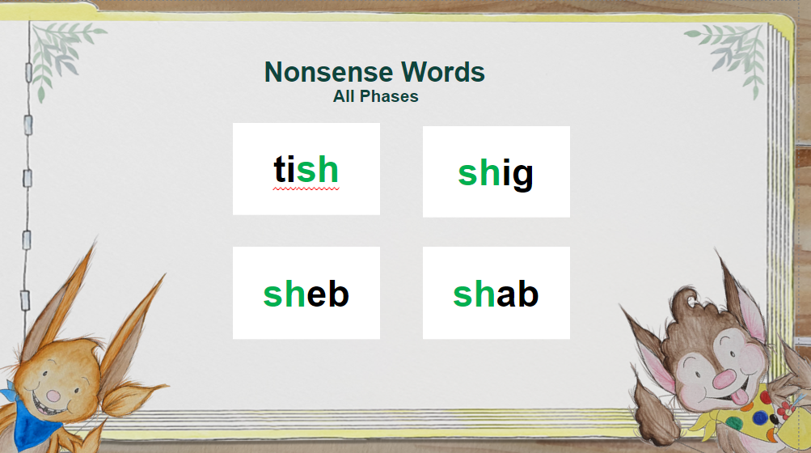

Slide 28
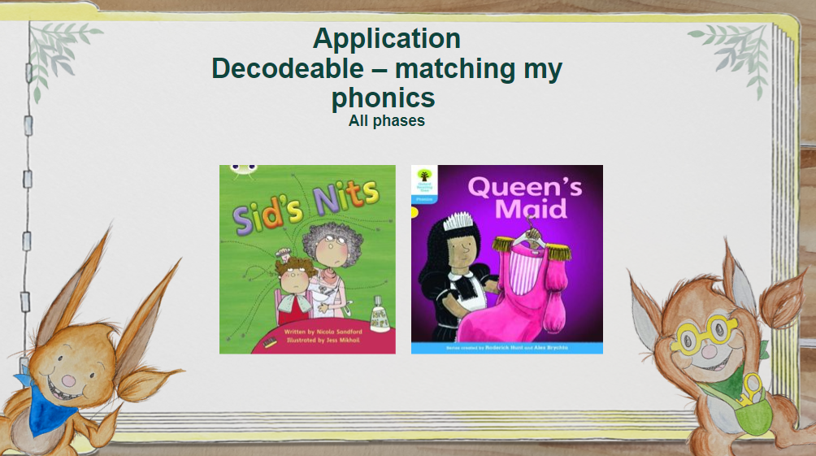
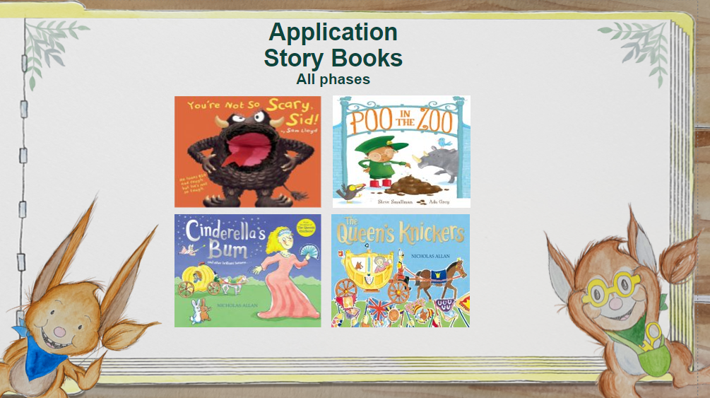
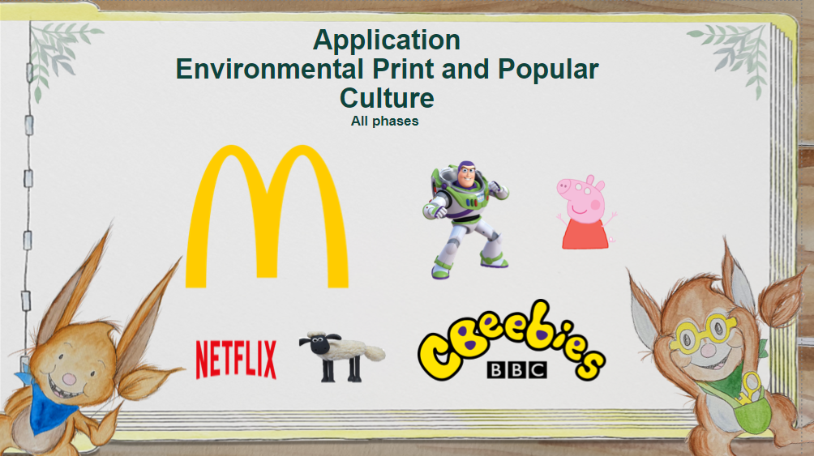
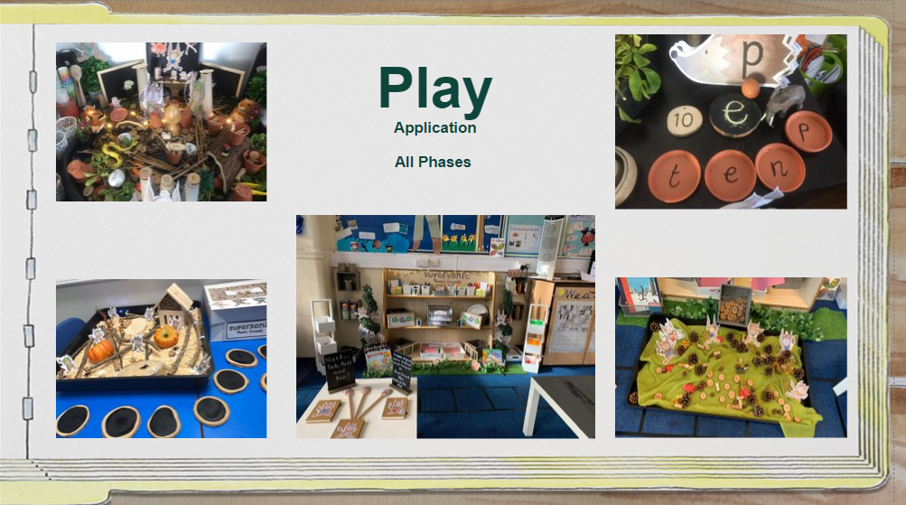

Slide 29
Reading
In Reception we will send home two types of books; ‘I Can’ and ‘We Can’ books.
‘I Can’ books are books that we would like the children to begin to read with support. These books initially are wordless books with the introduction of phonics books in a few weeks linked to the phonics learning that we are doing in school. As the children begin to learn the speech sounds for written letters they will be books that they can increasingly read. Reading is not just being able to read words but to also have discussions about their thoughts and ideas linked to the book.
Reading books more than once also develops a natural fluency and flow to their reading as well as developing their confidence.
‘We Can’ books are our library books which we encourage you to share together with your child.
Spend 10 minutes five times a week reading with your child – Reading to, paired reading, child reading and record in Reading Record.
Reading Book change- Please make sure reading books (‘I can’ books) and diaries are in their bookbags everyday and we will change reading books on a Tuesday.
Library book (‘We can’ books) changed on Friday.
Our reading expectation is 5 times a week for 10-15 minutes. This could be a mixture of an adult and child shared read, an adult reading to a child or a child reading. Please record in their reading diaries.

Slide 30
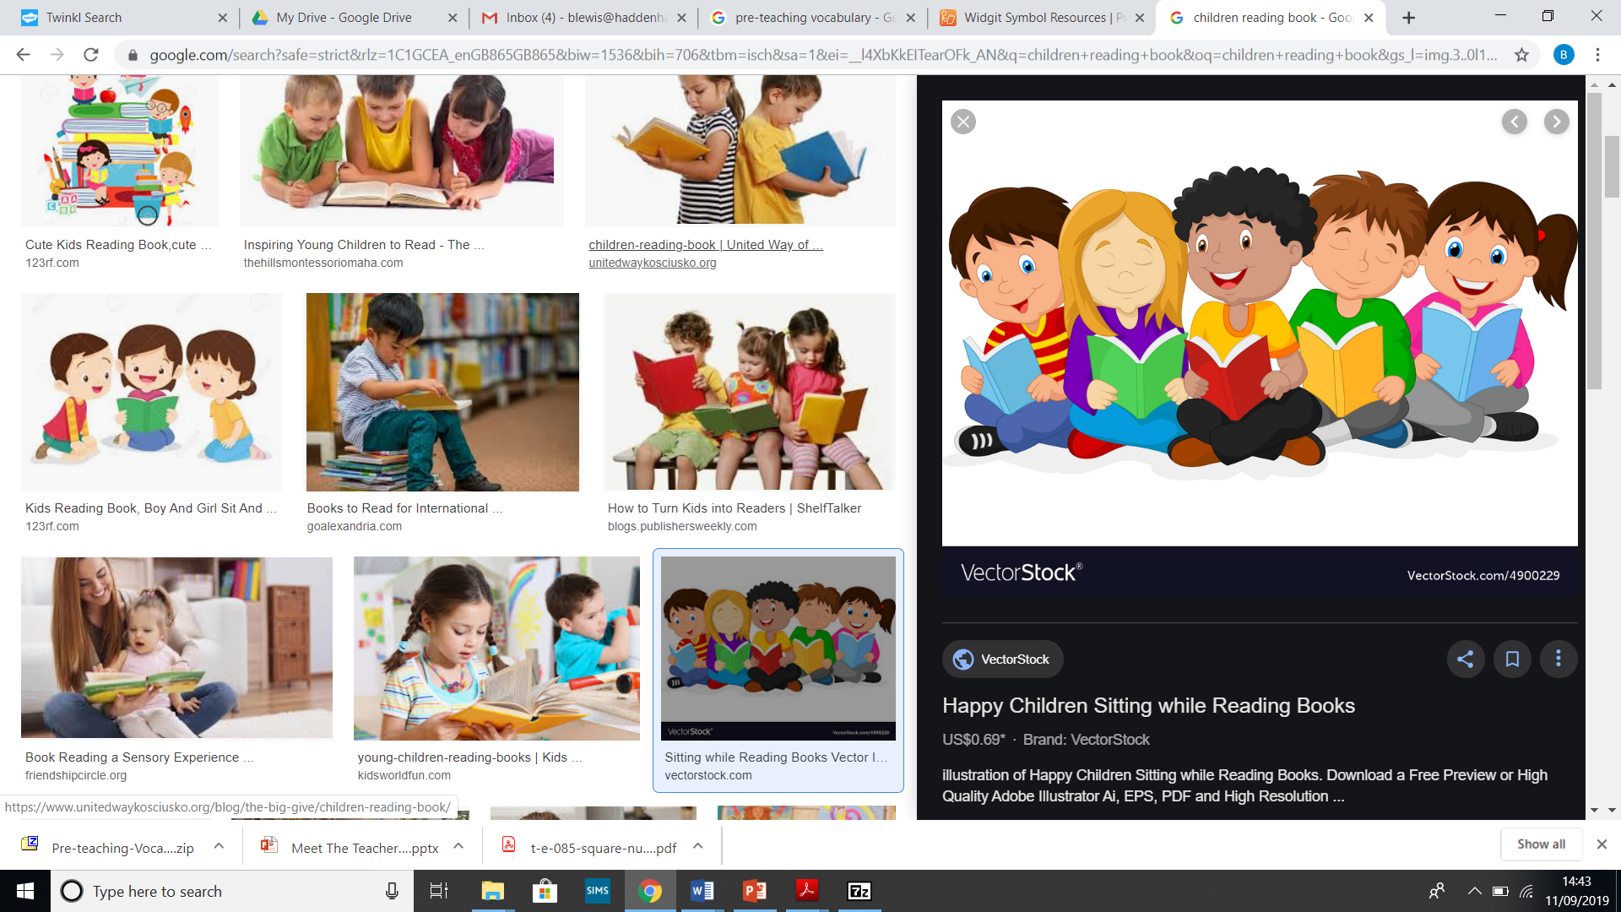
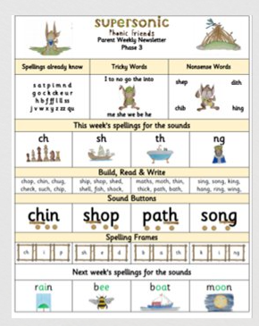
Parent newsletter
Reading cont.:
Please read at home to parents or another family member as frequently as possible. Reading every evening for roughly 10 minutes will greatly improve your child’s progress, understanding and experience in all areas. It will help consolidate the reading skills taught in school. It is hugely beneficial to hear your child read regularly and also to talk about the text that you have shared together.
You could also read a book from home.
We read with your child in many different ways across the school day, we are unable to record each and every one of these reading experiences but please be reassured they are taking place!

Slide 31
Maths
Maths is everywhere!
We encourage children to ‘notice’ and we build upon their skills within their own interests and curiosity with a spotlight on skills from the Early Years framework.
Noticing supports their:
Communication development
Use of existing and new words
Interactions
Sharing of ideas
Reasoning and explaining
And more!

Slide 32
Key Maths Concepts in Early Years
Noticing
Sorting, matching and comparing.
Subitising (recognising quantities without counting) to develop number sense – Karen Wilding EYMaths https://www.youtube.com/watch?v=w-P6DlWDGl0.
Recognising amounts 0-10 as ‘concept images’.
A deep understanding of number to 10 including composition, odd and even numbers and double facts.
Verbally count beyond 20 and recognise the pattern of the number counting system.

Slide 33
How can I help my child with maths?
Use maths in everyday life: shopping, laying the table, measuring (time, capacity, weighing, lengths), den building/obstacle courses (positional language; on top, behind, next to etc.), fair and not fair when sharing amounts of item, patterns in nature (doubles on butterflies and ladybirds) …
What do you see? NOT how many.
Practice subitising everything! Tins in the cupboard, on outdoor walks, pictures in books...
Questioning: If I have two pieces of apple but I want four how many more do I need? I had five grapes and I’ve eaten three, how many do I have left?
Sorting food, are the two groups fair? More, less, fewer, same etc.
Number songs
Play games such as snakes and ladders, dominoes…
Have a ‘growth mind-set’ attitude, no-one is rubbish or ‘can’t do’ math. It’s ok to make mistakes, that’s how we learn and grow our brains.

Slide 34

The Year Ahead
We have already made a fantastic start to the year and it will be a busy one, with lots of exciting topics and activities planned.
We’d like to thank you, the parents and carers, for all your support at home; it really does make all the difference!
Please take your time to add any of your ideas onto our mind maps around the classroom to support us in your child’s learning journey.

Slide 35
Useful Links
https://home.oxfordowl.co.uk/learning-at-home-4-5/
Phonics Family
https://phonicsfamilycom.wordpress.com/
https://phonicsfamilycom.wordpress.com/printables/
Instagram: @phonicsfamily
Karen Wilding EY Maths
  Karen Wilding EYMaths Youtube channel
Why counting doesn’t make sense to young children;
https://www.youtube.com/watch?v=K0usFfRGj68
Karen Wilding Facebook Community;
'EYMaths 3-7 With Karen Wilding'
School Website-
www.haddenhaminfant.bucks.sch.uk

