Slide 1
Welcome

Slide 2
Welcome Meeting 2024
Year 2

Slide 3
Curriculum Developments
Our curriculum was reviewed at the end of July 2019 and new topics which run for a term on a two year rolling programme across KS1 were introduced.
Term | Autumn | Spring | Summer
Topic Cycle A | Animal Magic Celebrations | We are Britain | If you go down to the woods today
Topic Cycle B | Enchanted | Inventors and Explorers | Wonders of the World; Space and Sea and The Olympics

Slide 4
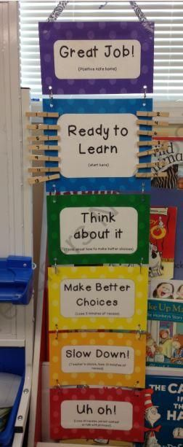
Behaviour
The Rainbow Ladder

Slide 5
Staffing
Class Teachers
Miss Brake
Teaching Assistant
Miss Saffari
Mrs Ciortan

Slide 6
Expectations
Role Models for the rest of the school
Behaviour (Rainbow Ladder)
Learning Gems
Uniform:
School shoes.
Named water bottle
Coats in school every day
PE days – Come to school in PE kit on Tuesday (Trainers, No ear-rings, hair up please)
Wellies in school
Book bag - no rucksacks/large bags as we don’t have room in the classroom
All named please
8.45 start.
Reading books and reading records in every day.
Library Day- Wednesday
PE Day – Tuesday
Outdoor learning/ Active Maths – Friday – Wellies

Slide 7
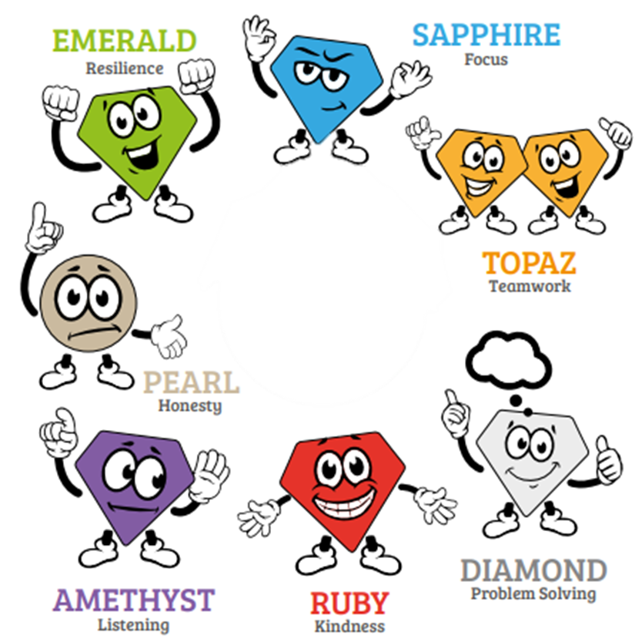
Gem Powers

Slide 8
Curriculum Coverage Where we can the curriculum is linked through our main topic theme which both Year 1 and Year 2 follow.
Literacy
Stories with familiar settings
Traditional stories
Information texts
Instructions
Non chronological reports
Extended stories
Stories by a significant author
Poems
Maths ~ Applying, Problem Solving and Consolidation
Place Value
Calculation ( Addition / Subtraction/ Multiplication/ Division)
Measures
Fractions
Shape
Data Handling

Slide 9
Curriculum Coverage Topic Themes : Enchanted, Inventors, Designers and Explorers, Wonders of the world
Science ~ Autumn Term – Materials
R.E. ~ Autumn 1 –Kindness
P.E. ~ Mr Clark (Multisports and skills) and Miss Brake (Throwing and Catching – Cricket games)
Music ~ singing and listening to various genres of music and creating music with tuned and untuned instruments.
Art ~ To use drawing, painting and sculpture to develop and share their ideas, experiences and imagination and learn about a range of artists.
PSHE ~ Autumn 1 – Friendships and recognising privacy
ICT ~ Autumn 1 ~ Coding
Please view Year B Overview

Slide 10
Key Areas - Homework
Reading:
Reading to and with your child can make a dramatic difference to a child's achievement within school.
Make time to read- even 5/10 minutes a day
Choose different types of books
Take turns to read
Talk about the book- asking your child questions
Pay attention to the language
Enjoy reading
Books and reading records in every day please.

Slide 11
Key Areas - Homework
Homework will be set on Friday and will be due for the following Friday. Please support your child in getting into the routine of completing homework on time. Homework will be set on the school website and MyMaths.
The School Website:
To see the yearly overview and topics we will be learning.
Spellings:
No set spelling test but at the end of every half term we will do a spelling challenge on the common exception words.
If your child is finding the spellings less challenging, please encourage them to think of spellings which follow this rule and others that don’t. What’s the longest word they can find, using that spelling rule? And so on!

Slide 12
Medical Information
Medicines
Medical form to be completed
Children are not to administer medicine themselves
Inhalers/Epipens
Children can’t leave the school site if their inhaler/Epipen isn’t in school
Medical labels on the box
Sickness
Report to the office
48 hours

Slide 13
Key Information
Significant to year group;
End of Year Assessments
Intervention work / booster groups
Children throughout the year may be taken out for small booster groups, pre teaching or intervention work to support their learning and understanding.

Slide 14
The Year Ahead
We have already made a great start to the year and it will be a busy one, with lots of exciting topics and activities planned. We’d like to thank you, the parents and guardians, for all your support at home; it really does make all the difference!

