Slide 1
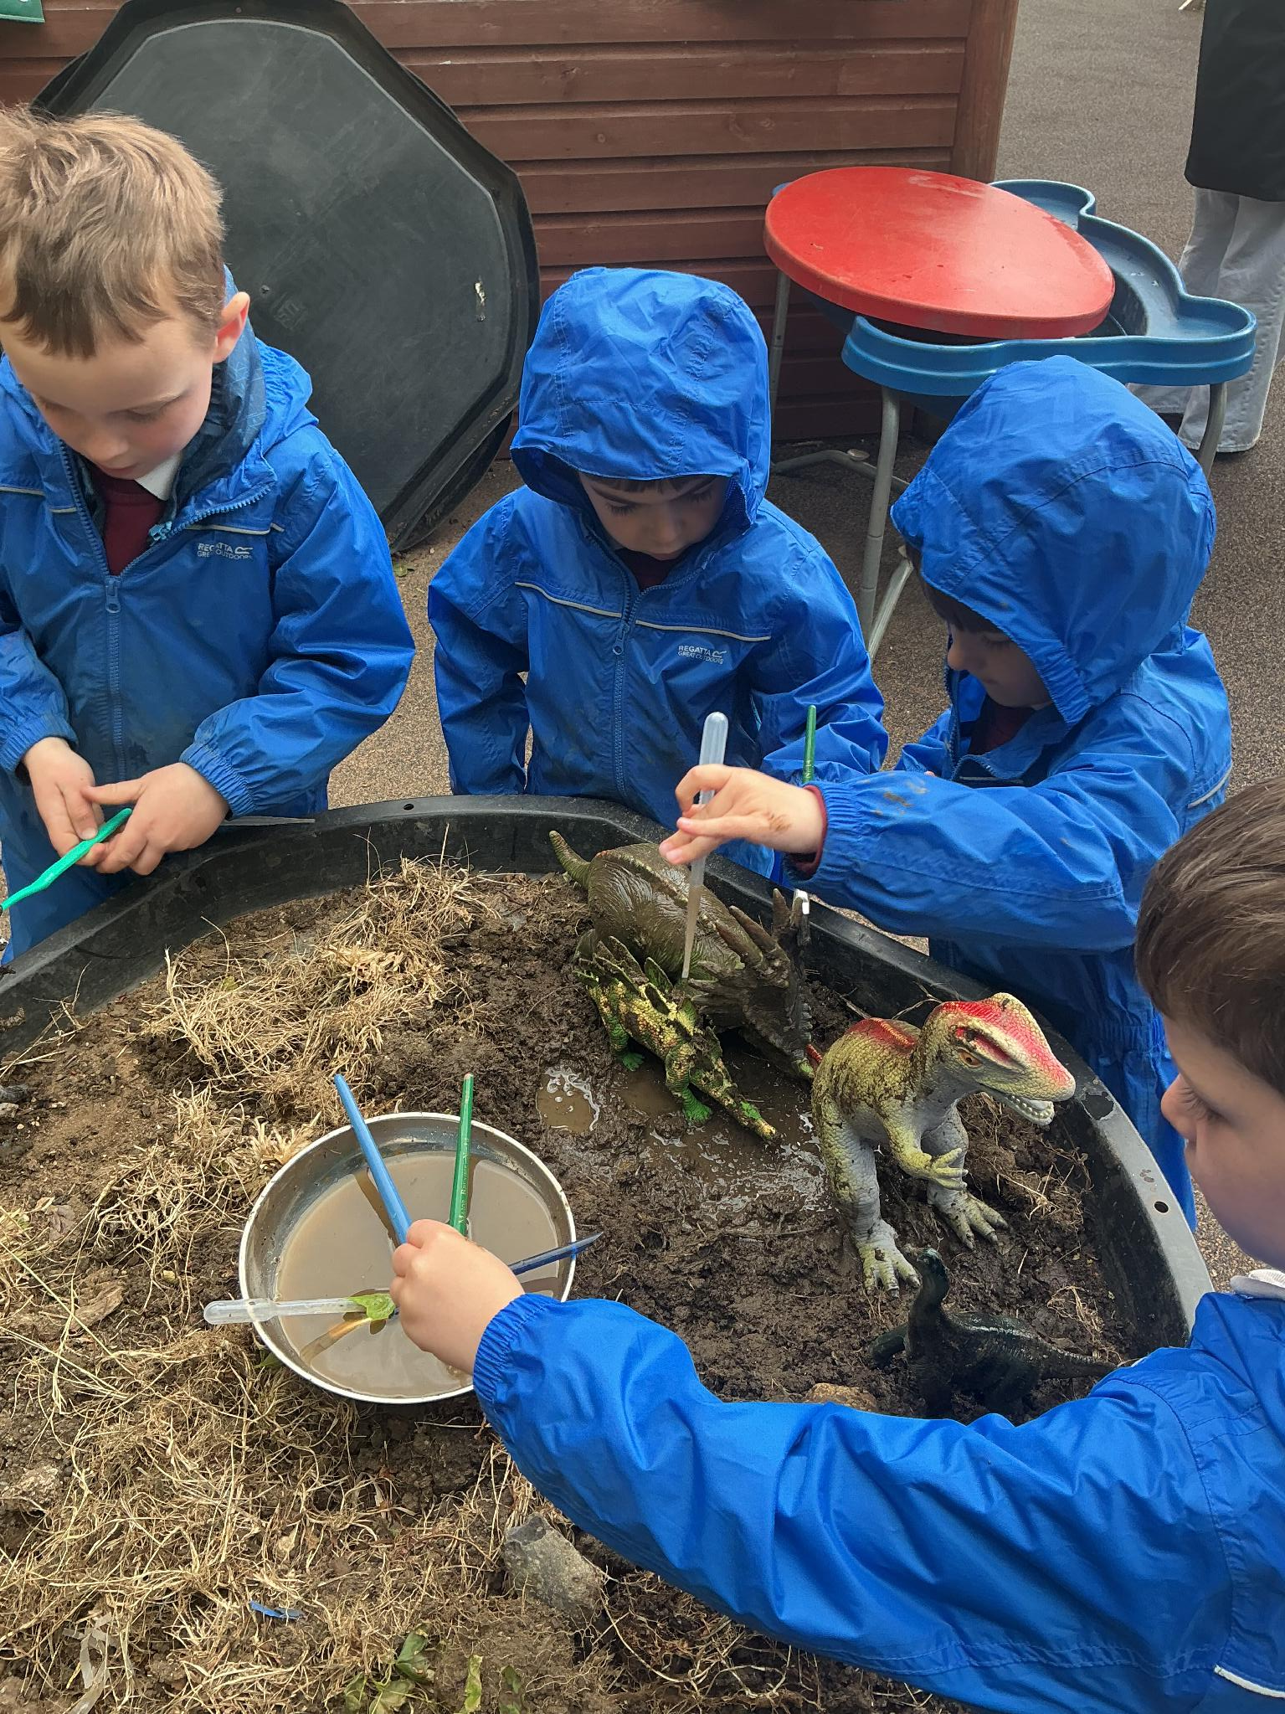
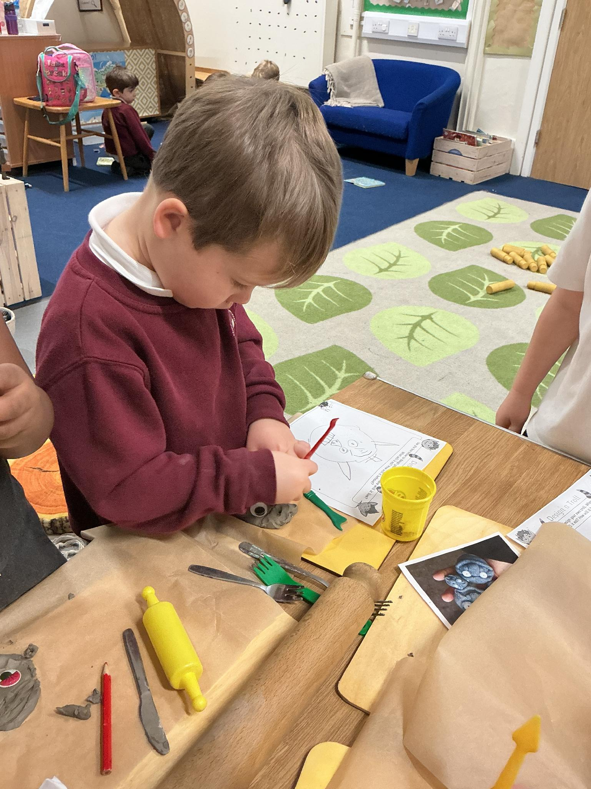
Welcome to Haddenham Community Infant School,
Early Years Foundation Stage

Slide 2
Haddenham Community Infant School
Welcome, families, to the start of an incredible journey for your children! We're thrilled to have you join our learning community.

Slide 3
Learning in the Foundation Stage
In Reception, children learn through a balance of play, exploration, and adult-guided activities. We follow children’s interests while supporting them to develop confidence, independence, communication, early reading, writing, maths, and social skills through meaningful, hands-on experiences.

Slide 4
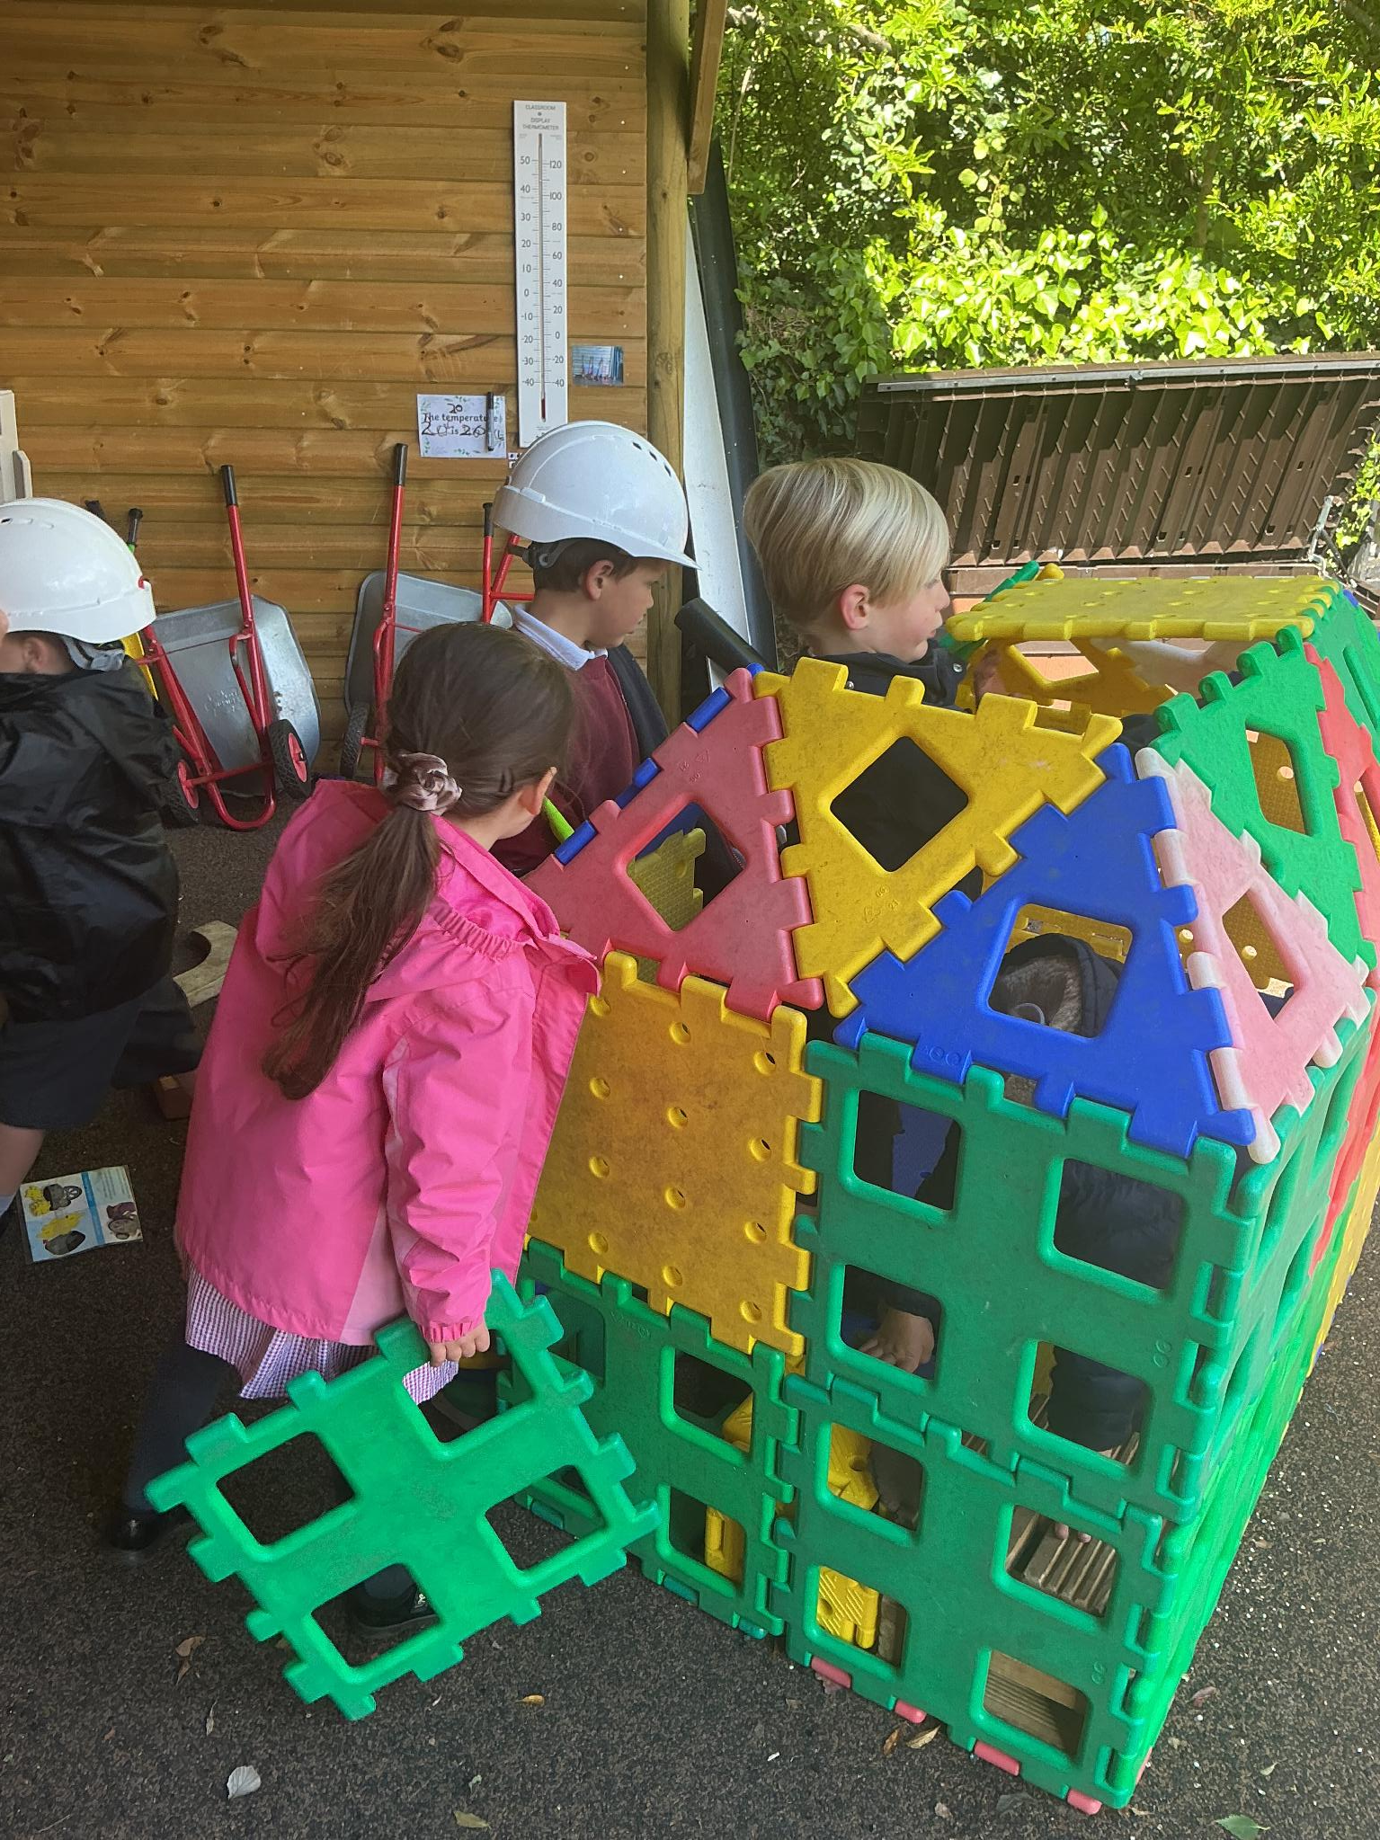
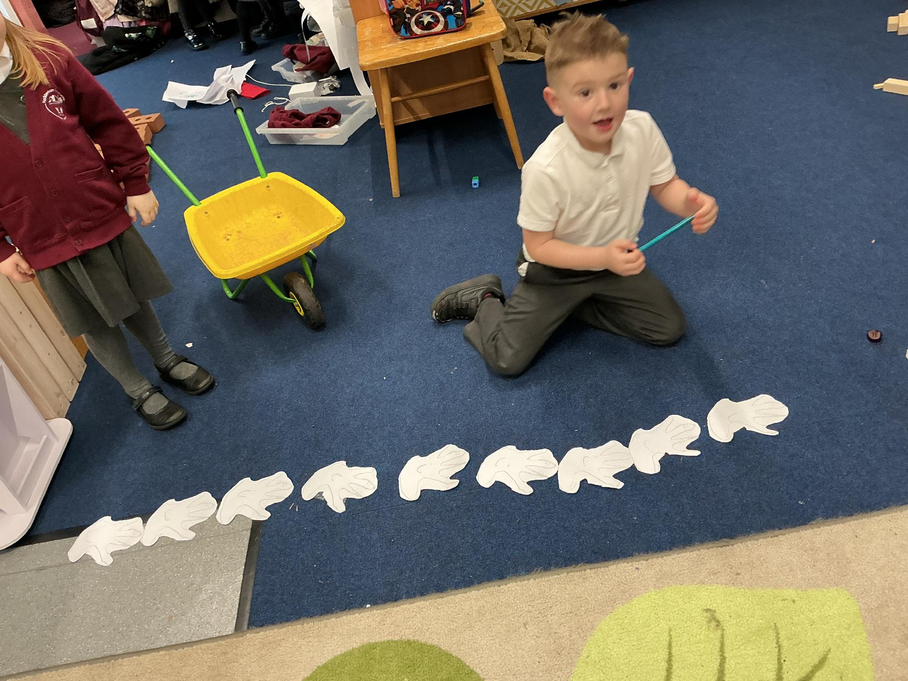
Learning in the Foundation Stage
We place a strong focus on helping children become confident, curious, and resilient learners. Through play, exploration, and trying new experiences, children develop important learning behaviours such as independence, perseverance, creativity, and problem-solving, helping them build a positive and lifelong love of learning.

Slide 5


Slide 6


Slide 7


Slide 8
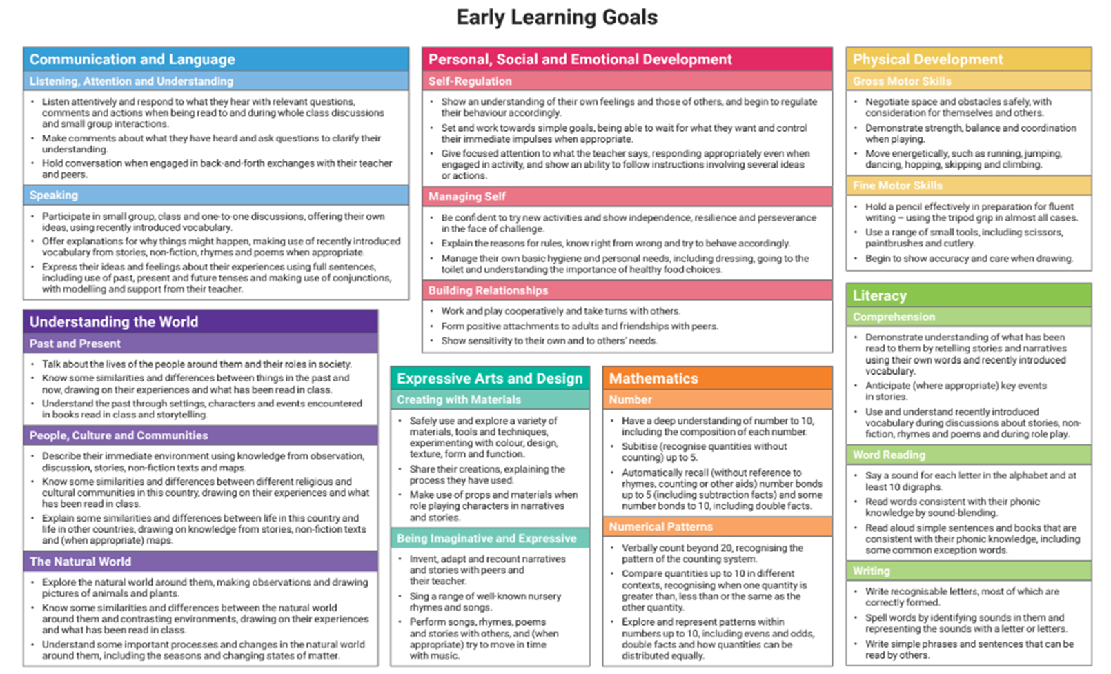
EYFS curriculum – Throughout the Reception year, children are supported through carefully planned activities, play opportunities, and learning experiences to help them work towards the national expectations for the end of the Early Years Foundation Stage (EYFS), known as the Early Learning Goals.(see handout)

Slide 9
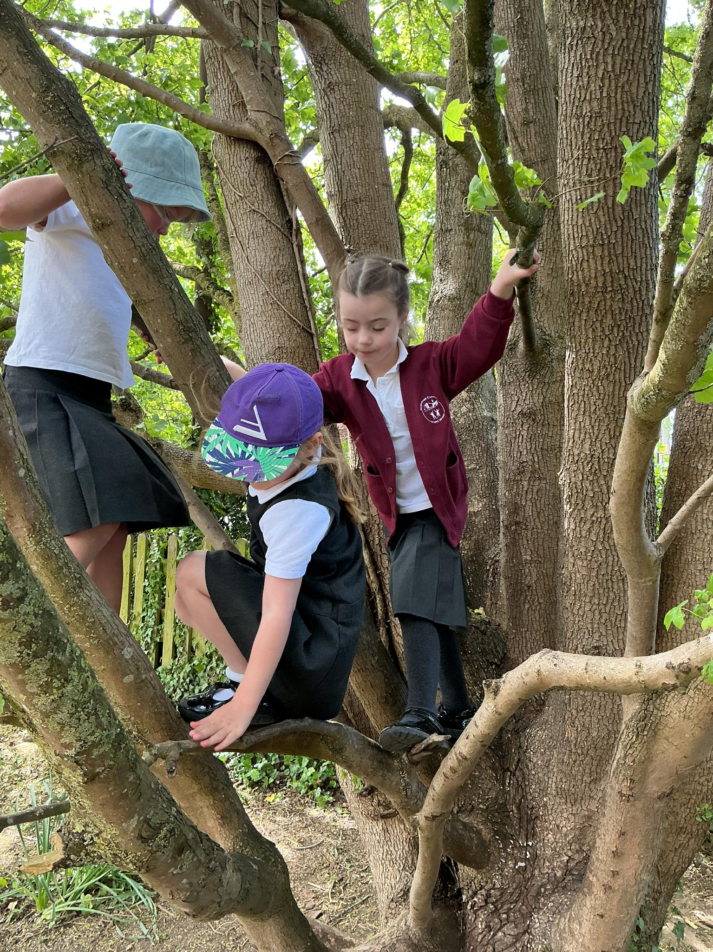
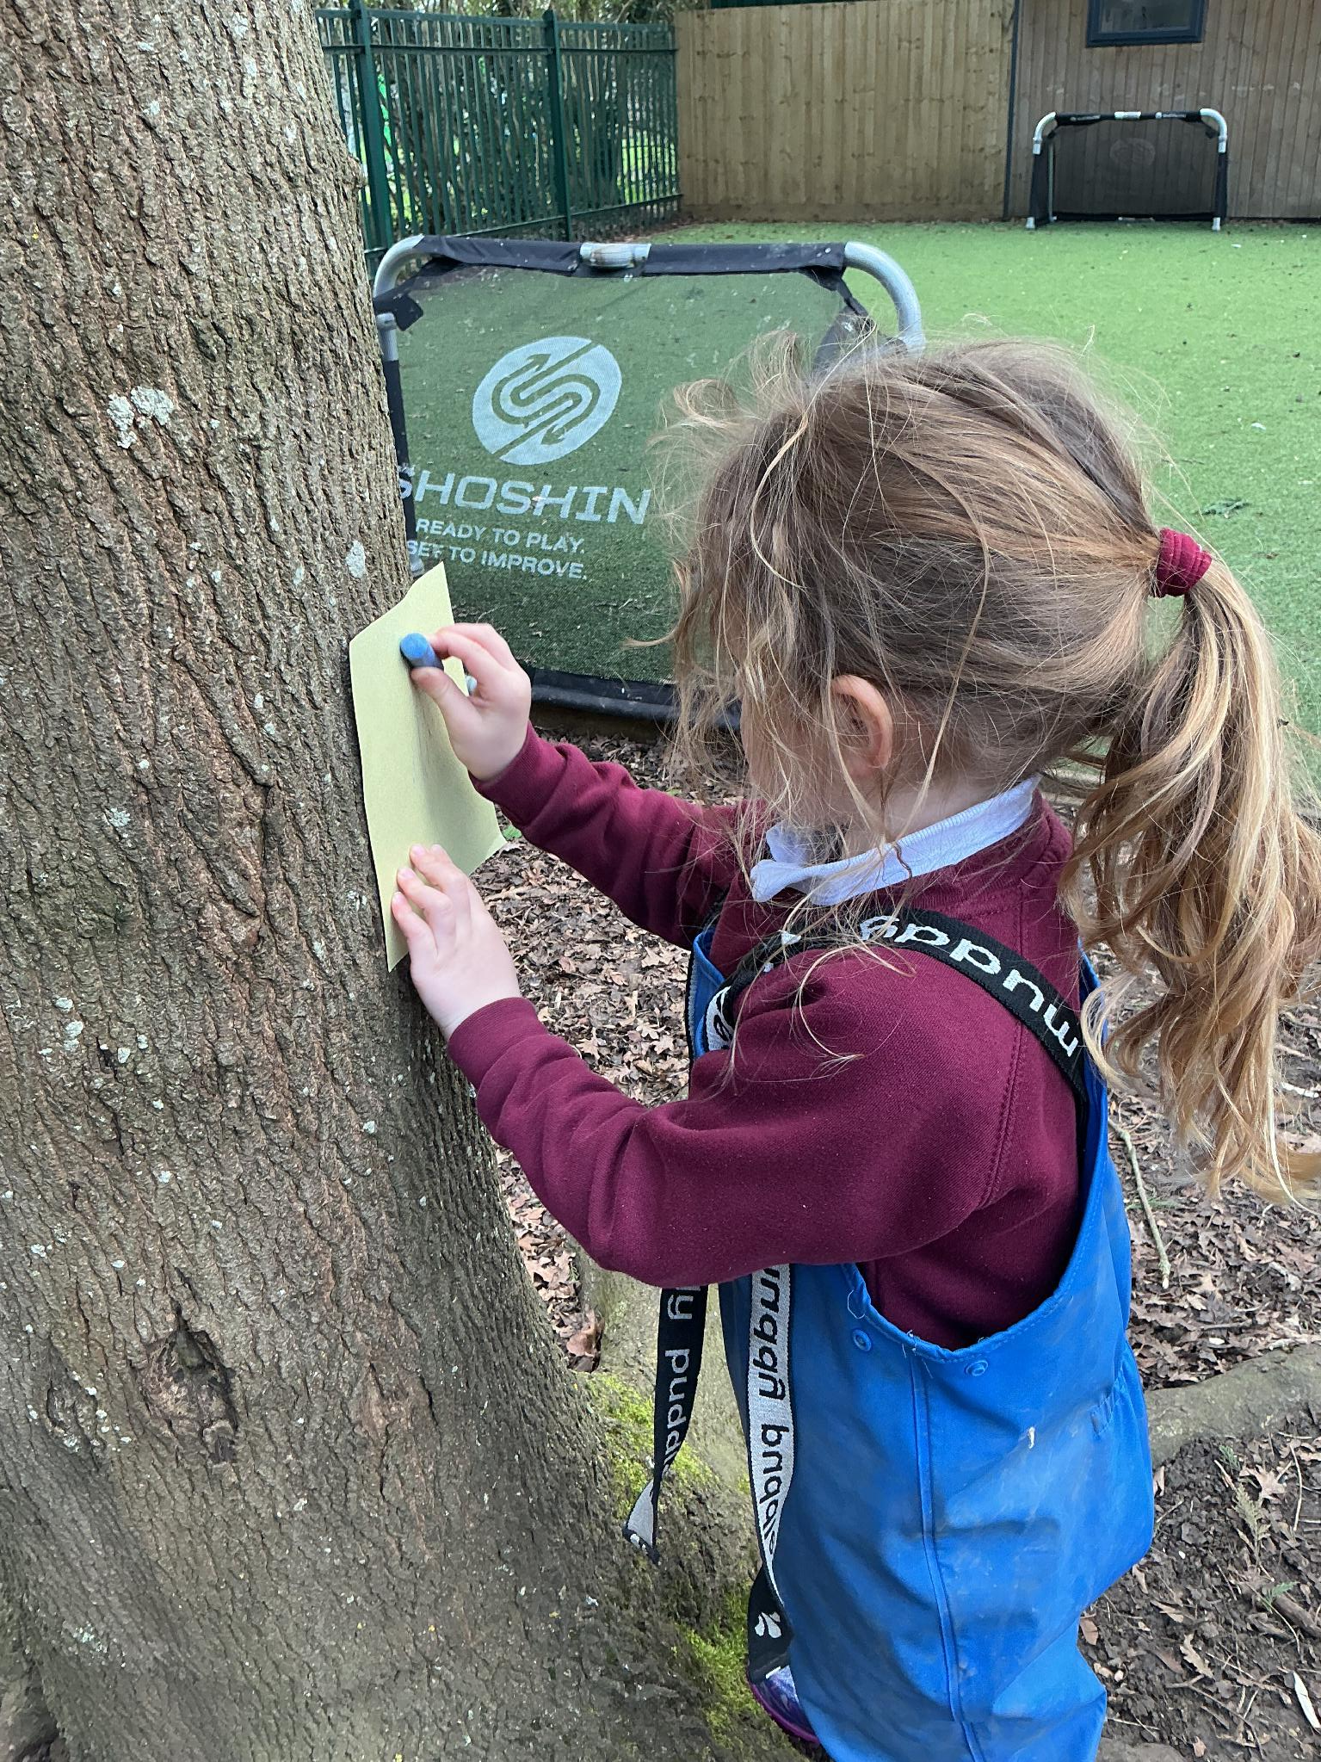
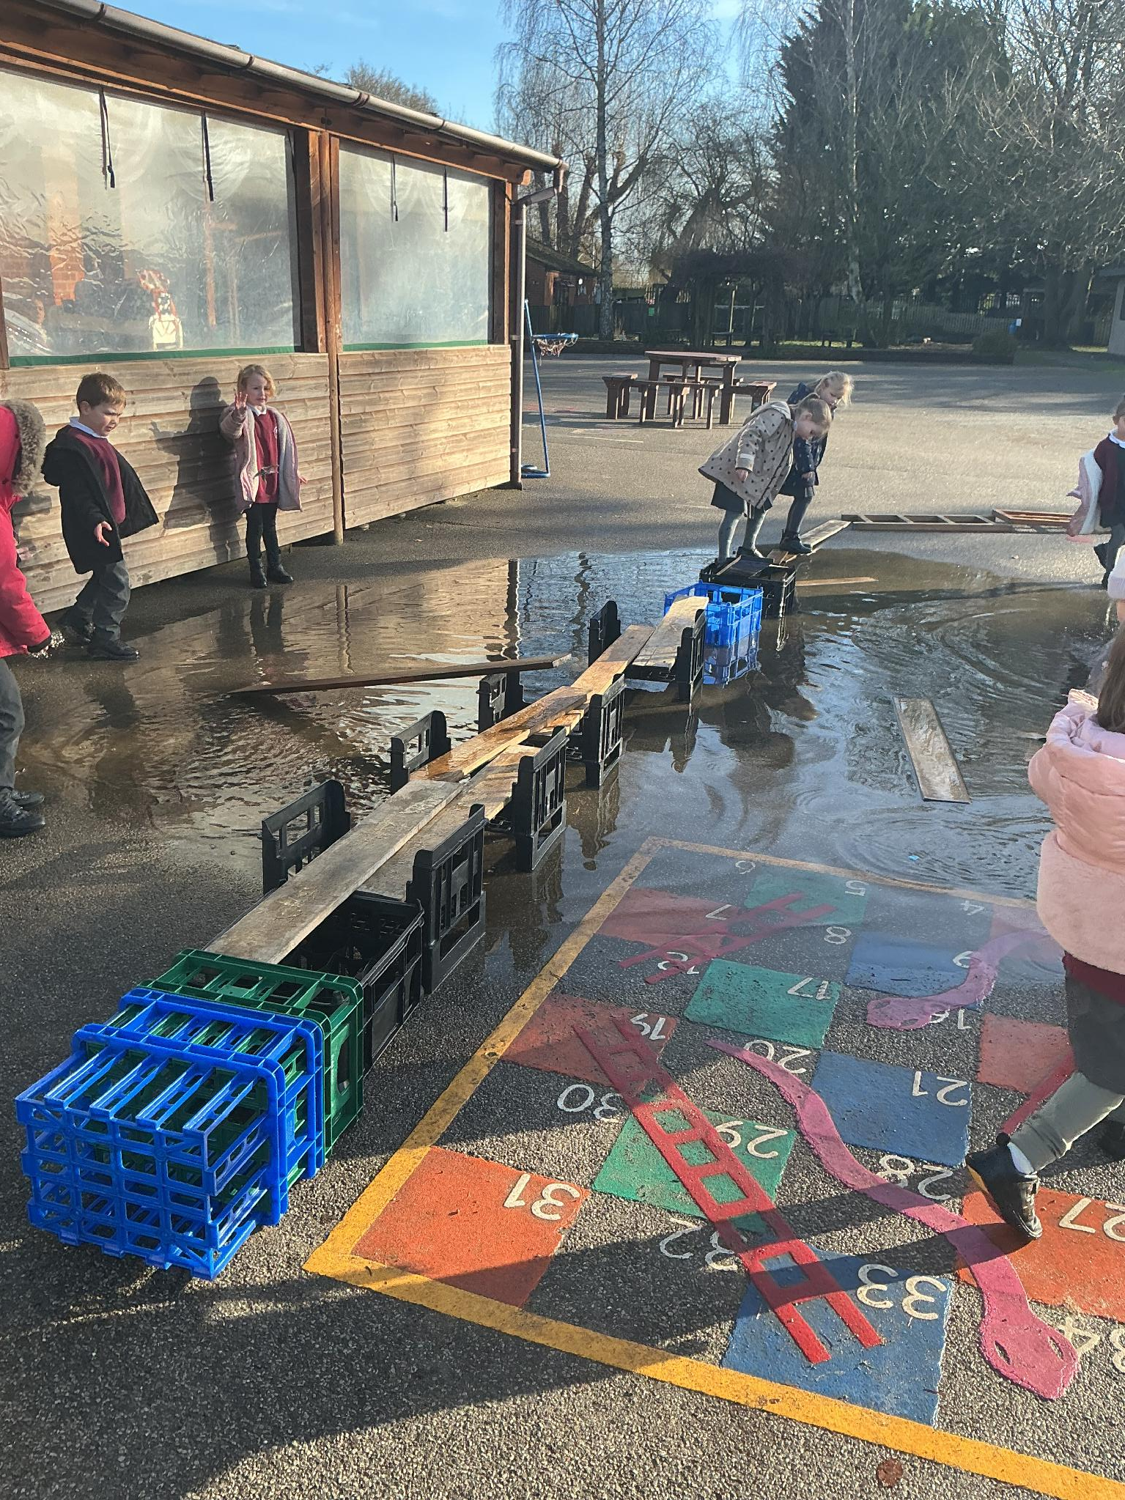
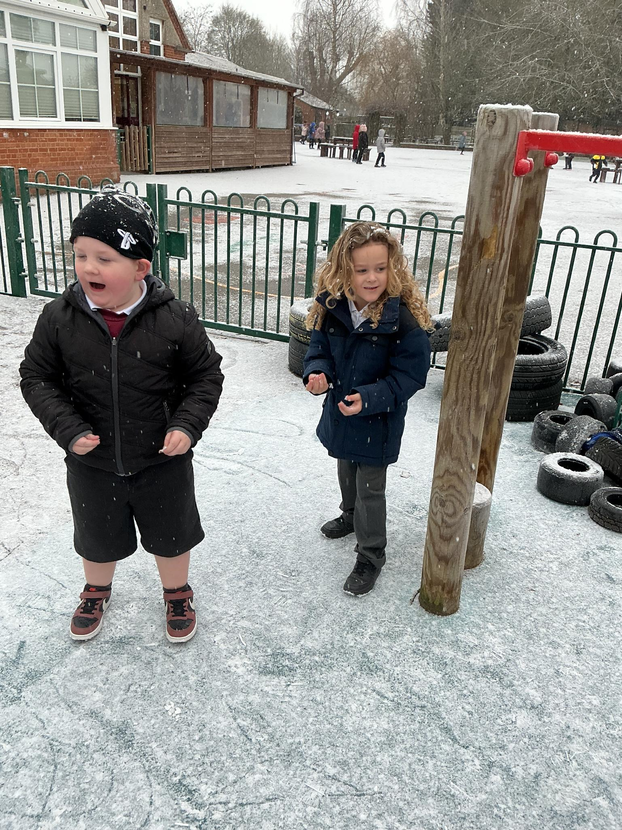
Indoor and Outdoor Curriculum
The outdoor curriculum is considered to be of equal importance. We are outside in all weathers!

Slide 10
Learning Together
We very much welcome your contributions to your child’s learning journey. While we bring our professional experience in learning and development, you know your child best, and we look forward to working in partnership with you.
Tapestry: A secure online learning journal where we share your child's school moments. Please upload your own photos and observations from home so we can celebrate their learning together!
Newsletters: Reception Weekly: Outlines upcoming adventures and suggested fun activities to do at home. (Alternative formats available upon request).
Whole School: Keeps you up to date with wider school news.

Slide 11
Learning Together
Reading at Home: Boosts your child's vocabulary, self-esteem, imagination, and even sleep patterns.
Stay & Play Sessions: Come into school to join our adventures!
Parent Workshops: Practical sessions to give you the best strategies for supporting your child at home.
Parent Feedback: Help us improve through our regular questionnaires and parent forum meetings.

Slide 12

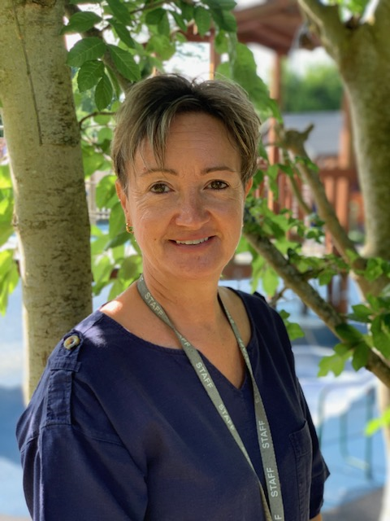

The Reception Team so far
?
Mrs Crump
Teacher and EYFS Lead
Mrs Bryson
Higher Level Teaching Assistant
Mrs Teggart
Teaching Assistant

Slide 13
The School Day
Soft Start Arrival: 8:35am – 8:45am
Morning Drop-Off: Walk with your child to the Early Years outdoor gate. Walking into the classroom on their own helps children settle quickly and build confidence.
Lunch: 11.30am
End of the Day: 3.15pm, collect from the Early Years outdoor gate.

Slide 14
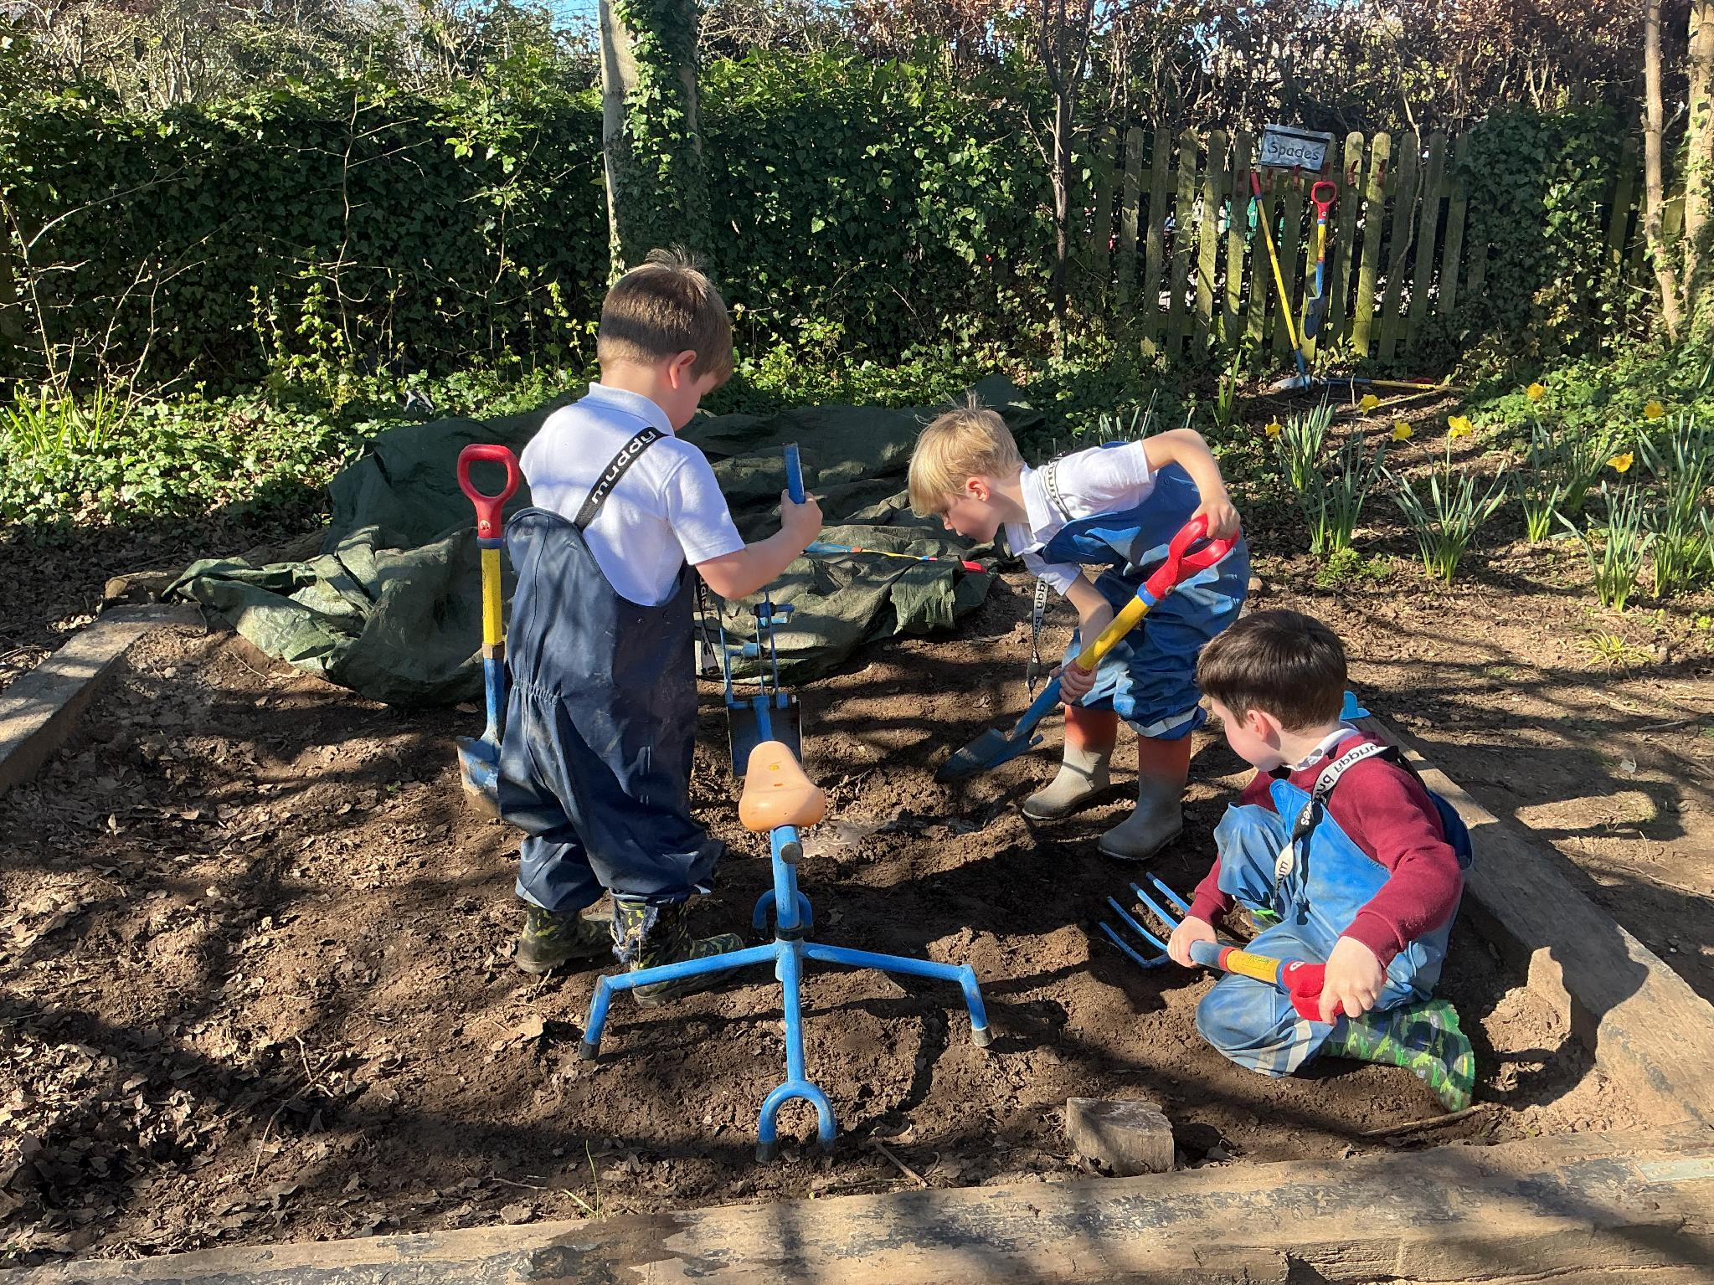
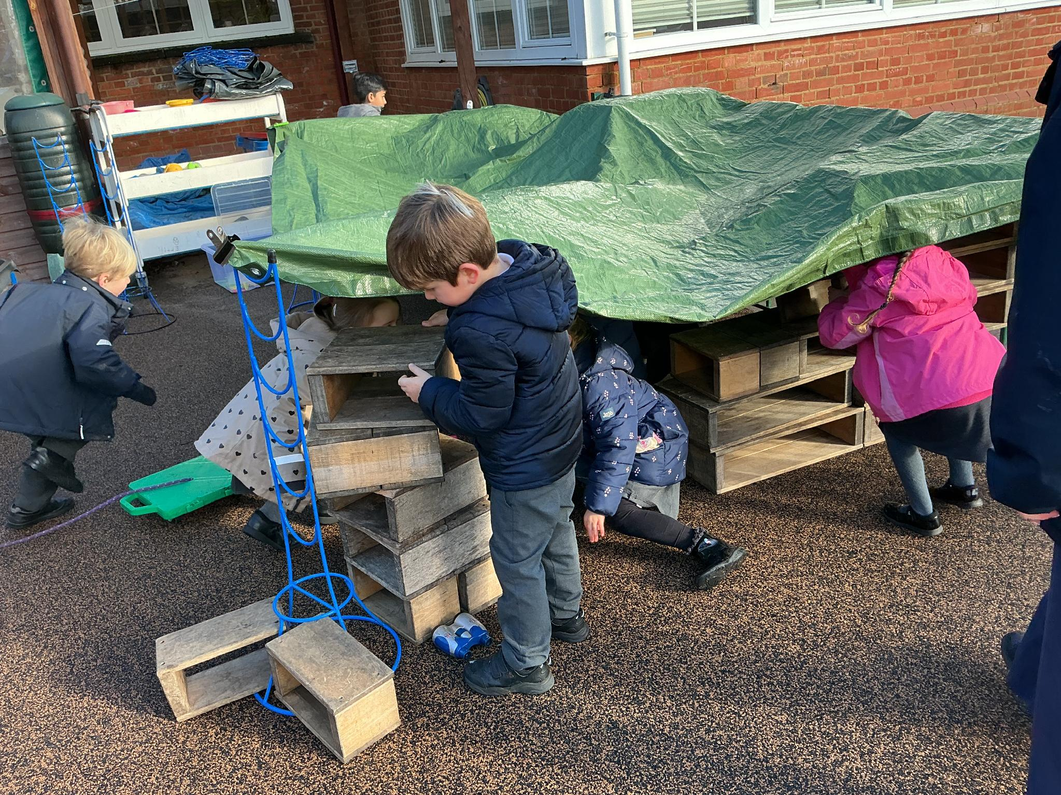
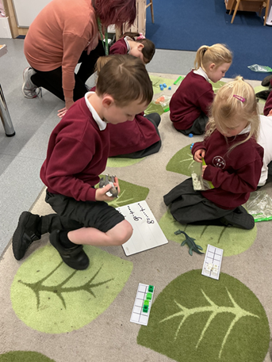
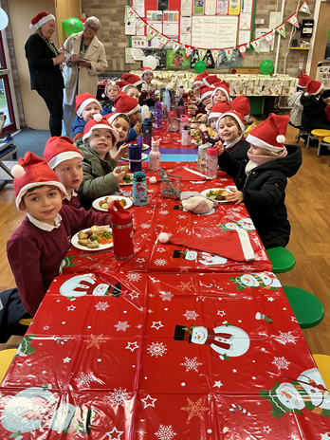
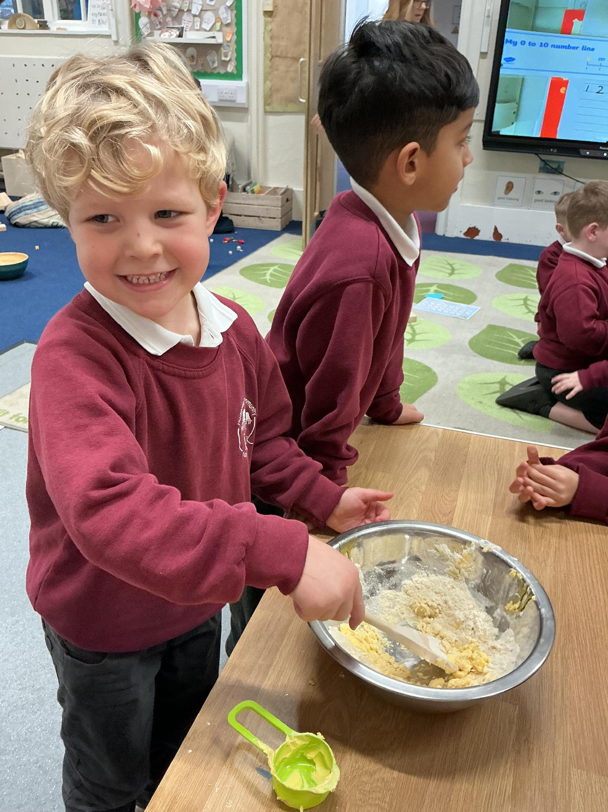

Slide 15
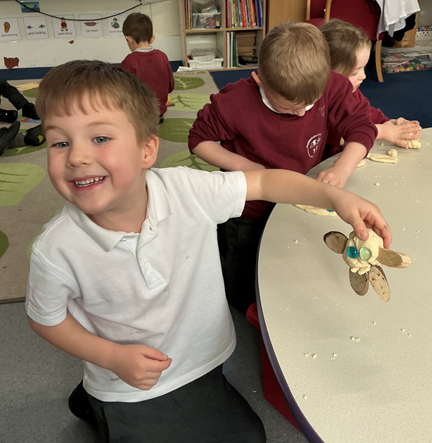
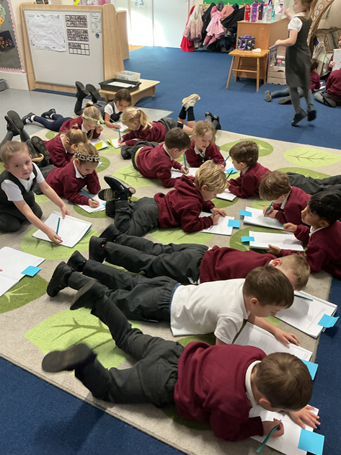

Slide 16
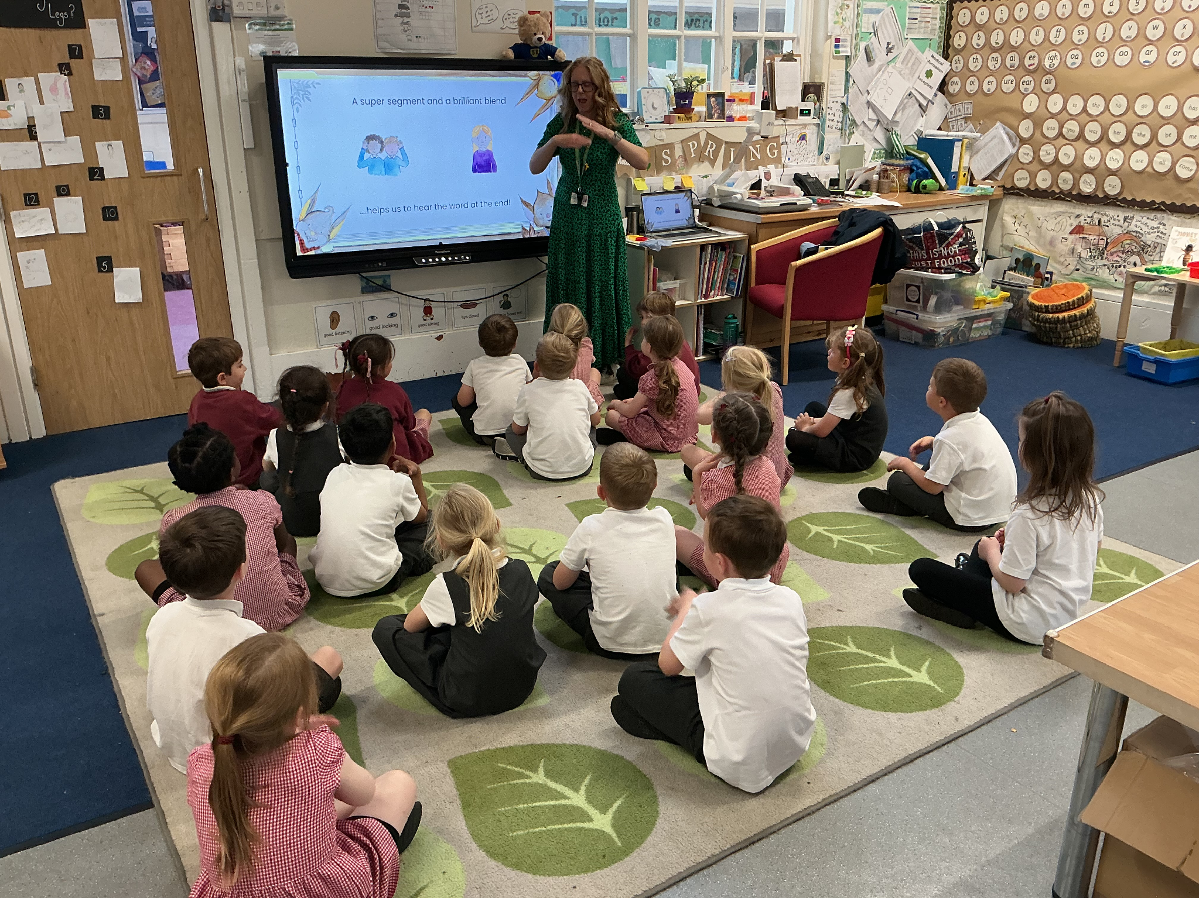
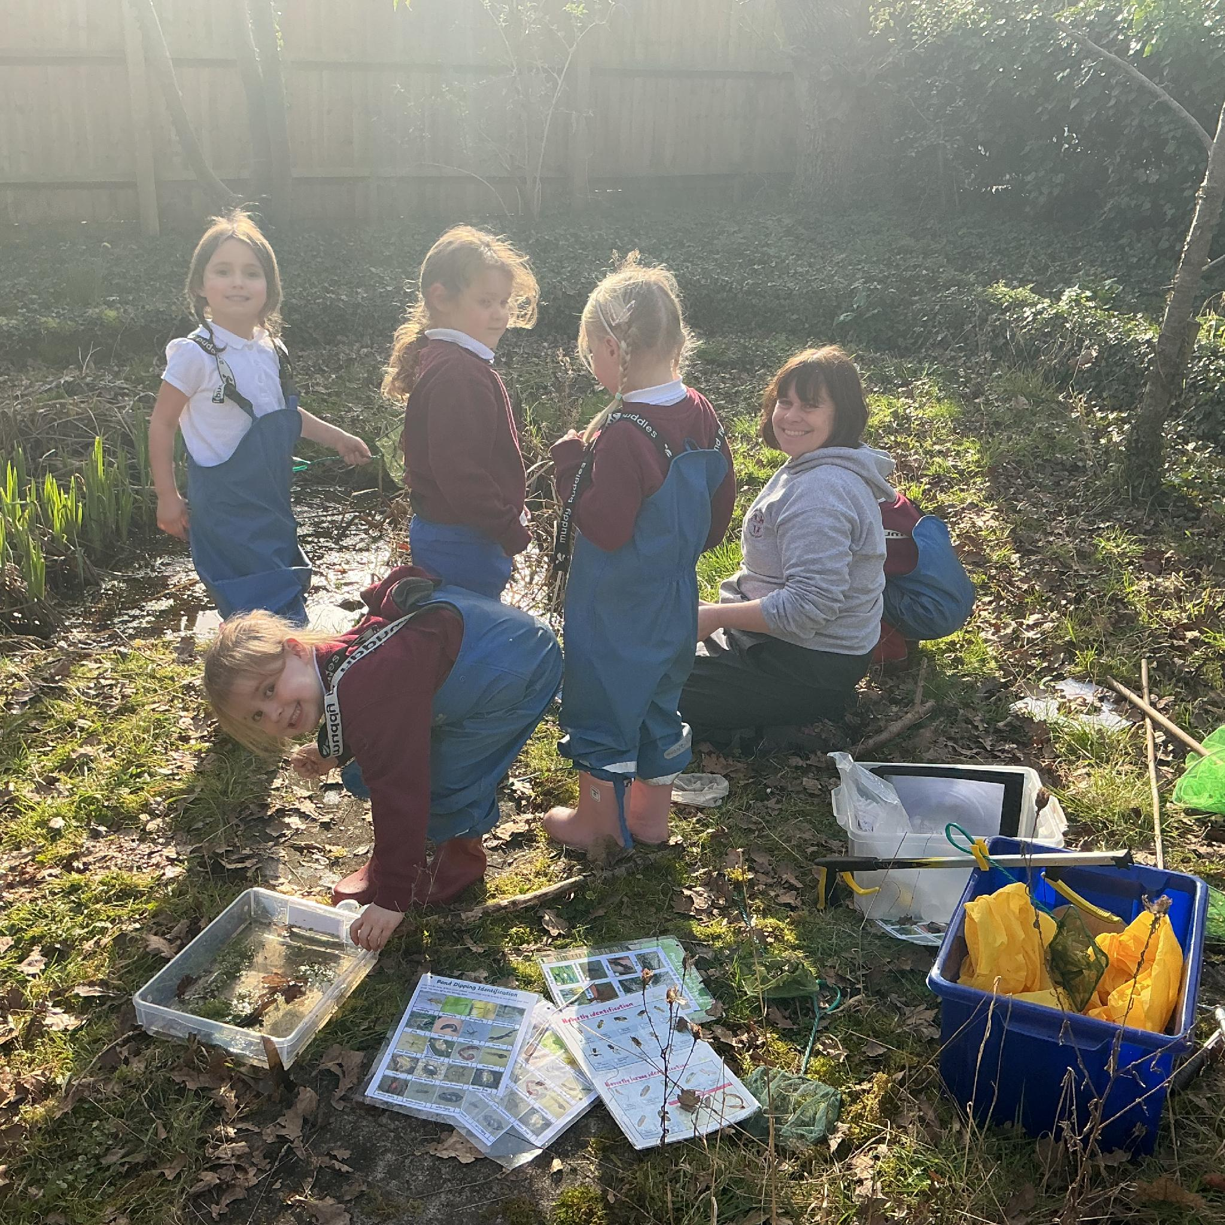
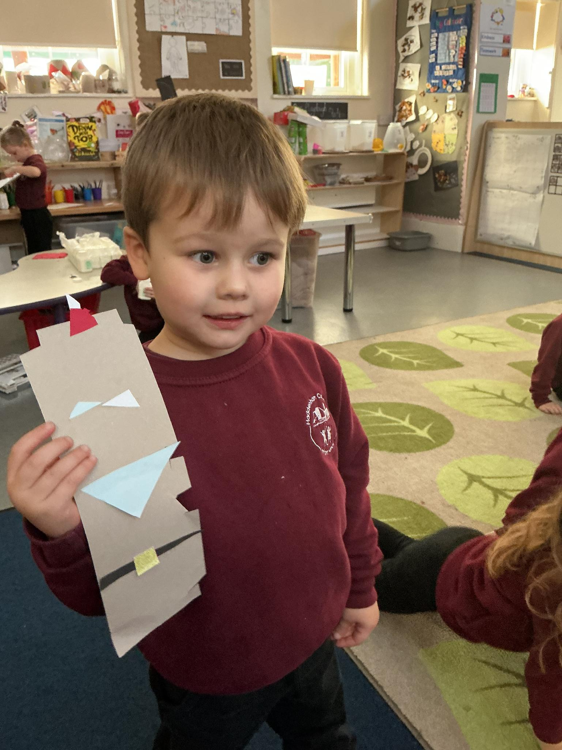
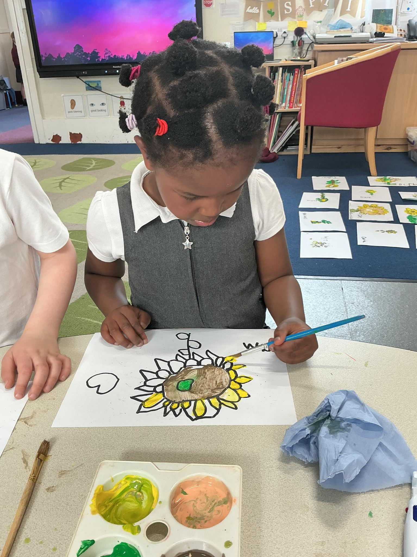

Slide 17
Our adventures…
Autumn 1 - Super Me, Super You
Autumn 2 - Let’s Celebrate
Spring 1 - Once Upon a Time
Spring 2 - Here, There and Everywhere
Summer 1 - Growing and Changing
Summer 2 - Brilliant Beasts
Past adventures from previous years; African Drumming workshop, Fun with Fairytales at Waddesdon, Bekonscot Model Village, Cotswold Wildlife Park

Slide 18
Settling in to new adventures
Please attend one of our transition sessions with your child on Tuesday 7th July.
Choose the time that suits you best:
Morning: 9:00 AM – 10:30 AM
Afternoon: 1:15 PM – 2:45 PM
Please sign up to one of these sessions at the end of this meeting or email the school office.

Slide 19
Settling in to new adventures
September
This gradual start gives your child the time and space to gently adjust to school life. Everything is brand new to them right now—new faces, new routines, and a big new environment! The first few days can be emotionally and physically tiring as they process it all, so plenty of rest and downtime at home will help them recharge.
Thursday 3rd September 9.15-11.30am | Settling in session
Friday 4th September 9.15-11.30am | Settling in session
Monday 7th September 8.35-11.30am | Settling in session
Tuesday 8th September 8.35-12pm | Settling in session with lunch
Wednesday 9th September 8.35-1.15pm | Settling in session with a full lunch time.
Thursday 10th September 8.35-3.15pm | Full day for all Reception children

Slide 20
Getting to Know You
Thursday 3rd September – Wednesday 9th September (Afternoons)
We would love to invite you in for a chat! This is a wonderful opportunity for us to:
Begin getting to know each other.
Share your child's unique interests and strengths.
Discuss any specific needs they may have so we can support them perfectly.
How to Book: Please sign up to a meeting slot this evening, or email the school office.
All About Me: Please bring along a completed ‘All About Me’ booklet which is available to take home tonight.

Slide 21



Things to bring to school:
Named Water Bottle: Inexpensive and clearly labelled.
Daily Book Bag: Please do not send rucksacks.
School-Keepers: Named wellies and in a bag a full change of named clothes to stay at school.
Weather-Ready Gear: A warm coat, hat, and gloves for the cold; a hooded waterproof coat for mild/wet days; a sun hat for hot days.
Tuesdays P.E.: Come to school wearing P.E. kit (no P.E. bag needed).
Please name all items!

Slide 22
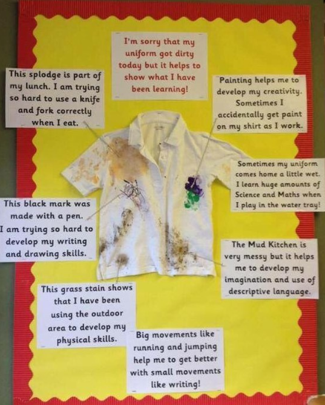
Messy play is a valuable and important part of hands-on learning in Reception. Keeping a named spare set of clothes in school will help your child continue enjoying their learning and play comfortably if they need to change during the day.

Slide 23

Any questions or concerns
We are always here to help: Come talk to teachers or Teaching Assistants about any questions or worries, big or small.
Daily catch-ups: Look out for us on the gate at the beginning and end of every school day.
Quick chats: After school is the best time for a brief conversation.
Longer meetings: Please book an appointment through the school office.

Slide 24
Useful Information
We have a class page on our school website that provides you with useful links and information;
Reception Classes Page
We also have a phonics page to provide you with useful information on how to support your child at home with phonics. Reception Phonics Support
We will be providing you with more information on how to support phonics and maths at home.

Slide 25
Working together to enrich our learning
At HCIS, we love involving our families. As we start this exciting new school year, we want your input!
How you can help:
Topic Ideas: What themes or experiences should we add to our curriculum?
Trip Suggestions: Where should we visit to spark the children's curiosity?
Share Your Talents: Do you have a job, hobby, or skill you could showcase to the class?
How to share:
Add your thoughts to the mind maps around the room or send a quick email to the school office. Your ideas help us create a personalised learning journey for every child!

Slide 26
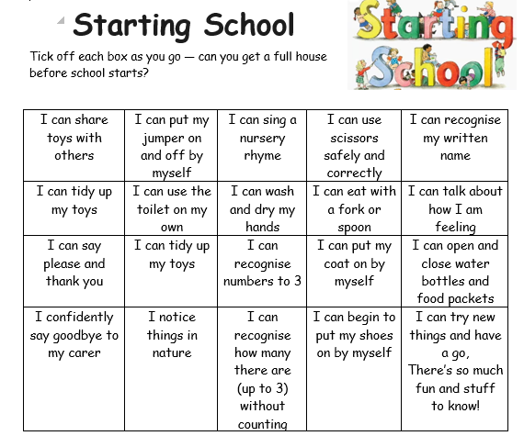
Starting School Bingo!
(see handout)

Slide 27
Family Photo
Please could we have a family photo so that we can create a welcoming classroom display ready for September. This could be emailed to the office or brought with you at your ‘Getting to Know You’ meeting in September.

Slide 28
Tonight….
Get your ‘Starters Pack’
Get your ‘Starters Pack’ from Mrs Busby.
Sign up for the July transition session and September ‘getting to know you’ meeting.
Collect resources: ‘All About Me’ booklet, ‘Starting School’ bingo sheet, and the Early Learning goals document.
Contribute ideas to the curriculum mind maps around the room.
Grab a ‘Ready, Set Throw!’ packet before you leave to save for their first day in September!

