Slide 1
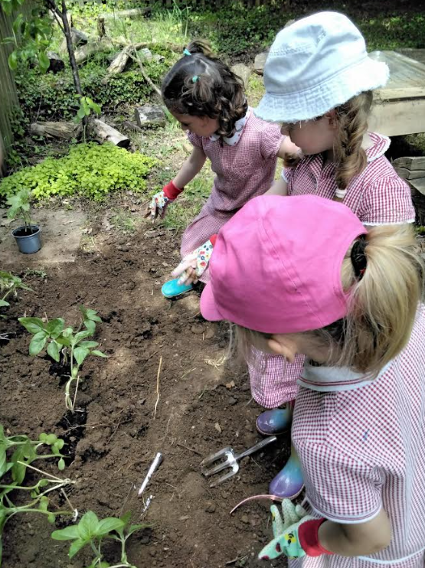
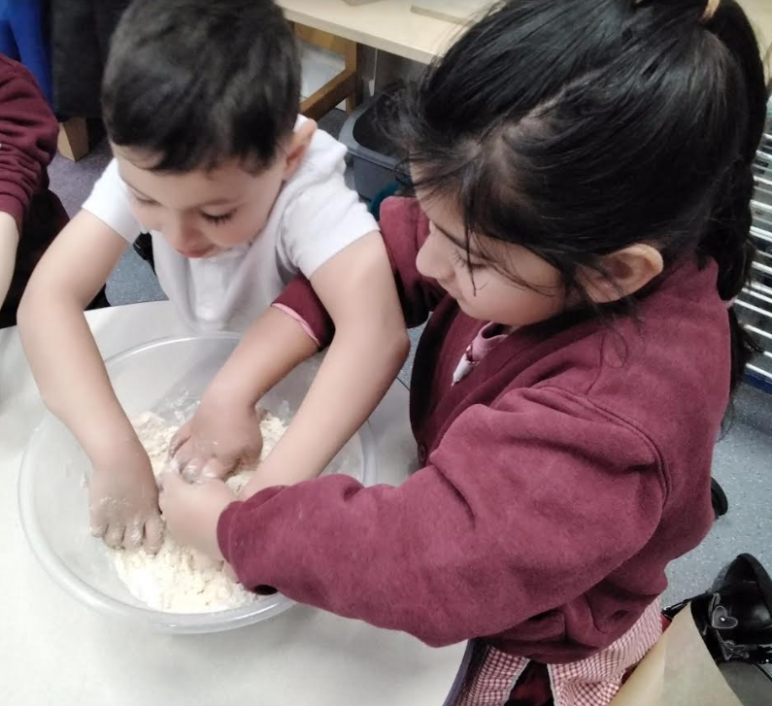
Welcome to Haddenham Community Infant School,
Early Years Foundation Stage

Slide 2
Haddenham Community Infant School
We are immensely proud of our school and all the stakeholders within it and we welcome you.

Slide 3

In Reception, as well as adult guided sessions we also learn through play. This is where children and adults actively engage in play so that children learn about the world and themselves following their own interests.

Slide 4


Slide 5
Learning in the Foundation Stage
At HCIS we follow the Early Years Foundation Stage framework (EYFS). There are 3 prime areas and 4 specific areas learning.
Prime Areas
Personal, Social and Emotional Development
Communication and Language Development
Physical Development
Specific Areas
Literacy
Mathematics
Understanding the World
Expressive Arts and Design

Slide 6
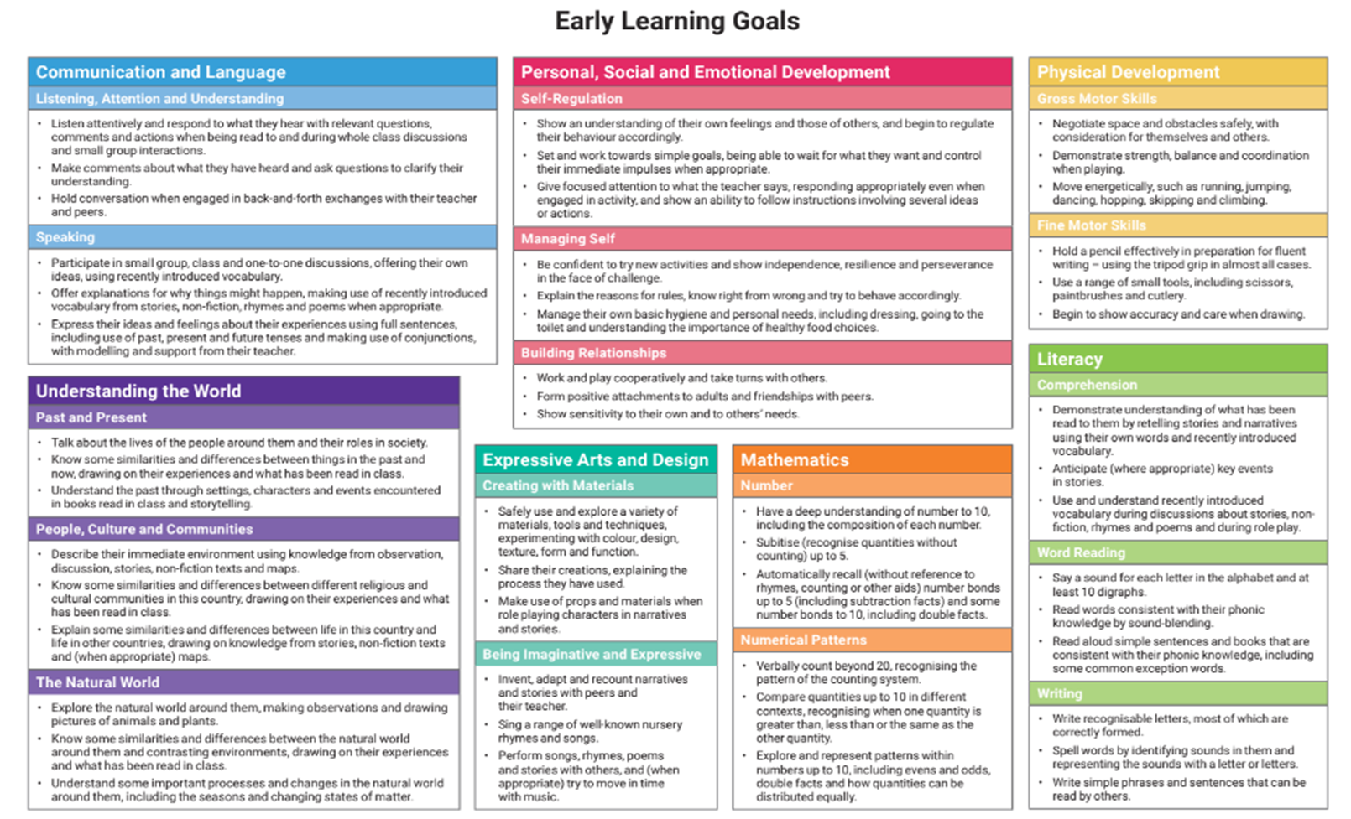
EYFS curriculum – End of year expectations (see handout)

Slide 7
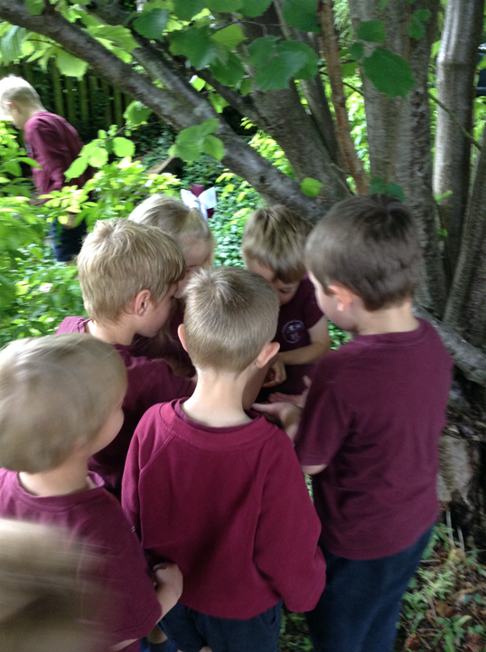
Indoor and Outdoor Curriculum
The outdoor curriculum is an essential extension of the indoor classroom and is considered to be of equal importance. We are outside in all weathers. Children don’t catch colds from being wet or cold—illnesses are caused by viruses, not the weather—so outdoor play, even in chilly or damp conditions, is safe and beneficial for their development.

Slide 8
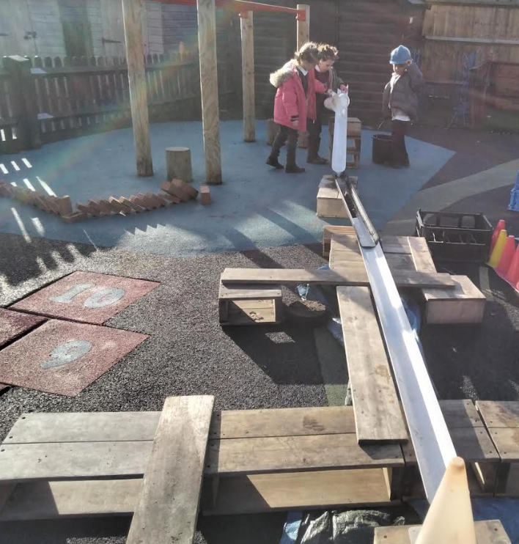
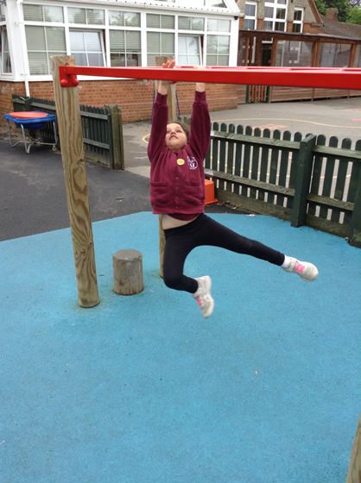
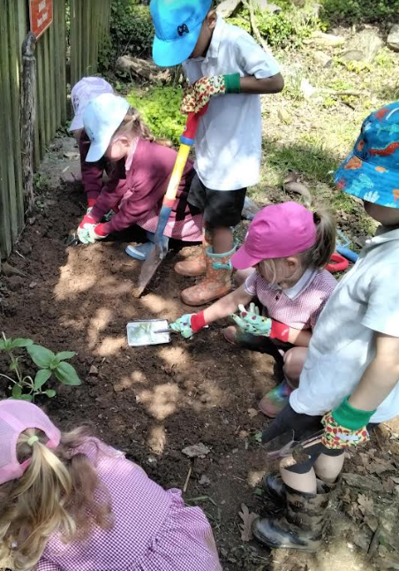
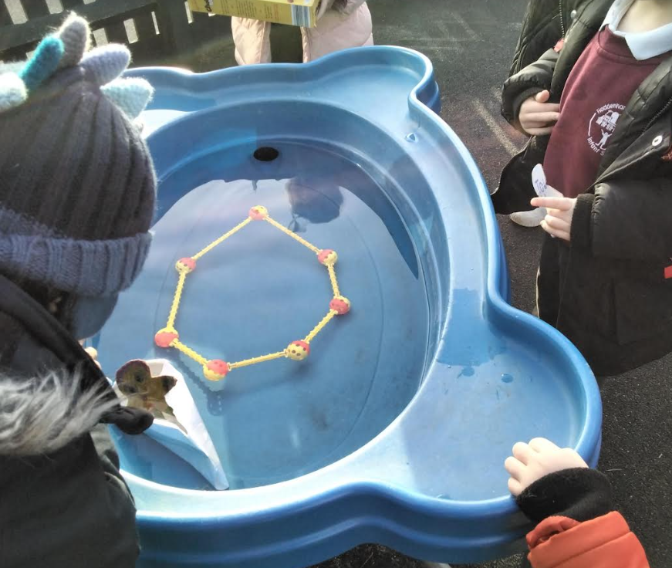
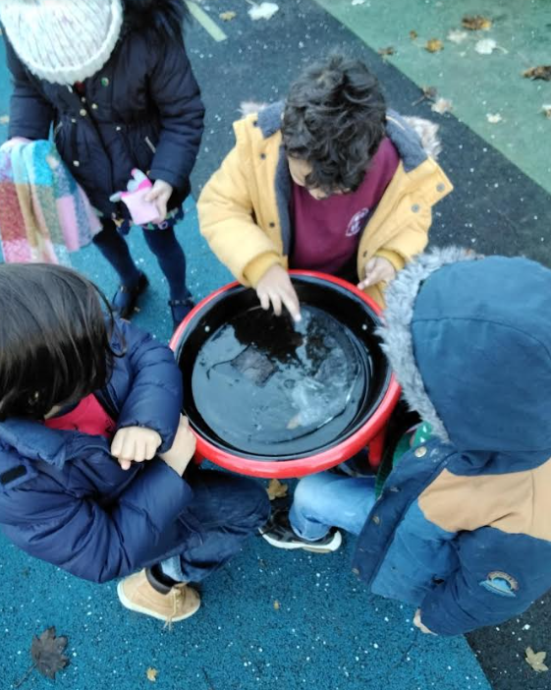
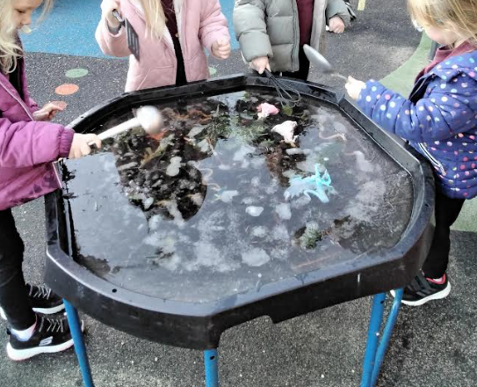
Outdoor learning

Slide 9
Learning in the Foundation Stage
There is also a strong focus on developing the characteristics of effective learning, which promote a lifelong love of learning:
Playing and exploring – engagement
Finding out and exploring
Playing with what they know
Being willing to have a go
Active learning – motivation
Being involved and concentrating
Keeping trying
Enjoying achieving what they set out to do
Creating and thinking critically
Having their own ideas
Making links
Choosing new ways to do things

Slide 10
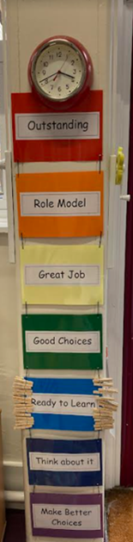
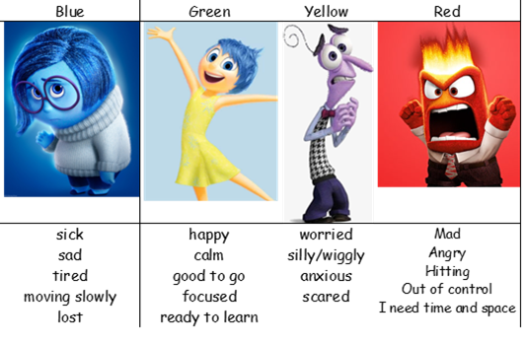
We actively promote positive behaviour
through key values and continual supportive
modelling.
Rainbow Ladder
Self Regulation
(the management of emotions)
Zones of Regulation; giving the child
the tools to discuss their emotions
and find strategies to support them.

Slide 11
Parental/Carer Involvement
We focus on the development of the whole child and family/carer and school relationships plays a big part in this. It is important to us that we build relationships of trust not only with your child but with their families as well.

Slide 12
Parental/Carer Involvement
We very much welcome and want to support your contributions to your child’s learning journey. We are the experts in learning and development and parents and carers are the experts in the child.
Tapestry - A secure online journal where we can share with you your child’s learning in school as well as us having the opportunity to see and value what learning moments are happening outside of school too.
Newsletters - Weekly Reception newsletter outlining our adventures for the following week and suggested fun activities to do with your children. Please let us know if you require this in an alternative format. We also send out a whole school newsletter so that you are kept up to date with whole school news.

Slide 13
Parental/Carer Involvement cont.
Reading at home - Special reading time at home holds so many benefits including building self-esteem, vocabulary, feeding imagination and it even improves their sleeping patterns!
Stay and play sessions - We invite you in to school join us in our adventures. We also invite you in for ‘Book Looks’.
Workshops to provide you with strategies on how best to support your child at home.
Parent Feedback - We are always striving to provide the best learning community for you and your child and we welcome your feedback in order for us to do this. We regularly send out questionnaires and we also have parent forum meetings.

Slide 14

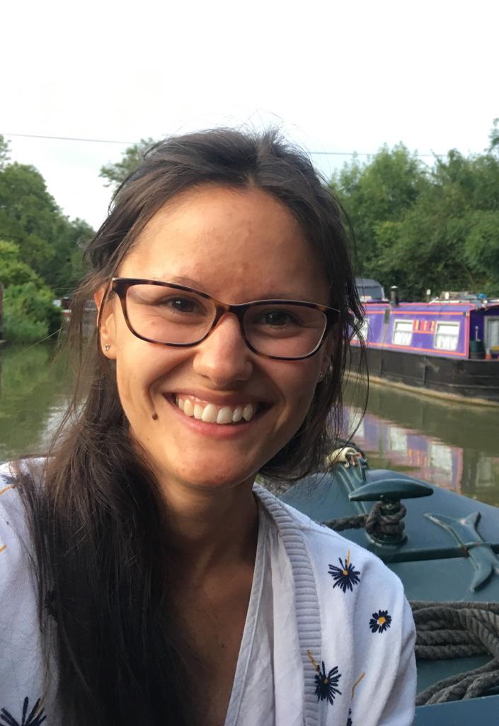
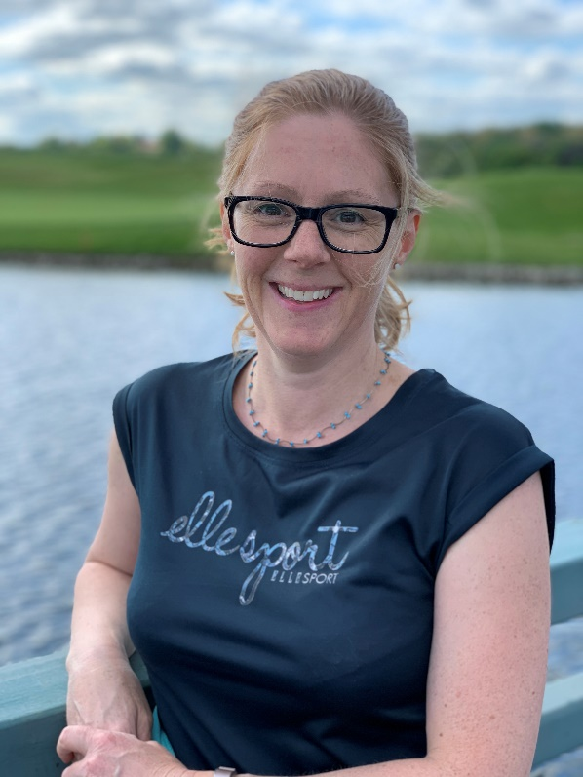

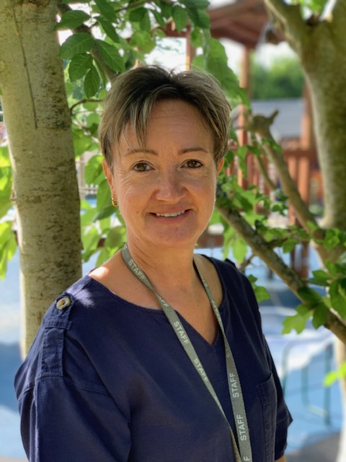
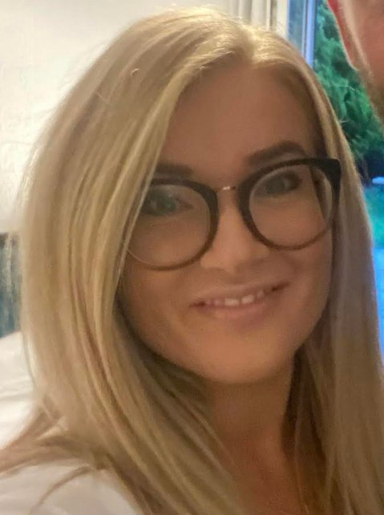
A Typical Day in Reception
Mrs Moult
Miss Lewis
Mrs Crump
Mrs Timberlake
Mrs Bryson
Mrs Teggart

Slide 15

8:35 – 8:45
The school gates are opened for parents and children to make their way to the gate of the Early Years outdoor area where they will be greeted by the Early Years team. When children come in on their own, they settle quicker, build independence and take more responsibility.

Slide 16
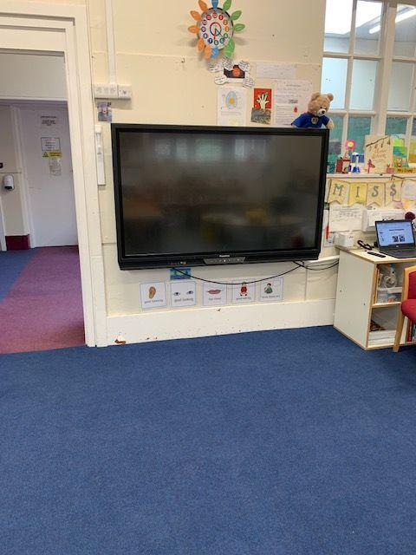
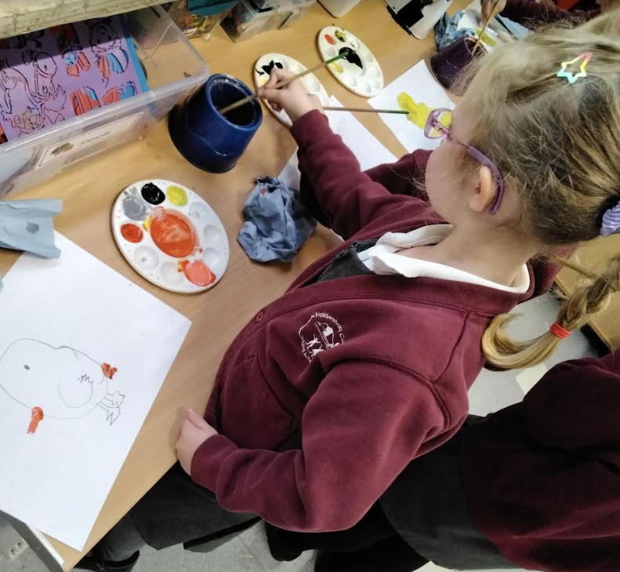
8:35 - 9:00
Children start the day with a learning activity as they come into the classroom.

Slide 17
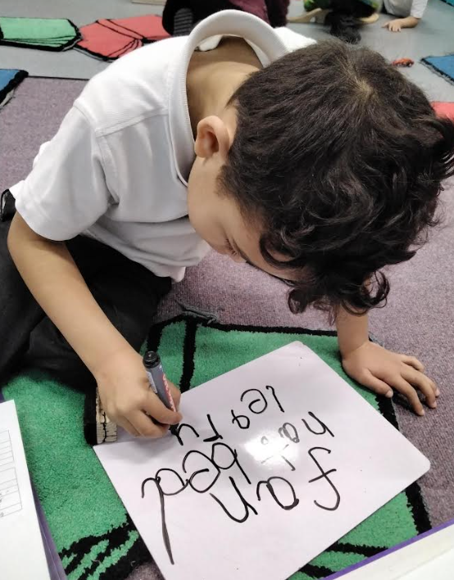
9:00, 11.15 and 1.00
We have three short whole class adult directed sessions. These tend to focus on phonics, maths or literacy.

Slide 18
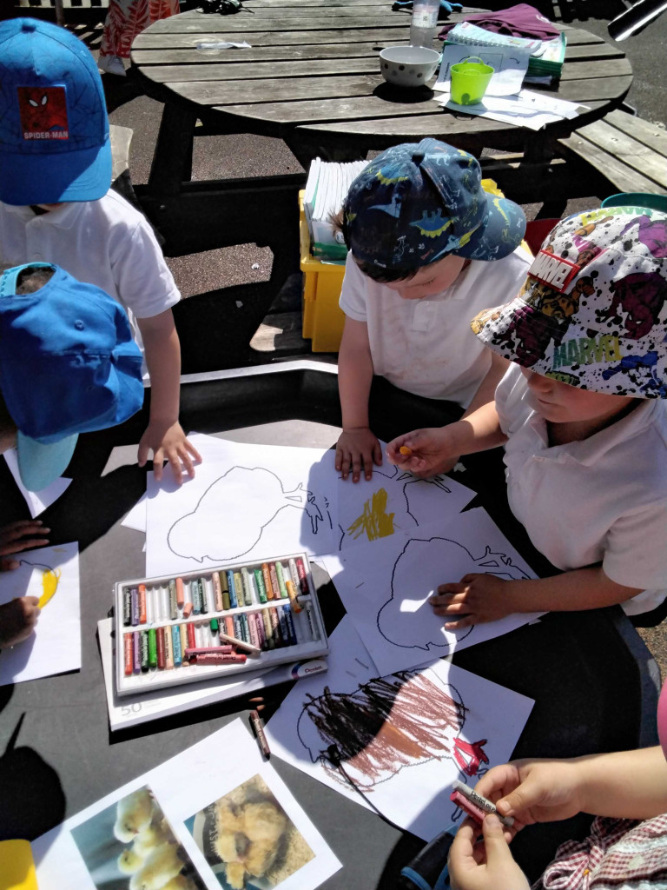
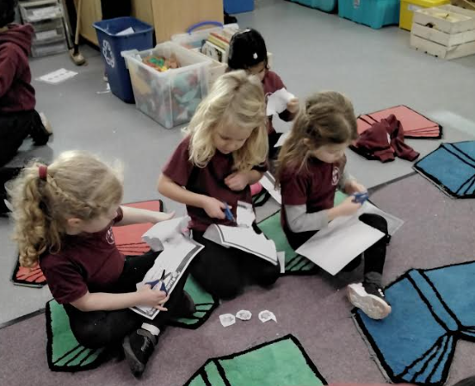
9.30 onwards
Our healthy fruit or vegetable snack table opens with the opportunity to also have some milk which is provided FOC until your child turns 5.
The children are involved in adult led and child led activities through play linked to our weekly learning and also linked to the children’s individual interests - ‘Discover and Do’.

Slide 19
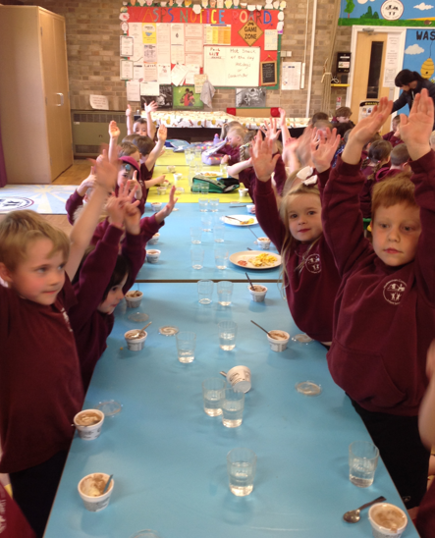
11.45
Lunch time in the hall!
Children in reception and key stage 1 are entitled to a free hot school meal. This is provided by Freshstart.
If you would prefer your child to have a packed lunch, you need to provide them with one in a named lunch box. *no nuts

Slide 20
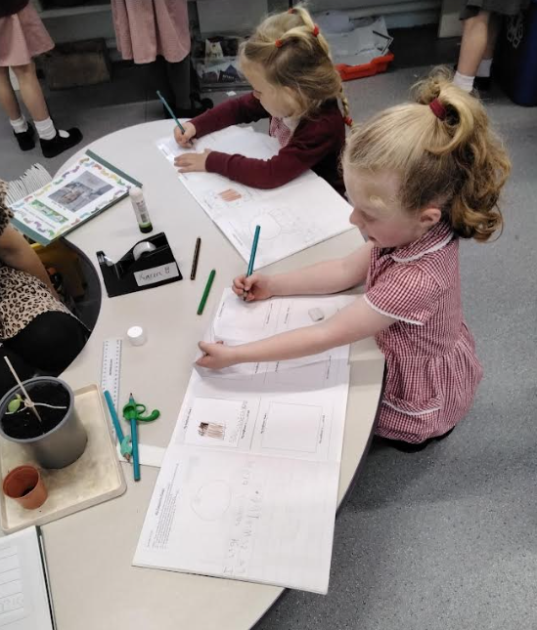
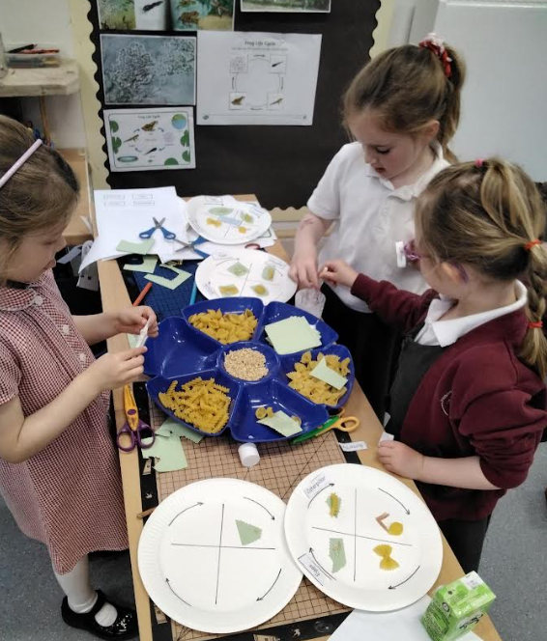
1:30
After our third adult guided session the children and adults continue with ‘Discover and Do’.

Slide 21


2.45
3.15
Tidy up time.
Storytime/Singing
Home time!
Children to be collected from the gate of the Early Years outdoor area.

Slide 22
Our adventures…
Autumn 1 - Super Me, Super You
Autumn 2 - Let’s Celebrate
Spring 1 - Once Upon a Time
Spring 2 - Here, There and Everywhere
Summer 1 - Growing and Changing
Summer 2 - Brilliant Beasts
Past adventures from previous years; African Drumming workshop, Fun with Fairytales at Waddesdon, Bekonscot Model Village, Cotswold Wildlife Park

Slide 23
Transition
Your child will attend two induction sessions; Tuesday 1st July (with a parent) and Tuesday 8th July (on their own). 9-10.30am or 11-12.30pm. Please sign up to one session for both days this evening or email the office.
September
This will help your child to gradually settle in. Those first few days are very tiring, they have a lot to take in!
Friday 5th September 9.15-11.30 | Settling in session
Monday 8th September 9.15-11.30 | Settling in session
Tuesday 9th September 9.15-11.30 | Settling in session
Wednesday 10th September 9.15-12pm | Settling in session with lunch
Thursday 11th September 8.45am-1.15pm | Settling in session with a full lunch time.
Friday 12th September 8.35-3.15pm | Full day for all Reception children

Slide 24
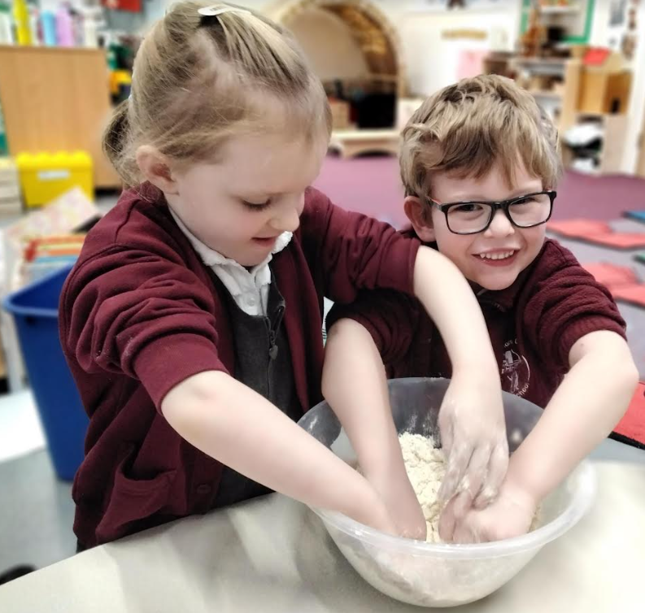
Transition continued…
Friday 5th September – Thursday 11th September afternoons we are inviting you in to meet with the us for a ‘getting to know you’ meeting. Please sign up to a meeting this evening or email the office.
We understand that some children have been in full-time nursery however the transition is in place to support your child with the move to full-time school, brand new setting and carers, a significant increase in space, a proportionally larger group of children, higher expectations of focus and attention across the day… We know it isn’t entirely practical with work but for one week it has a great pay off and ensures a more successful and happy transition for all!

Slide 25

Starting School Bingo!
(see handout)

Slide 26



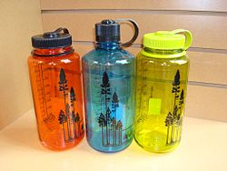
Things to bring to school:
A named bottle of water - not an expensive bottle.
A warm coat, hat and gloves in cold or mild weather.
Wellies that will stay at school - we play outside in all weathers.
A waterproof coat with hood in mild weather.
A sun hat in hot weather.
Book bags every day
(no rucksacks).
P.E. day - the children will come to school dressed in their P.E. kits on Friday’s. You don’t need to buy a PE bag.
Please name all items!

Slide 27
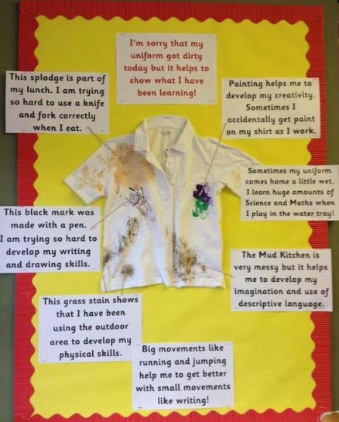
Getting messy is an inevitable part of immersed learning through play. It would be useful to us if we could have a spare complete set of named clothes in a bag that could stay in school.

Slide 28

Any questions or concerns
There will always be time for you to talk to the class teacher or the class teaching assistants about any questions or worries you may have... No matter how big or small. We are always on the gate at the beginning and end of the school day.
The best time to catch us is after school for a short chat/meeting or make an appointment through the school office if you feel you require a longer meeting.

Slide 29
Useful Information
We have a class page on our school website that provides you with useful links and information;
Reception Classes Page
We also have a phonics page to provide you with useful information on how to support your child at home with phonics. Reception Phonics Support
We will be providing you with more information on how to support phonics and maths at home.

Slide 30
Working together to enrich our learning
At HCIS, we truly value the unique knowledge, experiences, and ideas that our families bring to our school community.
As we begin our exciting year in EYFS, we would love your suggestions:
Ideas for topics or experiences you would love to see included in our curriculum
Suggestions for trips or visits that would support your child’s learning and spark their curiosity
Offers of visits or support – do you have a job, hobby, or talent you could share with the children?
Please feel free to share your thoughts on our mind maps around the room or via email to the school office. Your input helps us create a rich, meaningful, and personalised learning journey for every child.
Thank you for being part of our learning adventure!

