Slide 1
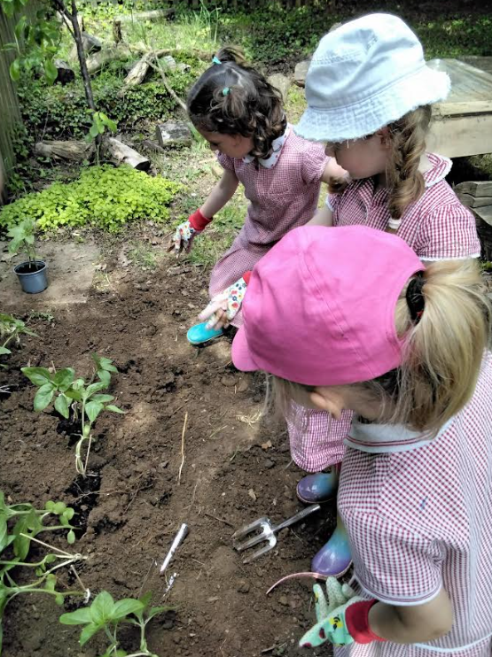
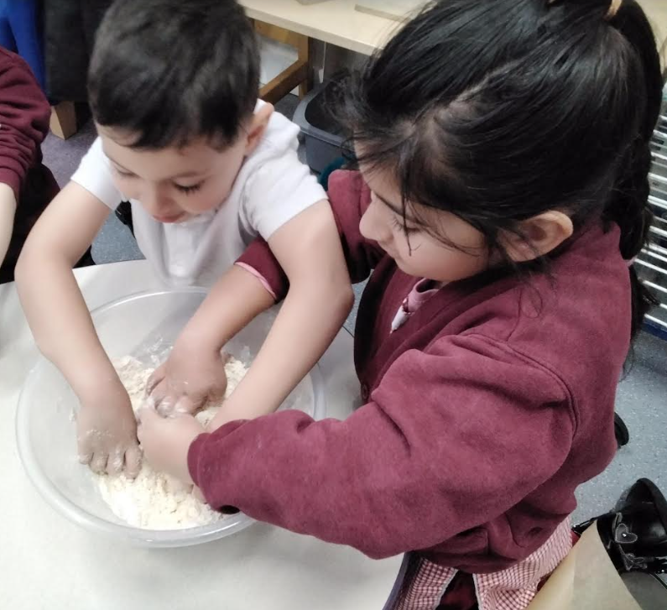
Welcome to Haddenham Community Infant School, Early Years Foundation Stage

Slide 2
Learning in the Foundation Stage
At HCIS we follow the Early Years Foundation Stage framework (EYFS). There are 3 prime areas and 4 specific areas learning.
Prime Areas
Personal, Social and Emotional Development
Communication and Language Development
Physical Development
Specific Areas
Literacy
Mathematics
Understanding the World
Expressive Arts and Design

Slide 3
Learning in the Foundation Stage
There is also a strong focus on developing the characteristics of effective learning, which are:
Playing and exploring – engagement
Finding out and exploring
Playing with what they know
Being willing to have a go
Active learning – motivation
Being involved and concentrating
Keeping trying
Enjoying achieving what they set out to do
Creating and thinking critically
Having their own ideas
Making links
Choosing new ways to do things

Slide 4
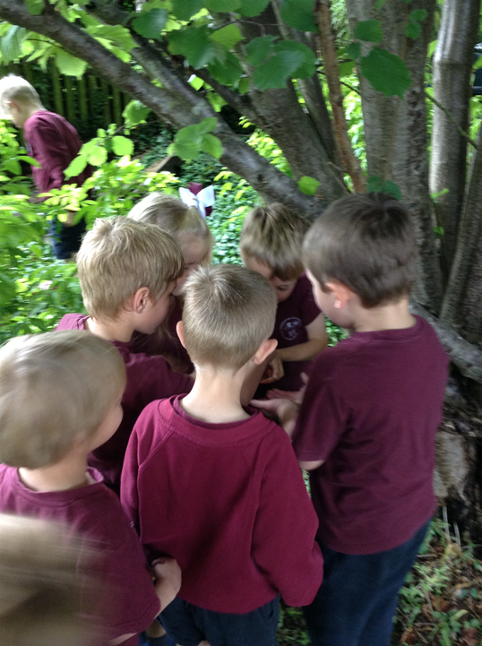
Indoor and Outdoor Curriculum
The outdoor
curriculum is an essential extension of the indoor classroom and is considered to be of equal importance.

Slide 5
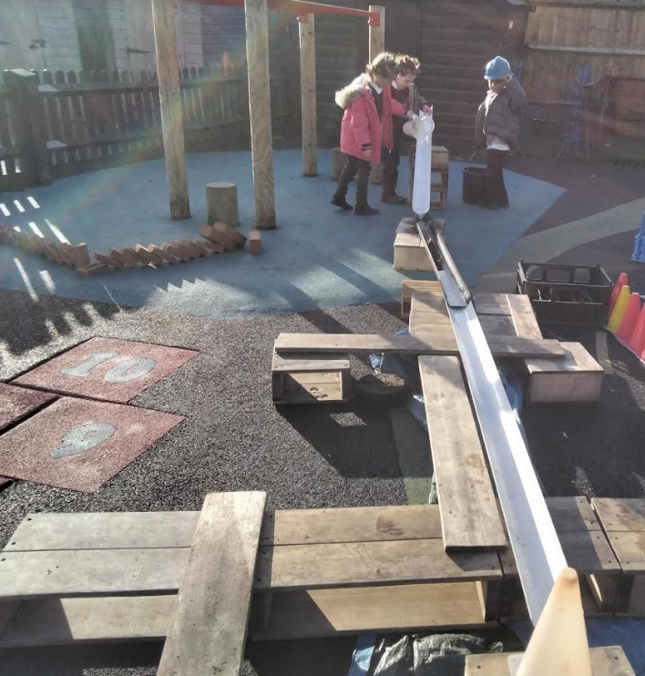
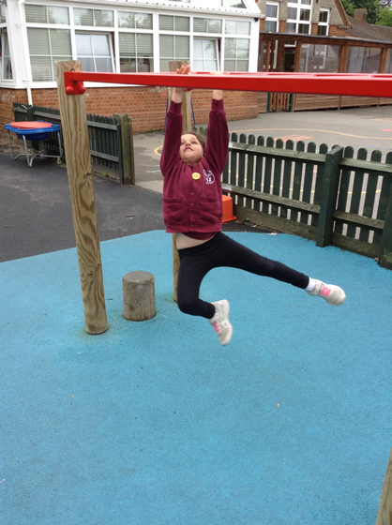
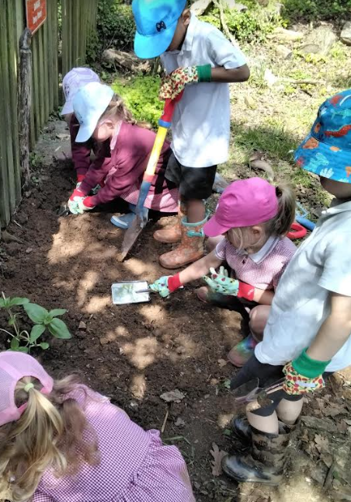
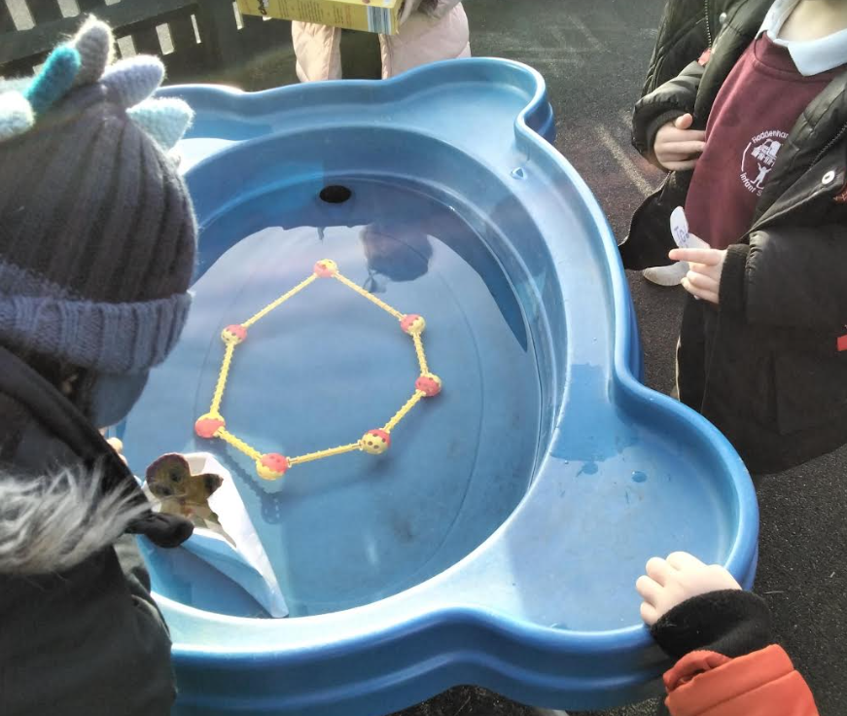
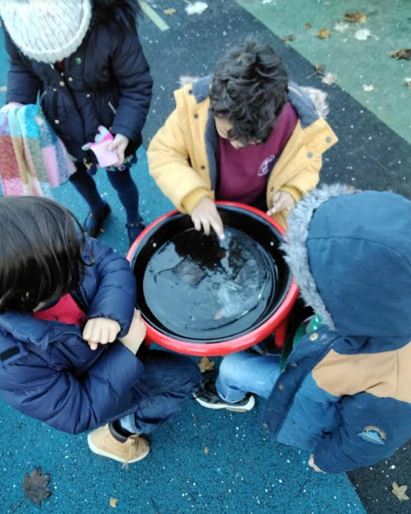
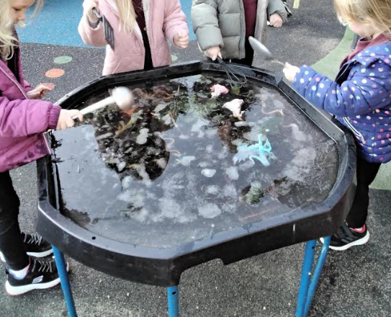
Outdoor learning

Slide 6
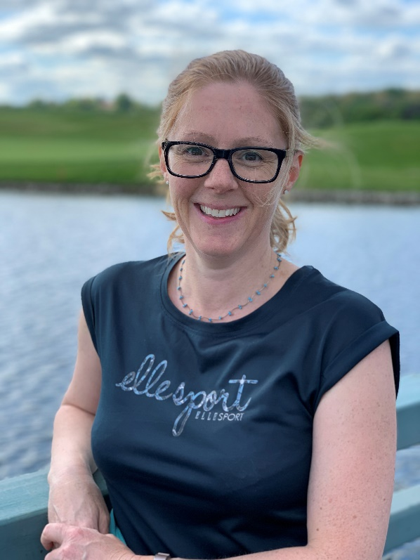
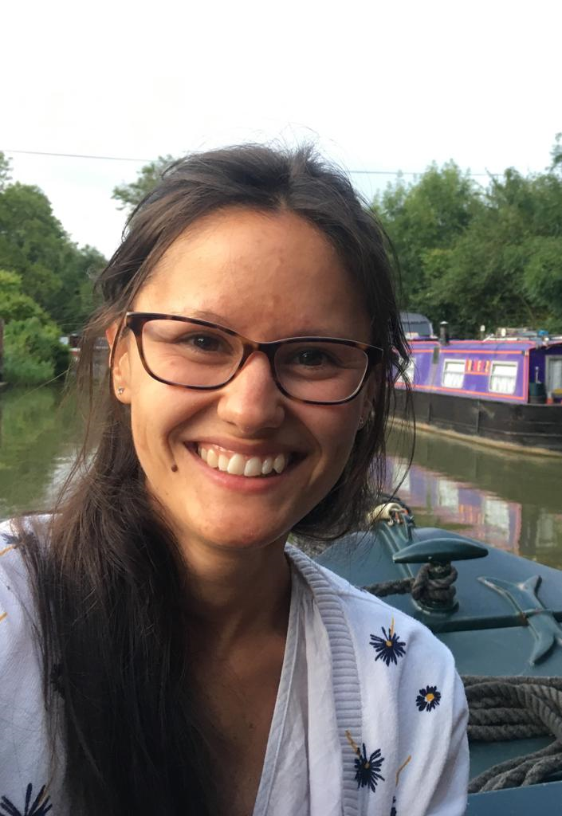
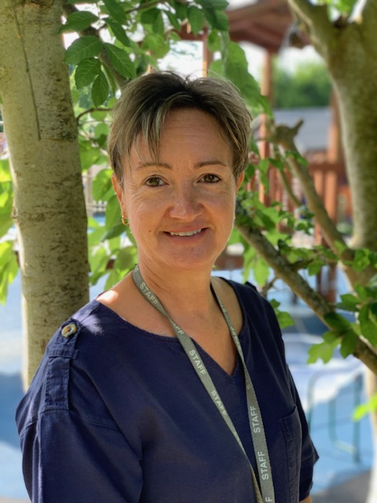
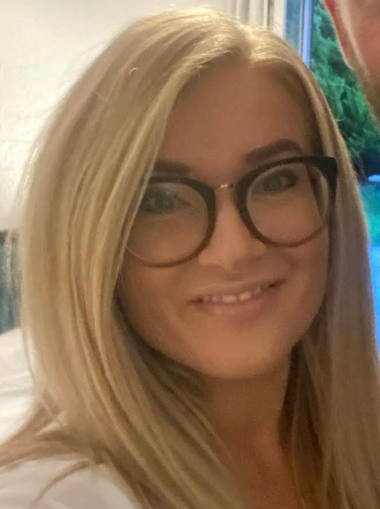
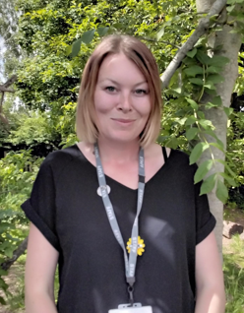
A Typical Day in Reception
Mrs Crump
Miss Lewis
Mrs Bryson
Mrs Teggart
Miss Cory

Slide 7
8:35 – 8:45
The school gates are opened for parents and children to make their way to the gate of the Early Years outdoor area where they will be greeted by the Early Years team.

Slide 8
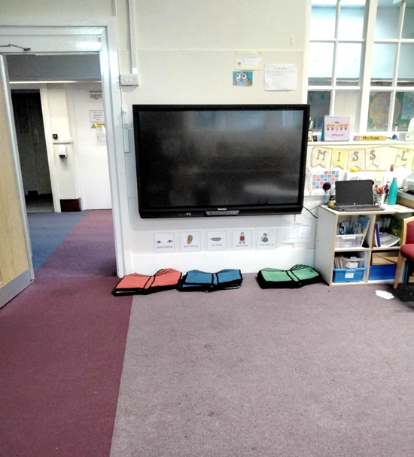
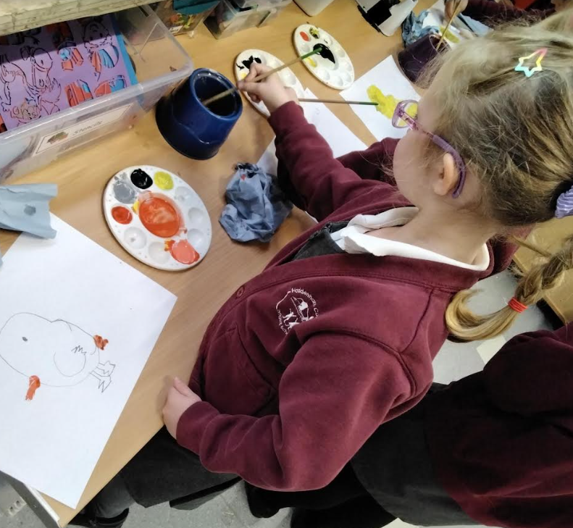
8:45 - 9:00
Children start the day with a learning activity as they come into the classroom.

Slide 9
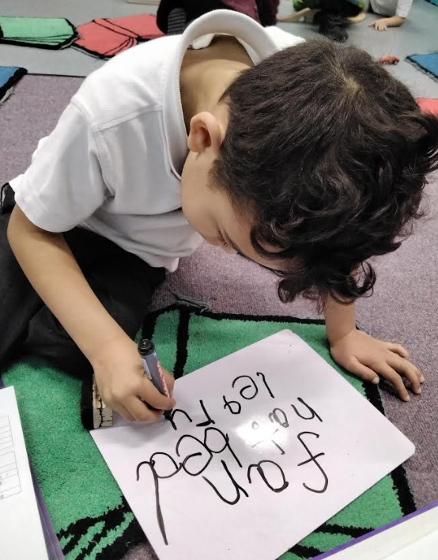
9:10
First session- this is a short whole class adult guided session which may be a phonics, maths or literacy session.
Throughout the day the children will complete adult guided and independent activities linked to our weekly learning and also linked to the children’s individual interests.

Slide 10
9.30 onwards
We have a snack table in our classroom which is opened for the children. They are encouraged to help themselves to a healthy fruit or vegetable snack and some milk.

Slide 11
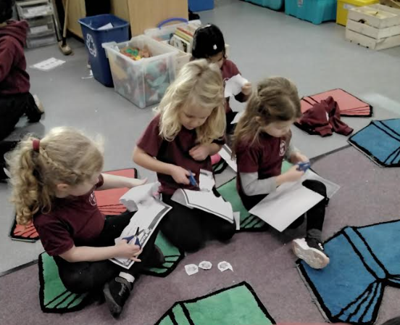
11:15
The children will take part in another adult guided short session together on the carpet for either maths, literacy or phonics.

Slide 12
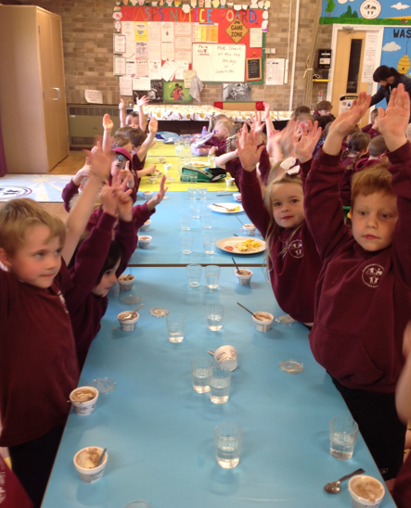
11.45
Lunch Time in the hall!
Children in reception and key stage 1 are entitled to a hot school meal and we are partnered with Homemade@Haddenham St Mary’s who provide the meals.
If you would prefer your child to have a packed lunch, you need to provide them with one in a named lunch box. *no nuts

Slide 13
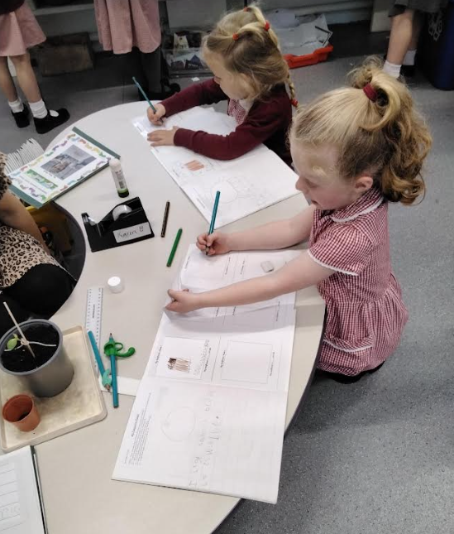
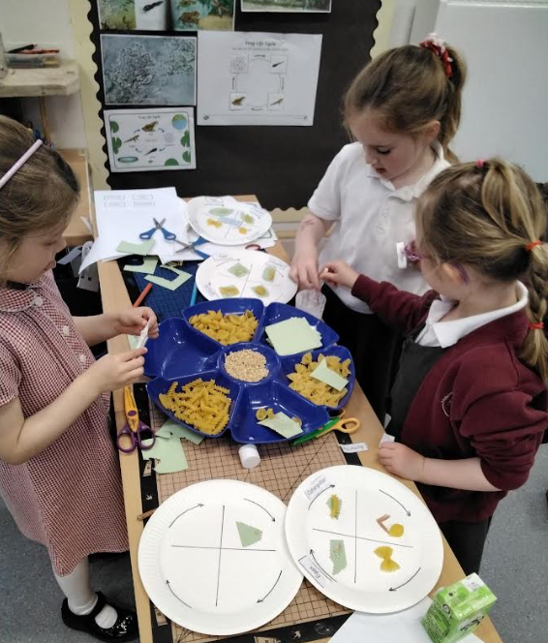
1:00
A third session and further adult guided and child initiated independent activities.

Slide 14
2.45
Tidy up time.
Storytime.

Slide 15
3:15
Home time!
Children to be collected from the gate of the Early Years outdoor area.

Slide 16
Parental Involvement
Your child will attend two induction sessions; Tuesday 2nd July (with a parent) and Tuesday 9th July (on their own). These sessions will be booked through the Schoolcloud system.
Parents have the opportunity to contribute to their child’s learning journal via Tapestry this is a secure online record for staff and families to celebrate their children’s learning and development.
Each week, a Reception newsletter will be sent home giving you an insight in to the learning adventures that will be taking part the following week as well as suggested fun activities to do with your children. This gives you the opportunity to have conversations linked to our learning with your child at home before the learning in school takes place.
At Haddenham Infant we hold a strong emphasis on reading at home. Special reading time at home holds so many benefits including building self-esteem, vocabulary, feeding imagination and it even improves their sleeping patterns!

Slide 17
September settling in sessions
This will help your child to gradually settle in. Those first few days are very tiring, they have a lot to take in!
Thursday 5th September 9.15-11.30 | Settling in session
Friday 6th September 9.15-11.30 | Settling in session
Monday 9th September 9.15-11.30 | Settling in session
Tuesday 10th September 9.15-12pm | Settling in session with lunch
Wednesday 8.45am-3.15pm | Full time for all Reception children.
Thursday 5th September – Tuesday 10th September afternoons we are inviting you in to meet with the us for a ‘getting to know you’ meeting. This will be booked through the Schoolcloud System.

Slide 18
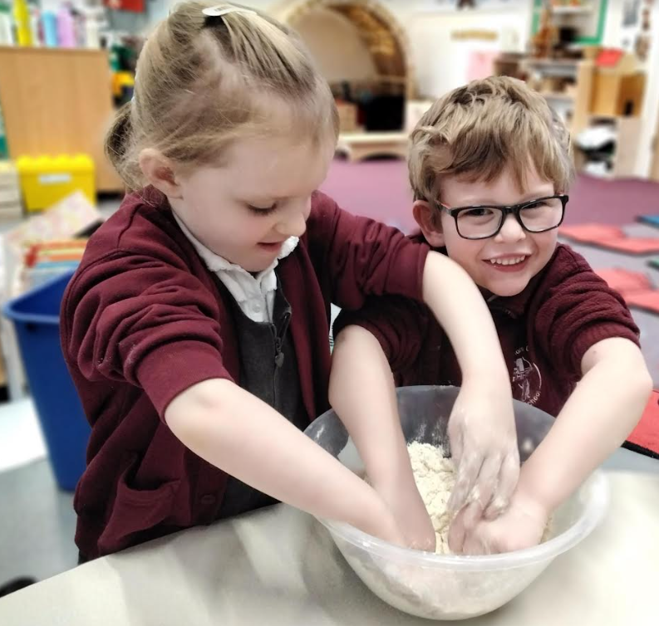
September settling in sessions continued…
We understand that some children have been in full-time nursery however the transition is in place to support your child with the move to full-time school, brand new setting and carers, a significant increase in space, a proportionally larger group of children, higher expectations of focus and attention across the day… We know it isn’t entirely practical with work but for one week it has a great pay off and ensures a more successful and happy transition for all!

Slide 19
Things to develop before starting school
Dressing and undressing independently
Using the toilet independently
Opening and closing water bottles, food packets etc.
Confidently saying goodbye to carer
Recognising own written name
Reading and enjoying stories and nursery rhymes with your child
Subitising and noticing everything and everywhere, maths is all around us!

Slide 20
Things to bring to school:
A named bottle of water.
A warm coat, hat and gloves in cold or mild weather.
Wellies that will stay at school - we play outside in all weathers.
A waterproof coat with hood in mild weather.
A sun hat in hot weather.
Book bags every day
(no rucksacks).
On P.E. day, the children will come to school dressed in their P.E. kits Tuesday’s and
Please name all items!

Slide 21
Any questions or concerns
There will always be time for you to talk to the class teacher or the class teaching assistants about any questions or worries you may have... No matter how big or small.
The best time to catch us is after school for a short chat/meeting or make an appointment through the school office if you feel you require a longer meeting.

