Slide 1
Welcome to the EYFS curriculum at Haddenham Community Infant School
September 2023

Slide 2
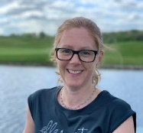
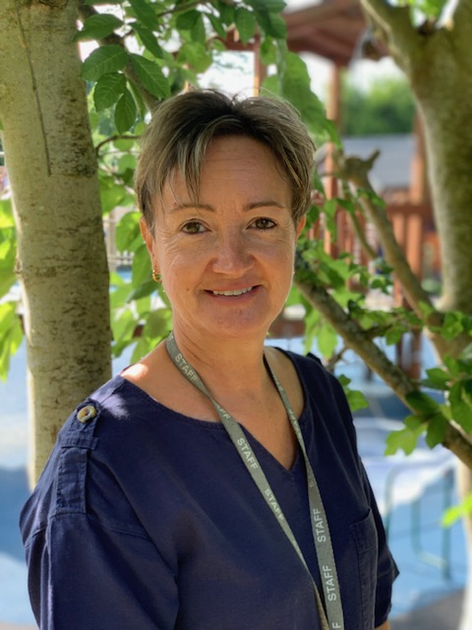
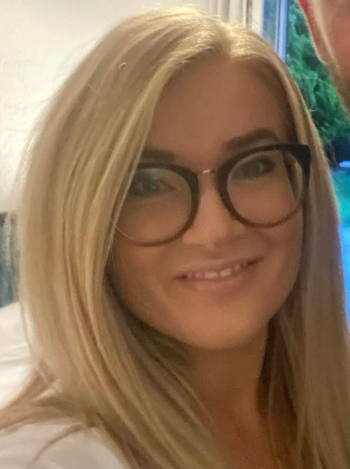
In EYFS…
Class Teacher
Mrs Crump Miss Lewis
Teaching Assistant
Mrs Bryson Mrs Teggart
Uniform:
School shoes.
Coats in school every day
PE days – Come in PE kit on Tuesday’s
(Trainers, No ear-rings, hair up please)
Wellies in school
Book bag – no rucksacks/large bags as we don’t have room in the cloakroom
All named please ☺
EYFS gate- 8:35am
Gate closes at 8:50-please enter through office to sign your child in
Library Day- Friday

Slide 3
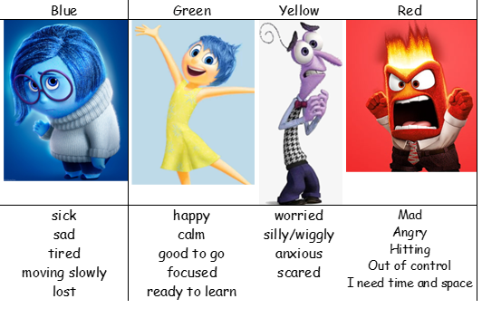
Behaviour: Rainbow Ladder
Self Regulation
(the management of difficult emotions):
Zones of Regulation

Slide 4
PE kit

Slide 5
EYFS curriculum
3 prime areas
4 specific areas

Slide 6
EYFS curriculum continued…
 | Autumn 1 | Autumn 2 | Spring 1 | Spring 2 | Summer 1 | Summer 2
Topic | Super Me, Super You | Let’s Celebrate | Once Upon a Time | Here, There and Everywhere | Growing and Changing | Brilliant Beasts
 | Senses, their body, families, people who help us | Diwali, Bonfire Night, RemembranceChristmas, Black History Month | Traditional tales, fairy tales, story telling | Transport | How they have changed, how animals change, plants, seasons | Animals, minibeasts
Suggested Further Enrichment | Visitors from people who help us | Experience to celebrate BHM | Waddesdon Manor-Fun with Fairytales | Beckonscot Model Village |  | Cotswold Wildlife Park
R.E. | Special People Christianity, Judaism | Christmas Christianity | Celebrations Hinduism | Easter Christianity | Story time Christianity, Islam, Hinduism, Sikhism | Special places Christianity, Islam, Judaism

Slide 7
EYFS curriculum continued…
Music we follow the KAPOW scheme of work.
P.E. - Athletes in Motion with Mr Clark and continuous physical development opportunities across the week

Slide 8
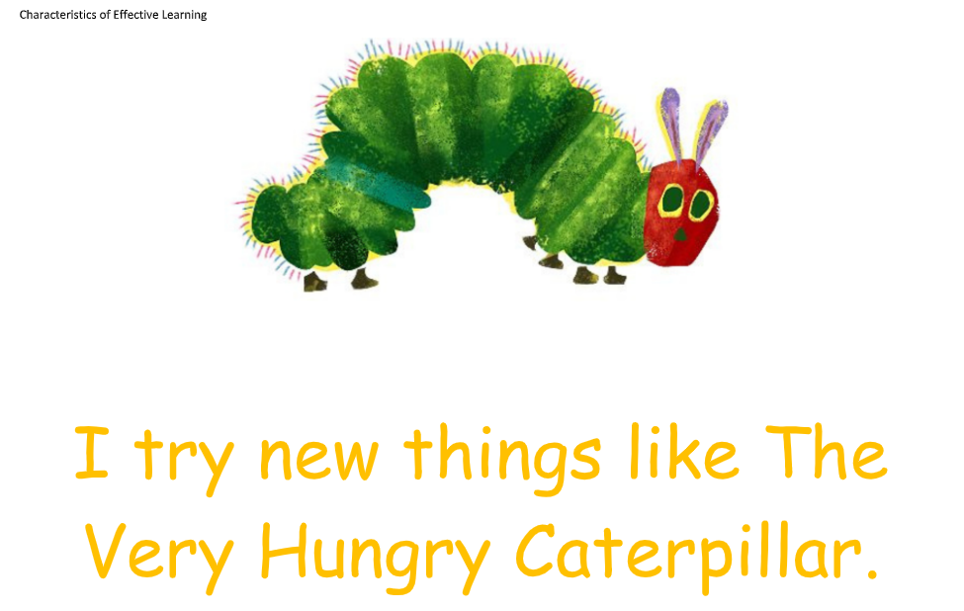
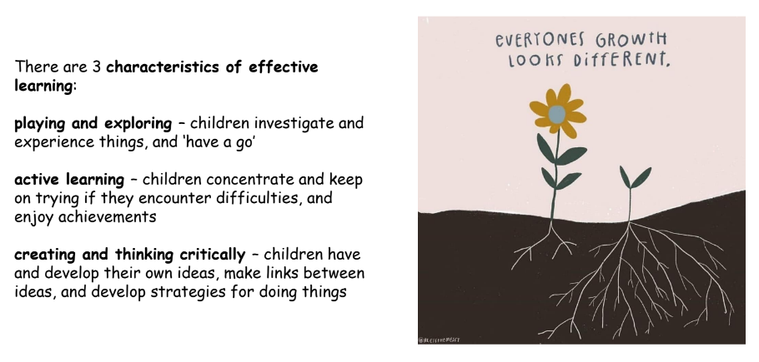
Characteristics of Effective Learning

Slide 9
Day in the life
Rolling fruit snack and milk 9:30-11am
Please do not provide extra snacks for your child due to potential allergies. Children have open access to their water bottles throughout the day and we encourage drinking, eating the government provided fruit snack and eating their lunch.
Reading Book change- Please make sure reading books and diaries are in their bookbags everyday and we will change reading books on a Tuesday.
Library book changed on Friday

Slide 10
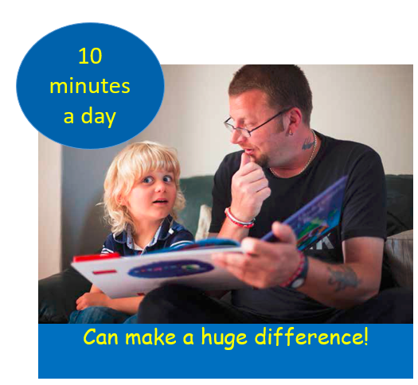
Phonics
‘the most effective way of teaching young children to read.’ DFE Reading: the next steps Supporting higher standards in schools March 2015

Slide 11
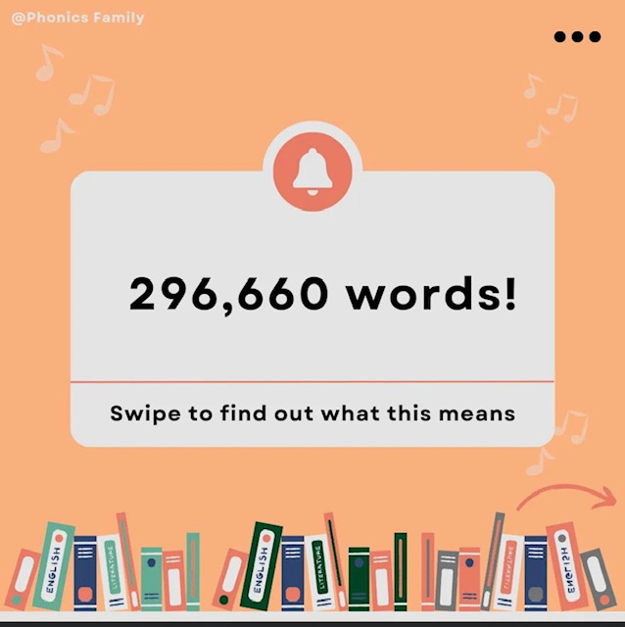

Slide 12
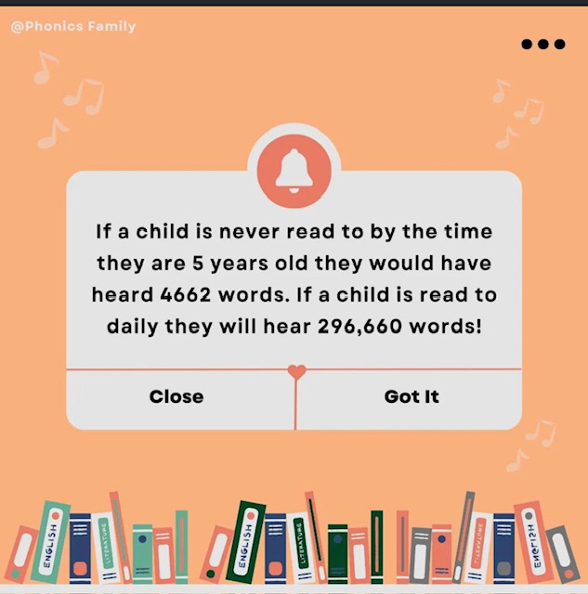

Slide 14
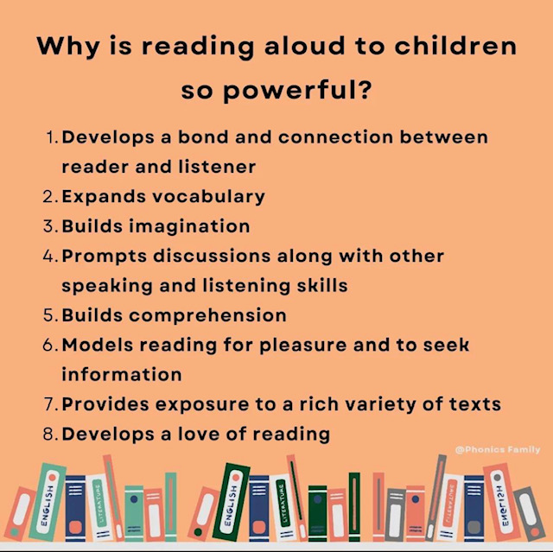

Slide 15
Phonics Definitions
Phonics is the way children are taught to read and write in schools.
Blend - this is when you say the individual sounds that make up a word and then merge or blend them together to say the word as used when reading.
Segment – this is when we split the sounds up in words (c-a-t).
CVC Words - this is an abbreviation used for consonant-vowel-consonant words. It describes the order of sounds. Some examples of CVC words are: cat, pen, top, chat (because ch makes one sound).
Grapheme - it's a written letter or a group of letters which represent one single sound (phoneme) e.g. a, l, sh, air, ck.
Phoneme – the smallest unit of sound.
Digraph – two letters that make one sound (ch, sh, th).
Trigraph – three letters that make one sound (igh, tch).

Slide 16
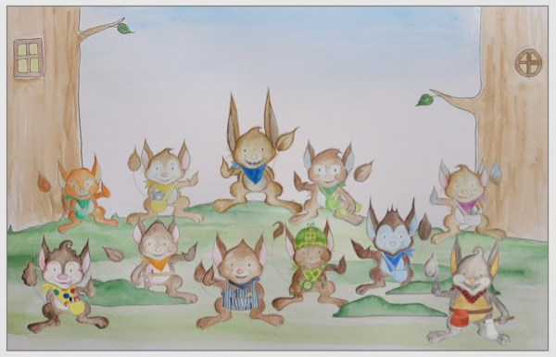

Slide 17
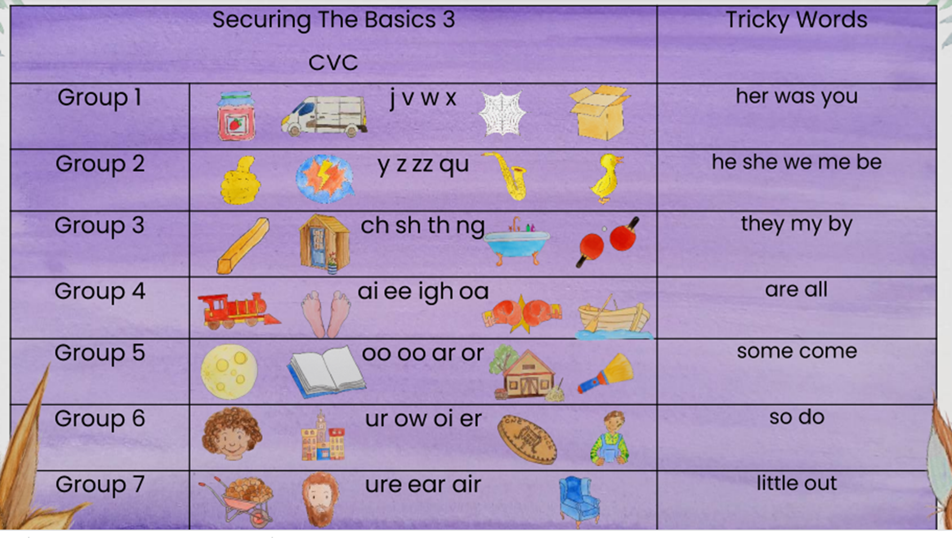

Slide 18
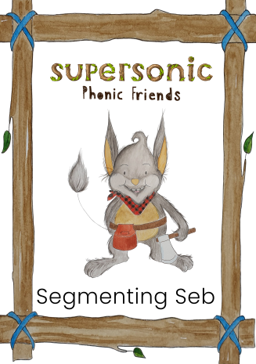

Slide 19
Pronouncing the phonemes
https://www.youtube.com/watch?v=UCI2mu7URBc
Long: f l m n r s sh v th z
Bouncy: c p t ch h b d g w qu y
https://home.oxfordowl.co.uk/reading/phonics/

Slide 24
Parent newsletter
Reading:
Reading 10 - 15 minutes daily
Please read at home to parents or another family member as frequently as possible. Reading every evening for roughly 10 minutes will greatly improve your child’s progress, understanding and experience in all areas. It will help consolidate the reading skills taught in school. It is hugely beneficial to hear your child read regularly and also to talk about the text that you have shared together.
Reading books and reading records in school every day. We will change books on a Tuesday if written in the diary to say that it has been read at home.
There is no harm reading a book more than once to build confidence and fluency. You could also read a book from home.
The children will receive an ‘I can’ book during the first term when we begin to cover the phoneme letter sounds and a ‘we can’ book from the library for you to share together in the first weeks.
We read with your child in many different ways across the school day, we are unable to record each and every one of these reading experiences but please be reassured they are taking place!

Slide 25
Maths- White Rose
We follow White Rose Maths which is divided into ten phases to provide a variety of opportunities to develop the understanding of number, shape, measure and spatial thinking.
For more information follow https://whiterosemaths.com/advice-and-guidance

Slide 26
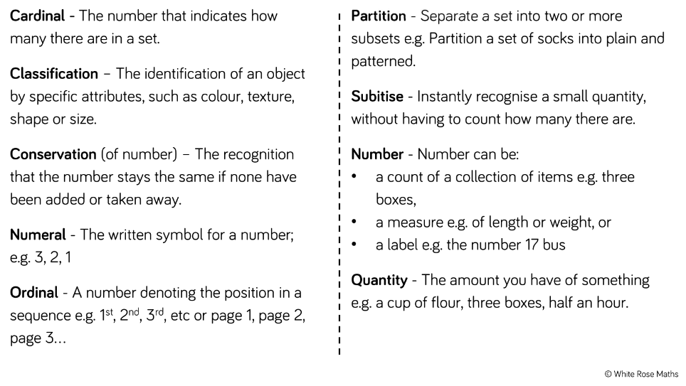
Maths- Key language

Slide 28
How can I help my child?
Use maths in everyday life e.g.: shopping, laying the table…Practice counting everything! How many tins in the cupboard, how many forks do we need for dinner? Sorting food etc.
Play games such as snakes and ladders, dominoes, frustration…
Questioning; how do you know that answer? How could you get to the answer a different way?
Have a ‘growth mind-set’ attitude, no-one is rubbish or ‘can’t do’ math. It’s ok to make mistakes. It’s ok to use resources and make jottings.

Slide 29
Throughout the year we will be practising these key skills…

Slide 30
Useful websites
https://home.oxfordowl.co.uk/learning-at-home-4-5/
https://www.nationalnumeracy.org.uk/free-family-maths-toolkit
https://www.bbc.co.uk/cbeebies/grownups/help-your-child-with-maths

Slide 31
We use Tapestry as our online learning journal.
Tapestry allows you to login with a secure username and password so you can view all your children’s observations, photographs and videos. You can like and comment on observations that we add for your child and it’s also possible for you to add your own observations. Your comments and own observations will allow us to find out about which activities your child really enjoyed and the learning they get up to at home.
All data that is entered to Tapestry is stored securely on their servers. If you are interested in finding out more information about this, you can go to https://tapestry.info/security
Once we have set you up with an account you will be able to login using any web browser from tapestryjournal.com or by downloading the Tapestry app from the Play or App store, depending on what type of device you are using. Remember, if you are going to use the App version of Tapestry to ensure auto updates are turned on for your device so you always have the most up to date version of the app.
We will set you up using your email address and once this has been done, you will receive an activation email from which you can set up your own password to login with. You will also be asked to set up a 4-digit PIN which you can use on the Tapestry app to quickly log back in once you’ve initially logged in. Do remember to keep an eye out on your spam/junk folders for this email.
We do hope you enjoy using Tapestry, do let us know if you have any questions about it.
Tapestry information for parents- https://tapestry.info/parents-carers.html

Slide 32
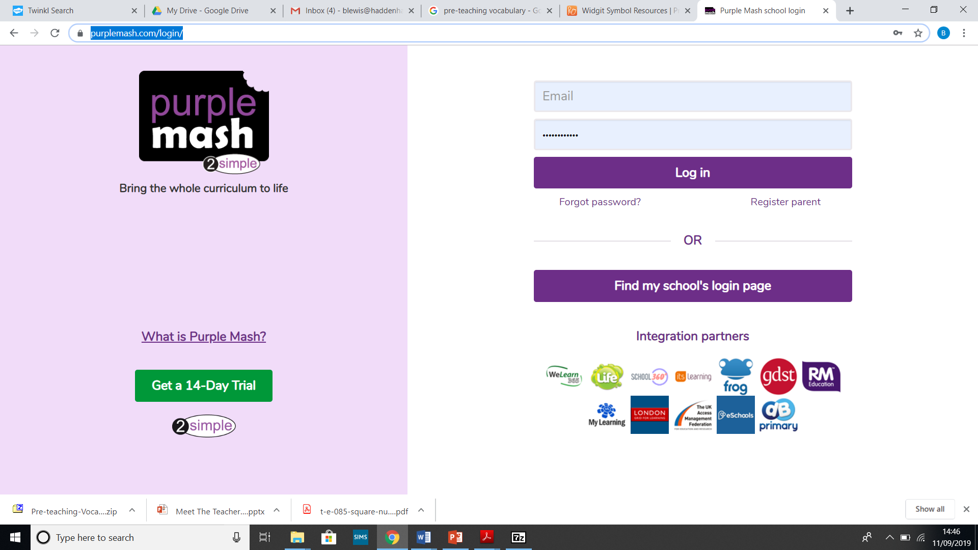
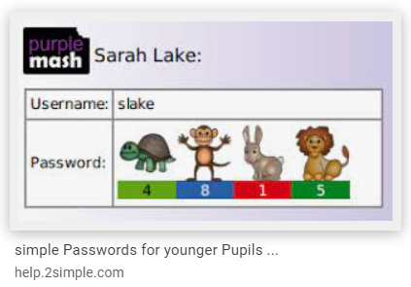
-School log in
-Childs log in
https://www.purplemash.com/login/

Slide 33
Pre-teaching vocabulary: The ‘next week we are learning’ newsletter is a useful tool to support your child at home with new vocabulary that might be coming up the following week. We work a lot on introducing and developing vocabulary linked to our topics. If you notice your child hasn’t come across a word before below are some steps to take and continue to repeat to embed the vocabulary into their working memory.

Slide 34
Medical Information
Medicines
Medical form to be completed
Children shouldn’t administer medicine themselves
Inhalers/Epipens
Children can’t leave the school site if their inhaler/Epipen isn’t in school
Medical labels on the box

Slide 35
Key Information
Significant to year group;
Working towards Early learning goals
Baseline assessment
Intervention work / booster groups
Either with teacher or teaching assistant to support progress.
Examples of these could be phonics catch up, fine motor or gross motor activities…
Treasure I would like to share…

Slide 36
Communication and parents forum
Communication happens in many ways here at HCIS.
The school weekly newsletter is a source of information as well as the Reception ‘next week we are learning’ weekly updates and the school website. We have a class page, a phonics workshop page and a topic plan page on the school website
https://www.haddenhaminfant.bucks.sch.uk/web
Each class has a WhatsApp group which is a very useful way to check what’s going on and communicate amongst yourselves.
Each term we host an active parent forum which asks for feedback on many aspects of school life.
Questionnaires are sent periodically to collect views too.

Slide 37
The Year Ahead
We have already made a fantastic start to the year and it will be a busy one, with lots of exciting topics and activities planned.
We’d like to thank you, the parents and guardians, for all your support at home; it really does make all the difference!
Please take your time to add any of your ideas onto our mind maps around the classroom.

Slide 38
School Website- www.haddenhaminfant.bucks.sch.uk

